Slide 1
BRYAN B. KAGAN, DPM, MCSFS, DASFP DEPARTMENT OF COMMUNITY MEDICINE NYCPM 2017 BBK©2017
ESSENTIALS OF
FORENSIC PODIATRY
Unit 1 Part 1

Slide 2
Unit 1
Introduction to Forensic Podiatry
Definition
Background
Duties and Responsibility
Education and Training
Crime Scene Investigation
METHODOLOGY ACE-V

Slide 3
Unit 2
Foot Measurements
Methods of Measurement
Photographs
Insoles
Lighting
Comparison of ACE-V
Discussion

Slide 4
Unit 3
Barefoot/ Sock Clad Analysis
Practical Workshop

Slide 5
Unit 4
Insole Analysis
Shoe Gear Analysis
Practical Workshop

Slide 6
Unit 5
Dynamic Gait Pattern Analysis
Evaluation of ACE-V
Methodology [Levels of Certainty I-V]
Practical Exercises and Discussion

Slide 7
Unit 6
Verification of ACE-V
Expert Witness Preparation
Expert Testimony [Frye and Daubert]
Discussion

Slide 8
Unit 7
Forms
Review of Forensic Podiatry Essentials
“GETTING A FOOTHOLD ON FORENSIC PODIATRY”
ForensicWeek Radio Show
Host: Tom Mauriello
Guests: Drs. Wesley Vernon and Jeremy Walker
Discussion

Slide 9
FINAL EXAM 8th Week
Grade Breakdown
CLASS ATTENDANCE/ASSIGNMENTS 10%
Part 1 – (25 Questions) 45 minutes 40%
Part 2 – (Practical) 60 minutes 50%

Slide 50
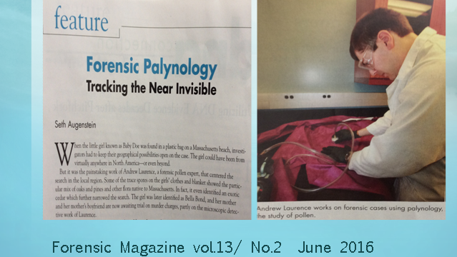

Slide 53
