Slide 1
Morphogenesis of Friction Ridge Skin
Bryan B. Kagan, DPM
Adjunct Instructor- Forensic Podiatry
Department of Community Health and Medicine
New York College of Podiatric Medicine

Slide 2
The largest organ of the body, the skin, is responsible for
Protection
Sensation
Excretion of waste
Regulation of body temperature

Slide 3
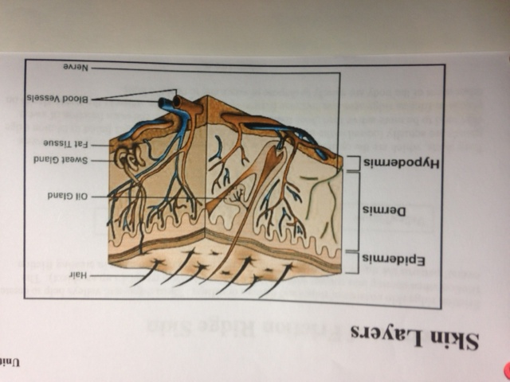
The Three Layers of Skin
Epidermis- the outer skin
Dermis- the middle layer containing eccrine and sebaceous glands and nerves that pass through from the dermis into the epidermis
Hypodermis- deepest layer containing loose connective tissue, adipose cells, blood vessels and nerves

Slide 4
There are two types of skin smooth skin that is found on the majority of the body and volar (friction ridge) skin that is found on the palmar and plantar surfaces

Slide 5
Smooth skin consists of hair, eccrine (sweat) glands and natural oil secreting sebaceous glands

Slide 6
Volar skin consists ONLY of eccrine glands

Slide 7
Oils that are found on the palmar and plantar surfaces are generally from other areas of the body that contain sebaceous glands

Slide 8
Friction ridge skin consists of ridges and valleys or furrows which create friction when coming in contact with another surface

Slide 9
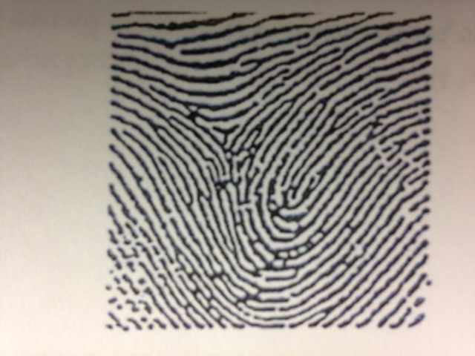
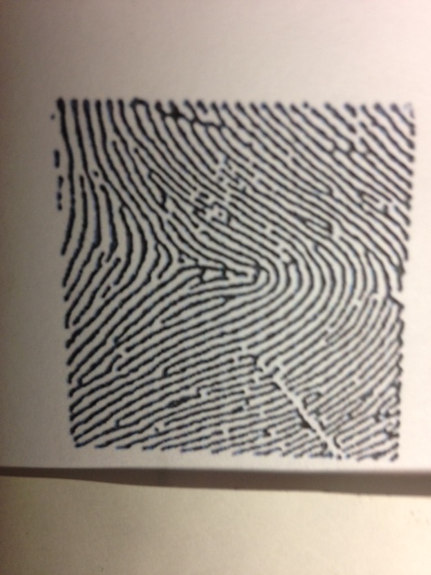
The patterns of the loops, arches and whorls assist in creating friction

Slide 10
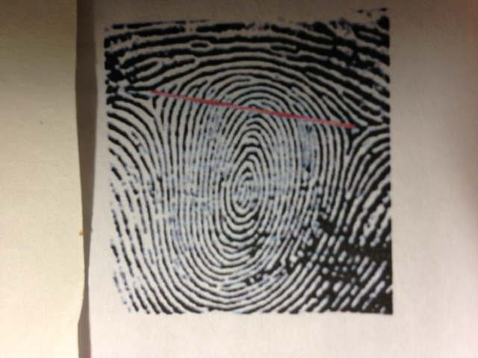
The patterns of the loops, arches and whorls assist in creating friction

Slide 11
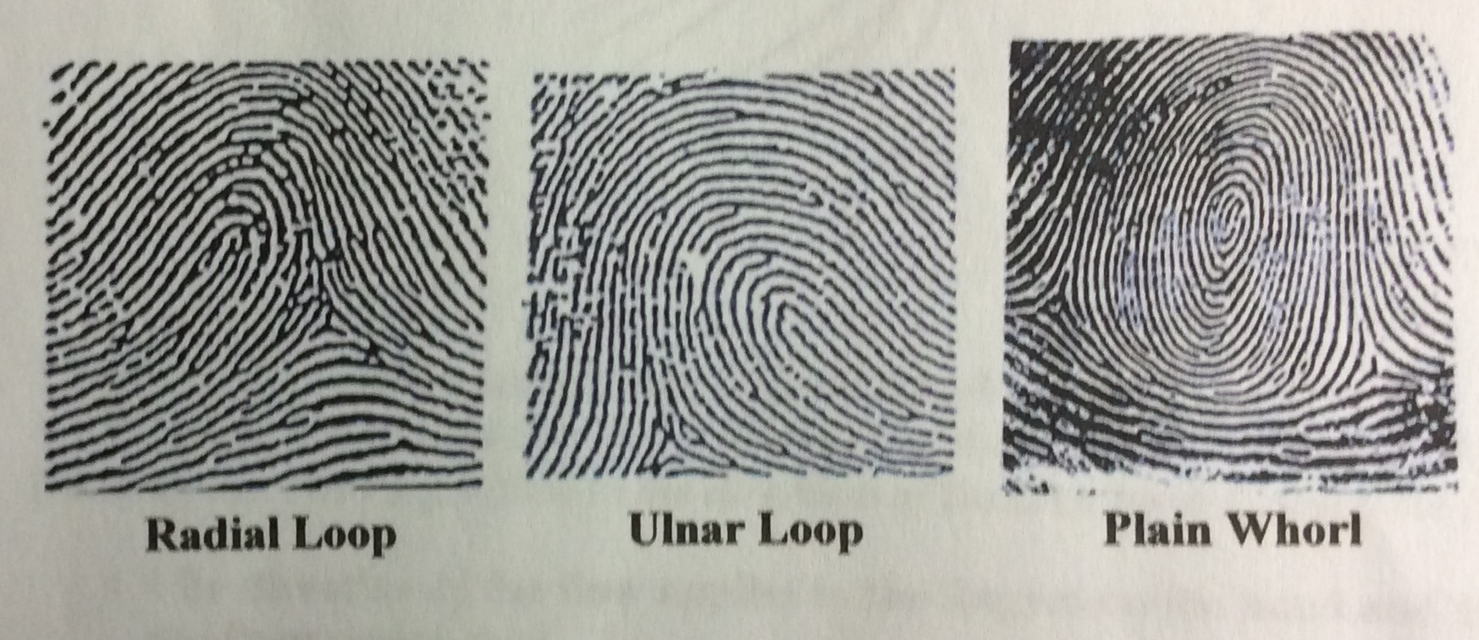
The patterns of the loops, arches and whorls assist in creating friction

Slide 12
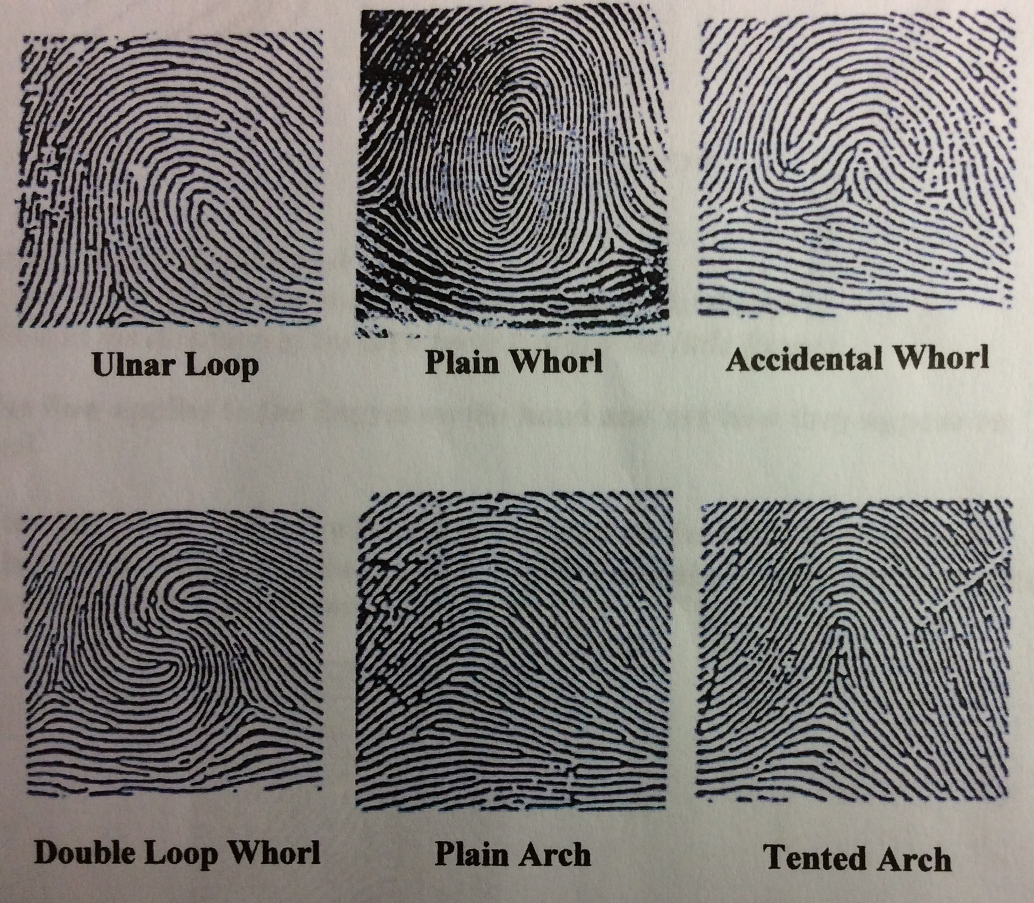
The patterns of the loops, arches and whorls assist in creating friction

Slide 13
Pore ducts open on the top of the ridges although the glands are in the dermal layer.
The eccrine (sweat) glands cool the body and dispose of waste increasing moisture which assists in friction

Slide 14
The principle of UNIQUENESS applies to all areas of friction ridge skin and links individuals to crime scenes.
Even though palm prints and foot prints are not readily found or utilized as often as fingerprints…when found they are valuable to assist in the conviction or exoneration of suspects

Slide 15

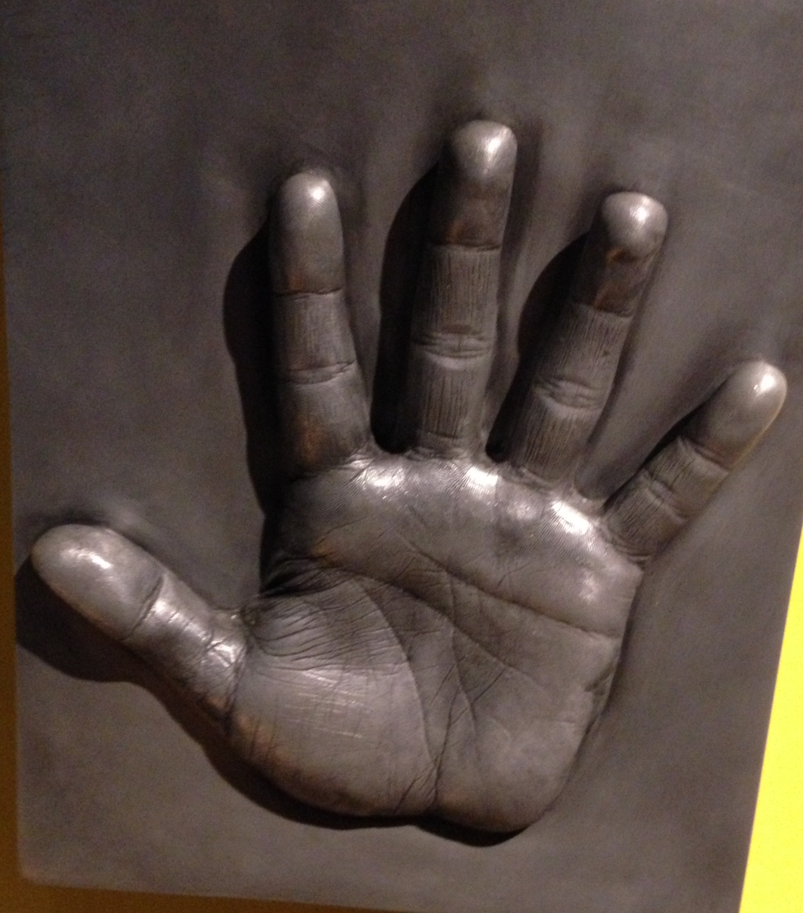
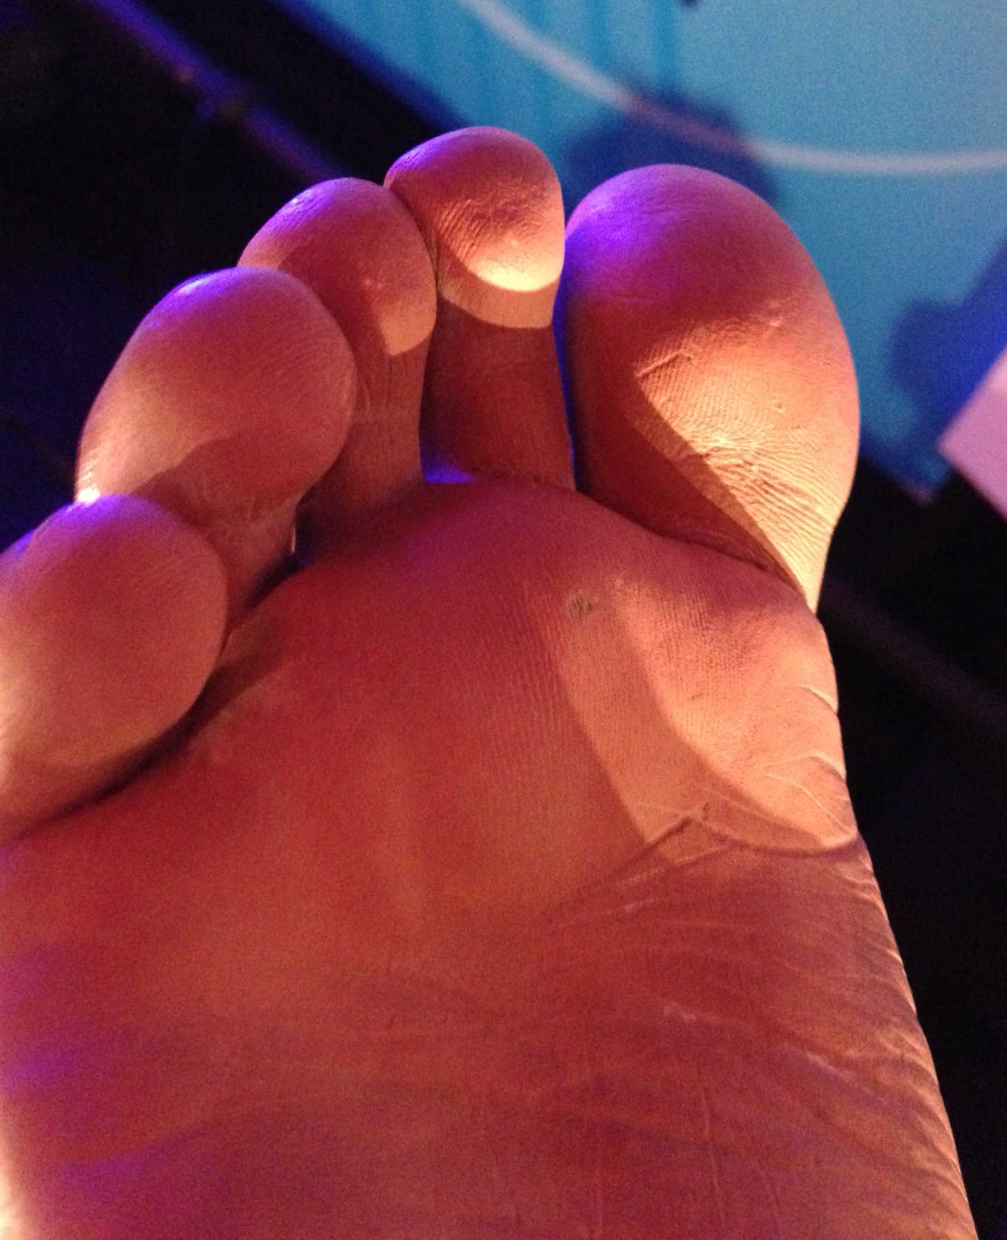

Slide 16
Many palm prints are now being lifted from crime scenes from knife handles, telephones, glasses and windows due to greater awareness.
It is now estimated that 20-30% of crime scenes have latent palm prints

Slide 17
Knowing the different parts of the palm will assist in classifying and identifying the print.
The palm is divided into 3 regions
HYPOTHENAR
INTERDIGITAL
THENAR

Slide 18
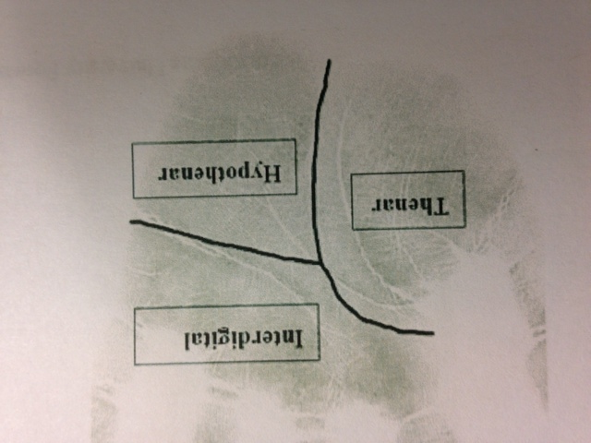
Palm print

Slide 19
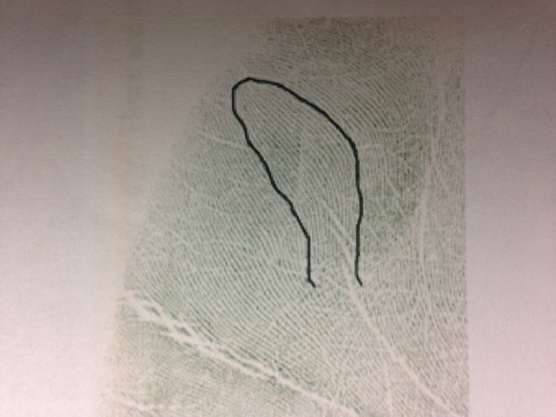
Hypothenar

Slide 20
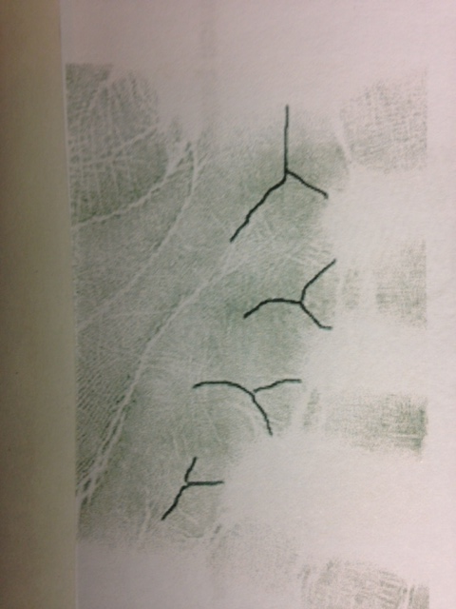
Interdigital

Slide 21
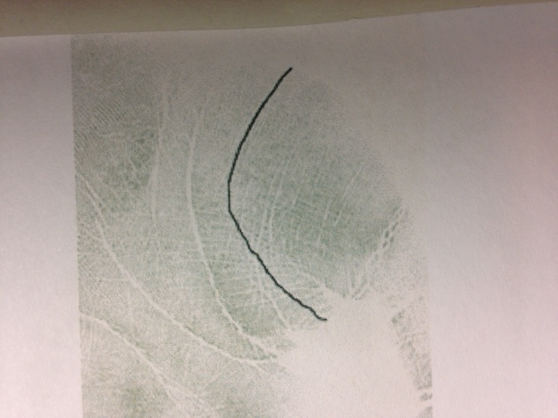
Thenar

Slide 22
It is important to note the flow of the friction ridge, the presence of loops and deltas and the
“secondary” flexion creases form as a result of age and hand movement.

Slide 23
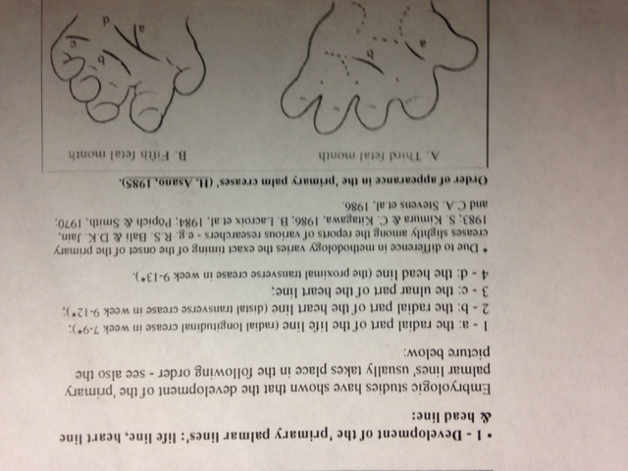
The 3 primary palmar lines start developing as early as the 2nd and 3rd embryologic month. They form independently from flexion movements of the hand unlike the secondary palmar creases.
VanMensvoort M,Embryology and Morphogenesis of the Hand Lines! 2002-2014

Slide 24
Barefoot prints are not regularly taken after an arrest unless there is a footprint found at the crime scene. Knowing the different zones of the plantar foot will assist in classification and identification as it does in the palm.

Slide 25
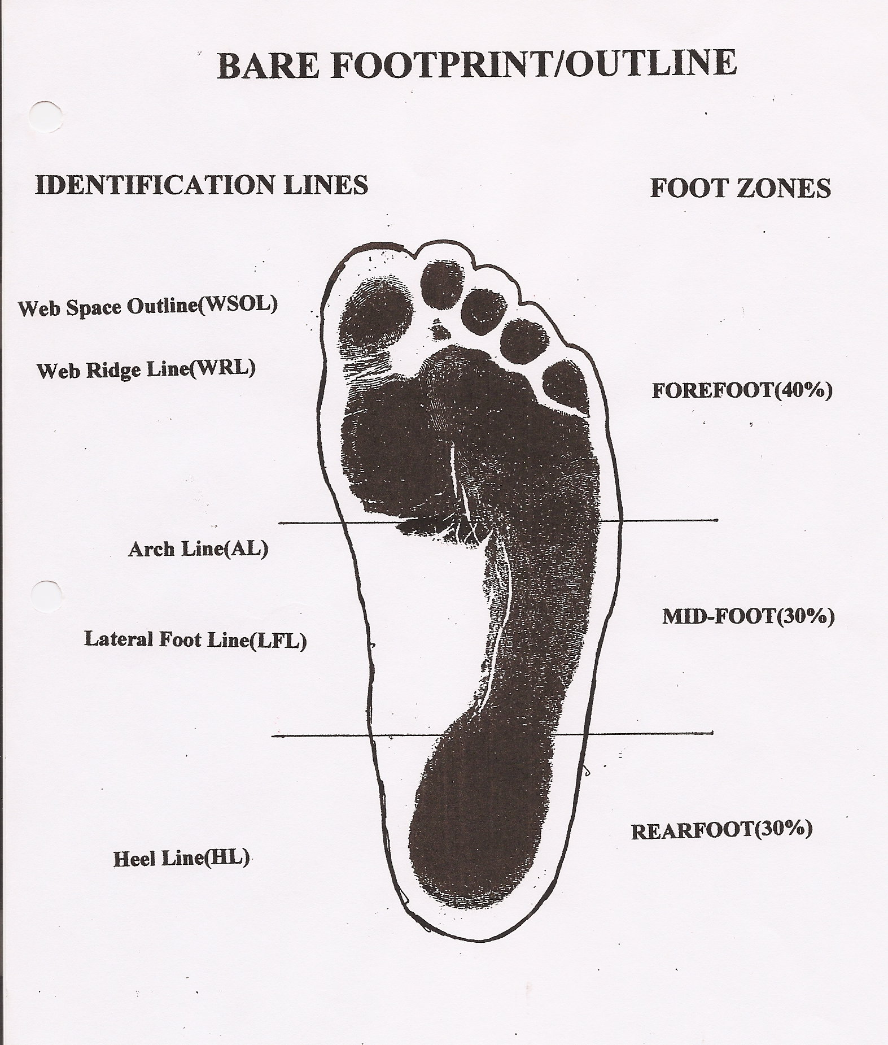
The 3 foot zones
Can also be subdivided into further classification lines to assist in identification

Slide 26
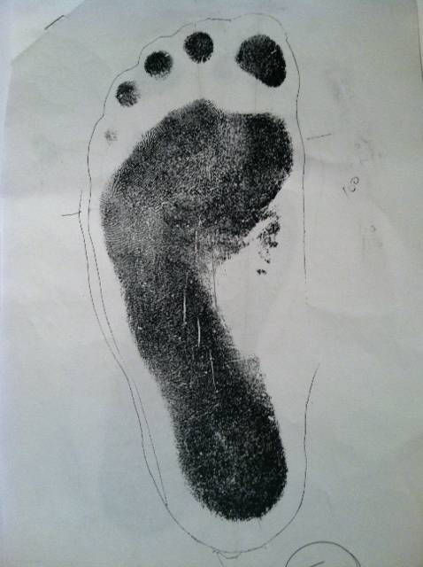
The (exemplar) prints are then compared to the prints from the crime scene to determine the level of certainty
The examination of the foot can reveal arches, loops and whorls on the bottom of each toe similar to fingertips but there is little pattern impression deposited when walking

Slide 27
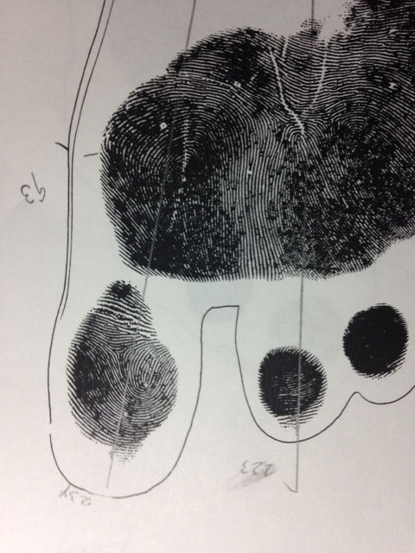
The (exemplar) prints are then compared to the prints from the crime scene to determine the level of certainty
The examination of the foot can reveal arches, loops and whorls on the bottom of each toe similar to fingertips but there is little pattern impression deposited when walking

Slide 28
Therefore as of today, there is NO standardized classification system recognized and accepted by law enforcement and military for plantar ridge patterns found on the foot.

Slide 29
The discipline of fingerprint identification as well as forensic podiatry emphasizes 4 fundamental premises which arise from ANATOMY and from the structure of friction skin and friction ridge formation.

Slide 30
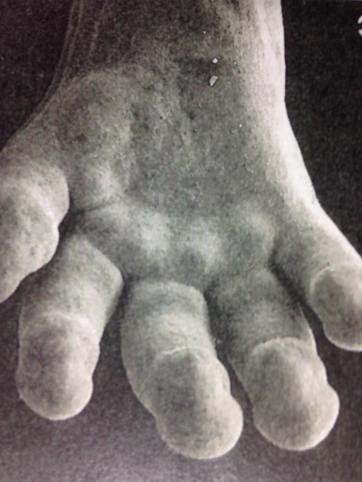
1. Friction ridges develop in the fetal stage and reach their definitive form before birth
A basic similarity between hand lines and fingerprints and foot/toe prints is that all are preceeded by the presence of volar pads, transient swellings of mesenchymal tissue that arise around the 7th week in the hands and feet of the embryo.

Slide 31
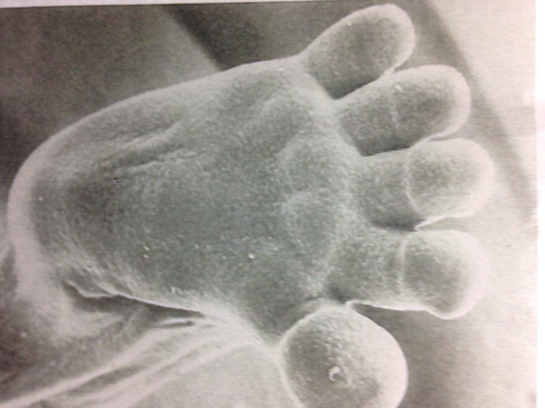
1. Friction ridges develop in the fetal stage and reach their definitive form before birth
A basic similarity between hand lines and fingerprints and foot/toe prints is that all are preceeded by the presence of volar pads, transient swellings of mesenchymal tissue that arise around the 7th week in the hands and feet of the embryo.

Slide 32
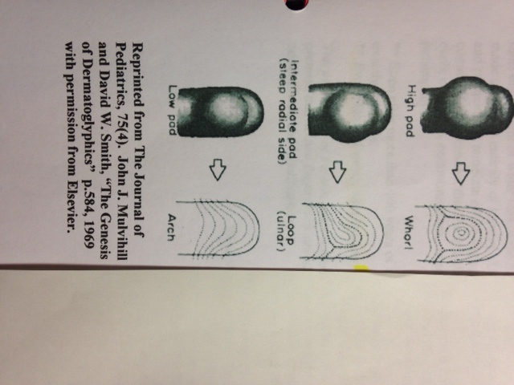
1. Friction ridges develop in the fetal stage and reach their definitive form before birth
Initially the volar pads appear as evenly rounded pads, however by the 9th week, the pads begin to vary in shape and position.
Regression of the volar pads occur around the 10th-11th week, which corresponds with the initial formation of epidermal ridge, the basic element of a finger/toe print ridge.

Slide 33
1. Friction ridges develop in the fetal stage and reach their definitive form before birth
Researchers have confirmed that the shape and size of the finger/toe print volar pads correlate directly to the print pattern.
High symmetrical ‘volar pads’ produce whorls.
Lower asymmetrical ‘volar pads’ with normal height produce loops.
Low ‘volar pads’ produce arches

Slide 34
1. Friction ridges develop in the fetal stage and reach their definitive form before birth
The process observed for the palm and plantar is similar where the volar pads manifest in the interdigital regions.
“the base point fixation of primary creases of palm and plantar is of embryonic nature and their orientation in shape and size is the pre-ordain manifestation of localized activity of volar pads.” Balli RS, Anthropology of Crease Morphogenesis: A Scientific Analysis.

Slide 35
1. Friction ridges develop in the fetal stage and reach their definitive form before birth
By week 24 the dermis development is finalized and the finger/toe prints are complete and fairly permanent.
The location and size of the pore ducts and pore openings along the surface of the friction ridge skin are also defined and do not change.
The individual pattern characteristics develop by the fetus touching and experiencing its womb environment.

Slide 36
1. Friction ridges develop in the fetal stage and reach their definitive form before birth
Since every fetus applies stresses and pressure to each of the volar pads differently, the ridge features, finger-palm-toe-plantar prints, that develop will be unique to that baby.
No two fingerprints have yet to be found to be exactly the same after more than 100 years of identification.
Even identical twins, who have the same DNA, have different sets of fingerprints.

Slide 37
2. Friction ridges remain permanent throughout life with the exception of scar distortion
The stratum basale (generating layer) of the epidermis does not change except for injury, disease or decomposition after death.
Some diseases, amputations or injury may affect the skin’s ability to regenerate, leading to formation of scar tissue.
Eczema…..Pitted Keratolysis..…Lichen Planus….. Tinea…..Pomfolyx…..warts….atopic eczema…psoriasis….

Slide 38
2. Friction ridges remain permanent throughout life with the exception of scar distortion
Systemic scleroderma…..Raynaud’s Phenomenon…
Injuries that penetrate into the dermal layer can permanently alter and damage the epidermal surface altering the friction ridge pattern creating a scar.

Slide 39
2. Friction ridges remain permanent throughout life with the exception of scar distortion
Bricklayers wear down the ridges of their fingerprints by handling heavy, rough materials as well as individuals who may walk barefoot on hot abrasive surfaces.
People who work with lime, a base chemical, can dissolve their skin.
People who can pineapple juice, an acid, can dissolve their skin.

Slide 40
2. Friction ridges remain permanent throughout life with the exception of scar distortion
Xeloda, Capecitabine, a chemotherapy agent, can cause foot-hand syndrome, an induced palmar plantar erythrodysesthesia.
However if the activity ceases, the skin will regenerate in the original pattern as the injury or insult did not penetrate into the dermal layers.
This was shown by experimentation in the late 1800’s by Sir Francis Galton- The Principle of Print Persistency

Slide 41
2. Friction ridges remain permanent throughout life with the exception of scar distortion
Naegeli Syndrome
Dermatopathia pigmentosa reticularis (DPR) a rare autosomal dominant congenital disorder that is a form of ectodermal dysplasia.
Triad of reticulate hyperpigmentation, noncicatricial alopecia and onychdystrophy.
Lack sweat glands, thin hair, brittle nails, mottled skin
LACK OF FINGERPRINTS
Both have a defect in the keratin 14 protein

Slide 42
2. Friction ridges remain permanent throughout life with the exception of scar distortion
The constant cycle of cellular morphogenesis, growth and migration that occurs throughout life accounts for the persistency of friction skin.
However, as an individual ages, the rate of cellular growth and elasticity of the skin decreases. The ridge can become thicker, decreasing the height between ridge and furrow thereby reducing prominence and causing the prints of elderly individuals to appear smudged or smeared.

Slide 43
3. ridge patterns and the minutiae within are ‘unique’
The science of fingerprint identification accepts the premise that no two fingerprints are alike.
However they would have to examine the fingerprints of everyone who has ever lived or will live to prove that absolutely.

Slide 44
3. ridge patterns and the minutiae within are ‘unique’
It has been challenged for that reason, (ie. United States v. Llera Plaza, The Madrid Bombings – Brandon Mayfield case).
While the belief in fingerprint individuality has so far been upheld by the manual expert examination of millions of fingerprints, the underlying scientific and statistical basis of fingerprint individuality has not been rigorously studied or tested.

Slide 45
3. ridge patterns and the minutiae within are ‘unique’
“Closely related individuals have a greater chance of having a similar genetic code that controls the appearance and development of the volar pads.
Therefore one may assume that the pattern characteristics may be passed from parent to child.
This is not the case as closer examination of the prints reveal a significant number of differences even between identical twins

Slide 46
3. ridge patterns and the minutiae within are ‘unique’
…….even between identical twins who would be expected to have the same genetic code and physical variations during friction ridge formation.
Hereditary does play a role in the appearance of the overall friction ridge configuration.

Slide 47
3. ridge patterns and the minutiae within are ‘unique’
It does NOT however affect the individualized ridge unit alignment during growth.
Ridge alignment, ridge shape, minutiae location and the location of pore openings on the ridge unit all occur randomly.”

Slide 48
4. Even though individual patterns are unique in their ridge characteristics, the overall pattern appearances have similarities that allow for systematic classification
  Finger (toe) prints share a sufficient quantity of basic similarities that allow for classification by the patterns of loops, whorls, and arches.
  The ridge detail on fingertips and palm can be classified by the small level details of islands and bifurcations and by extension similarly on toe prints and the plantar surface of the foot.

Slide 49
4. Even though individual patterns are unique in their ridge characteristics, the overall pattern appearances have similarities that allow for systematic classification
  It falls on podiatry, and specifically the discipline of forensic podiatry that devotes itself to the functioning foot, to conduct research to help and contribute to the development of a standardized Classification System that will be accepted and recognized by law enforcement authorities.

Slide 50
References
*Balli RS, Anthropology of Crease Morphogrenesis: A Scientific Analysis
*Mack, Fingerprints: The Science, https://mackcriminallaw.com/the-science-fingerprints/ p22
*Mulvihill JJ, Smith DW, The Genesis of Dermatoglyphics, The Journal of Pediatrics, 1969, 75(4). P584
*Pankanti S, Prabhakar S, Jain AK, On the Individuality of Fingerprints, IEEE
Transactions on Pattern Analysis and Machine Intelligience, vol. 24, no. 8, August 2002
*Van Mensvoort M, Embryology and Morphogenesis of the Hand
Lines!, http://www.handresearch.com/diagnostics/palmar-creases-hand-lines-embryology.htm, 2002-2014
* Morphogenesis of Friction Ridge Skin, West Virginia University Forensic Science Initiative ©2009

Slide 51
CONTACT EMAIL:
BRYAN B. KAGAN, DPM
BKAGAN@NYCPM.EDU

