Slide 1
A puzzling Step in The Right Direction
Bryan B. Kagan, DPM, MCSFS
IAI Educational Conference 2017- Atlanta, Ga

Slide 2
Financial Disclosure
The presenter has no financial interest with Optimet nor with The Orthotic Group

Slide 3
THE MERGING OF TWO MEDICAL TECHNOLOGIES MAY AUGMENT THE INVESTIGATIVE PROCESS OF SHOE GEAR FOOT IMPRESSIONS……..

Slide 4
Helping to reveal additional characteristics of the individual whose impressions are of interest

Slide 5
AS PODIATRISTS WE ARE ALL AWARE OF
GAIT ASSESSING SOFTWARE PRODUCTS

Slide 6
THESE PRODUCTS
        1. QUANTIFY FOOT FUNCTION AND GAIT PATTERNS
        2. IDENTIFY PLANTAR PROFILE DISCREPANCY AND ASYMMETRIES DURING STANCE

Slide 7
THESE PRODUCTS
3. ASSESS HIGH PRESSURES AND DEVIATED CENTER OF FORCE TRAJECTORIES RESULTING FROM FOOT DYSFUNCTION AND FOR GAIT RELATED DISORDERS [which are features characteristic to an individual]
4. PROVIDES INDIVIDUAL DATA FOR EACH FOOT AND DIFFERENCES BETWEEN FEET

Slide 8
THEY PROVIDE COMPARATIVE DIFFERENCES BETWEEN THE RIGHT AND LEFT FOOT AND FEET

Slide 9
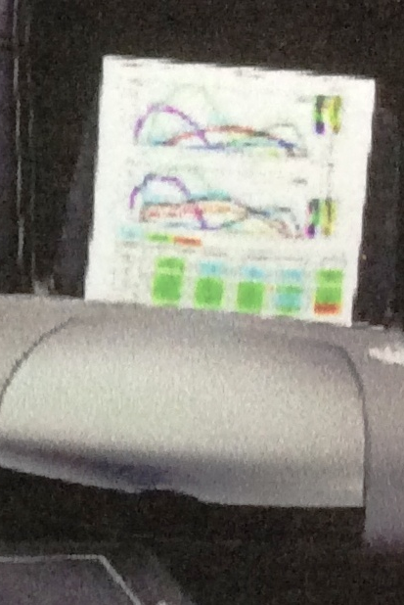
Tog gaitscan™ is an innovative diagnostic tool that allows for analysis of an individuals
Biomechanics.

Slide 10
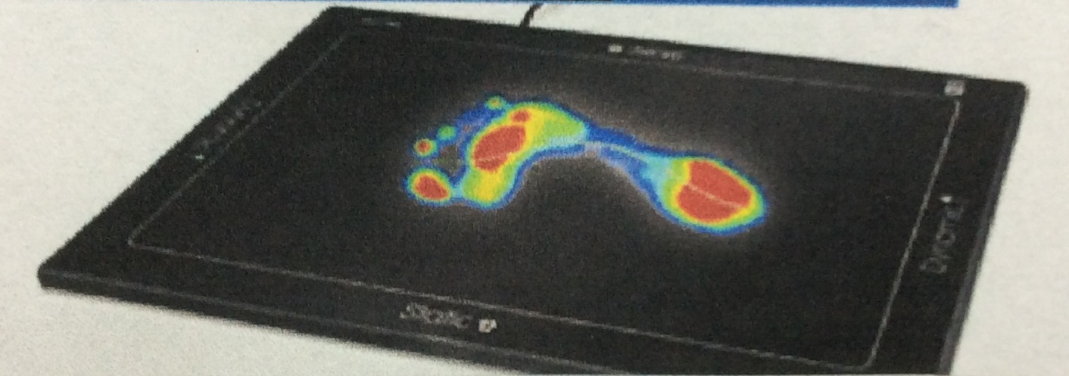
Tog gaitscan™ has 4096 sensors with a scan rate of 300 frames/second.
It has over a million points of data

Slide 11
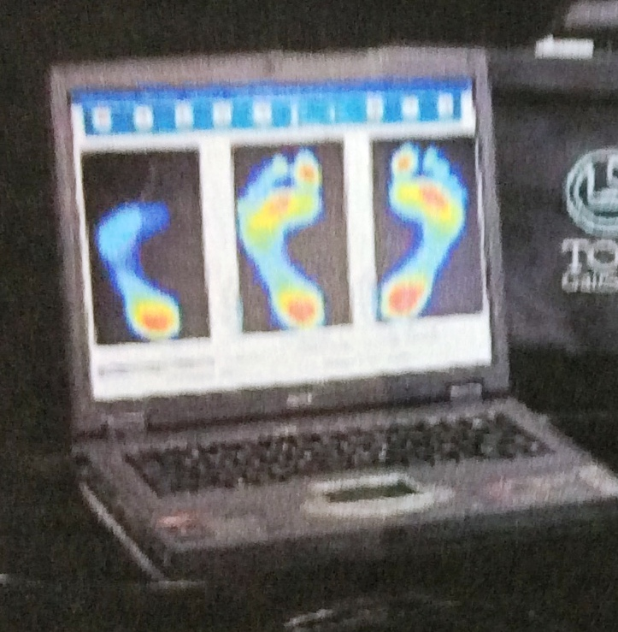
Tog gaitscan™ provides medical practitioners with a comprehensive biomechanical analysis

Slide 12
BUT THERE ARE OTHER GAIT ASSESSING PRODUCTS OUT THERE BEING USED IN THE MEDICAL FIELD
IE. TEKSCAN®,
GAITRITE®,
LITEGAIT®,
NORAXON®
THAT CAN BE UTILIZED FOR SUSPECTS.

Slide 13
BUT THERE ARE OTHER GAIT ASSESSING PRODUCTS OUT THERE BEING USED IN THE MEDICAL FIELD
THAT CAN BE UTILIZED FOR SUSPECTS.
LiteGAIT®
Sophisticated sensors that record real time weight bearing dynamics.
NORAXON®
Records dynamic and static plantar pressure distribution of the foot with thin flexible insoles.
Up to 240 sensors/foot

Slide 14
BUT THERE ARE OTHER GAIT ASSESSING PRODUCTS OUT THERE BEING USED IN THE MEDICAL FIELD
IE. TEKSCAN®,
GAITRITE®,
LITEGAIT®,
NORAXON®
THAT CAN BE UTILIZED FOR SUSPECTS.

Slide 15
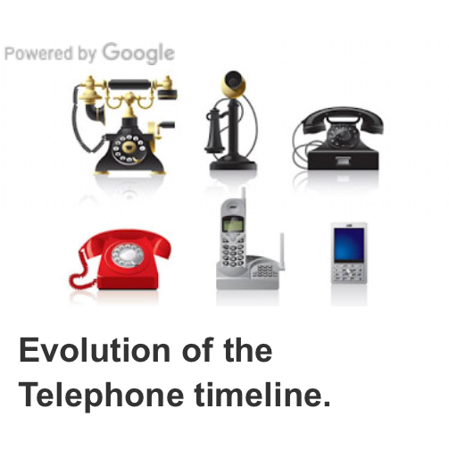
Developing a Protocol for insole examination

Slide 16
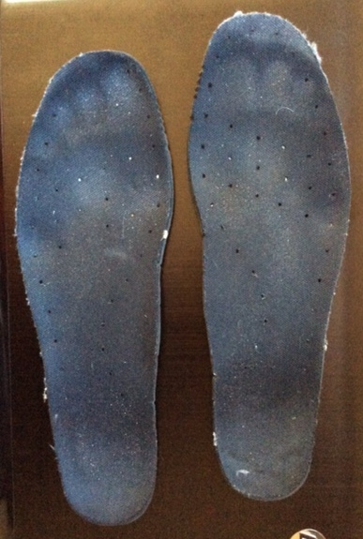
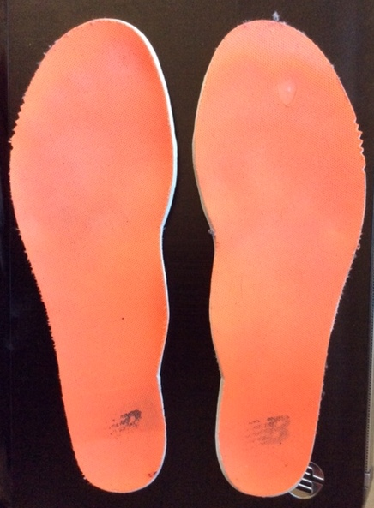
At crime scenes shoes or insoles may be recovered

Slide 17
CAN WE DETERMINE WHO WORE THE SHOE…….

Slide 18
OR WHO WALKED ON THE INSOLE???

Slide 19
HOW DO WE EXAMINE THE INSOLE?
The evaluation of foot impressions made within the footwear is similar to the evaluation of bare footprints.

Slide 20
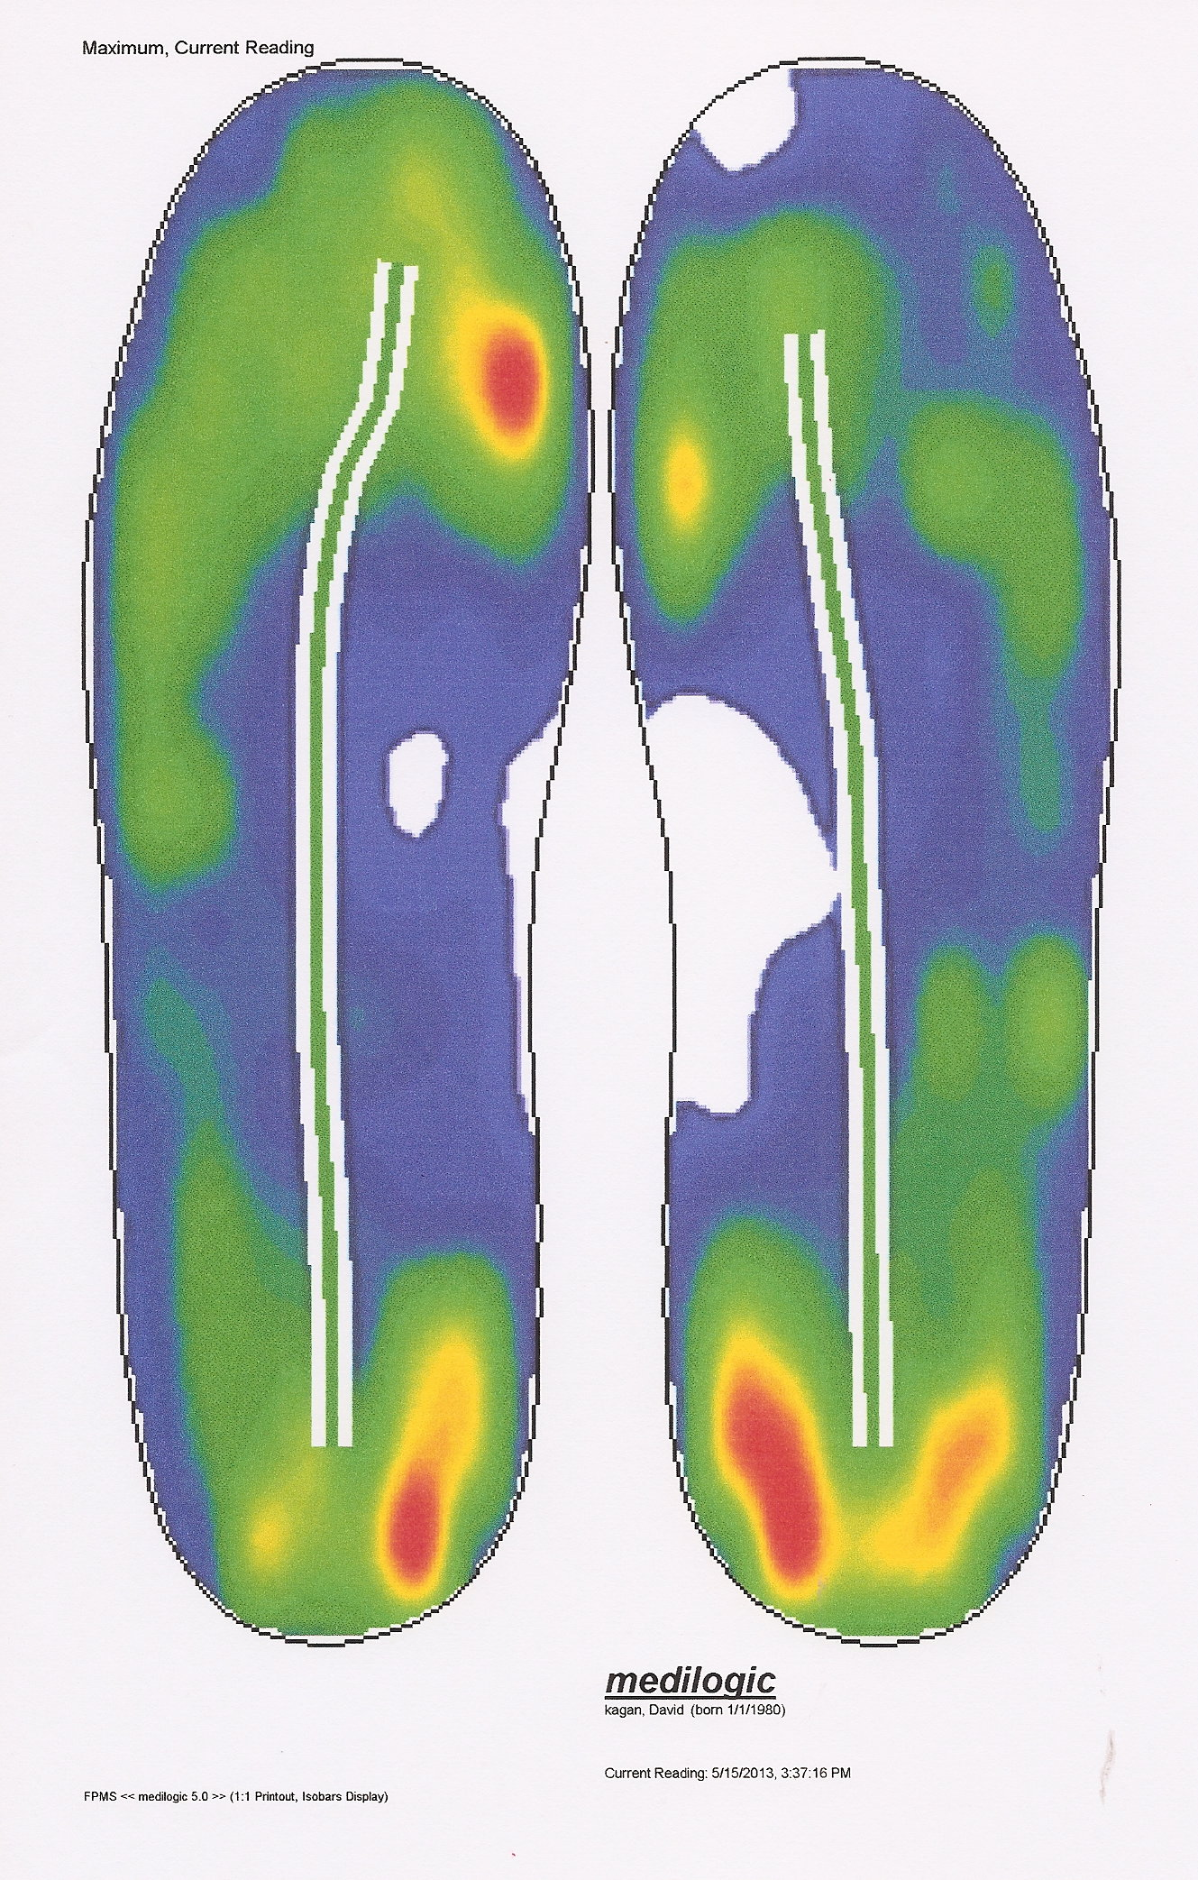
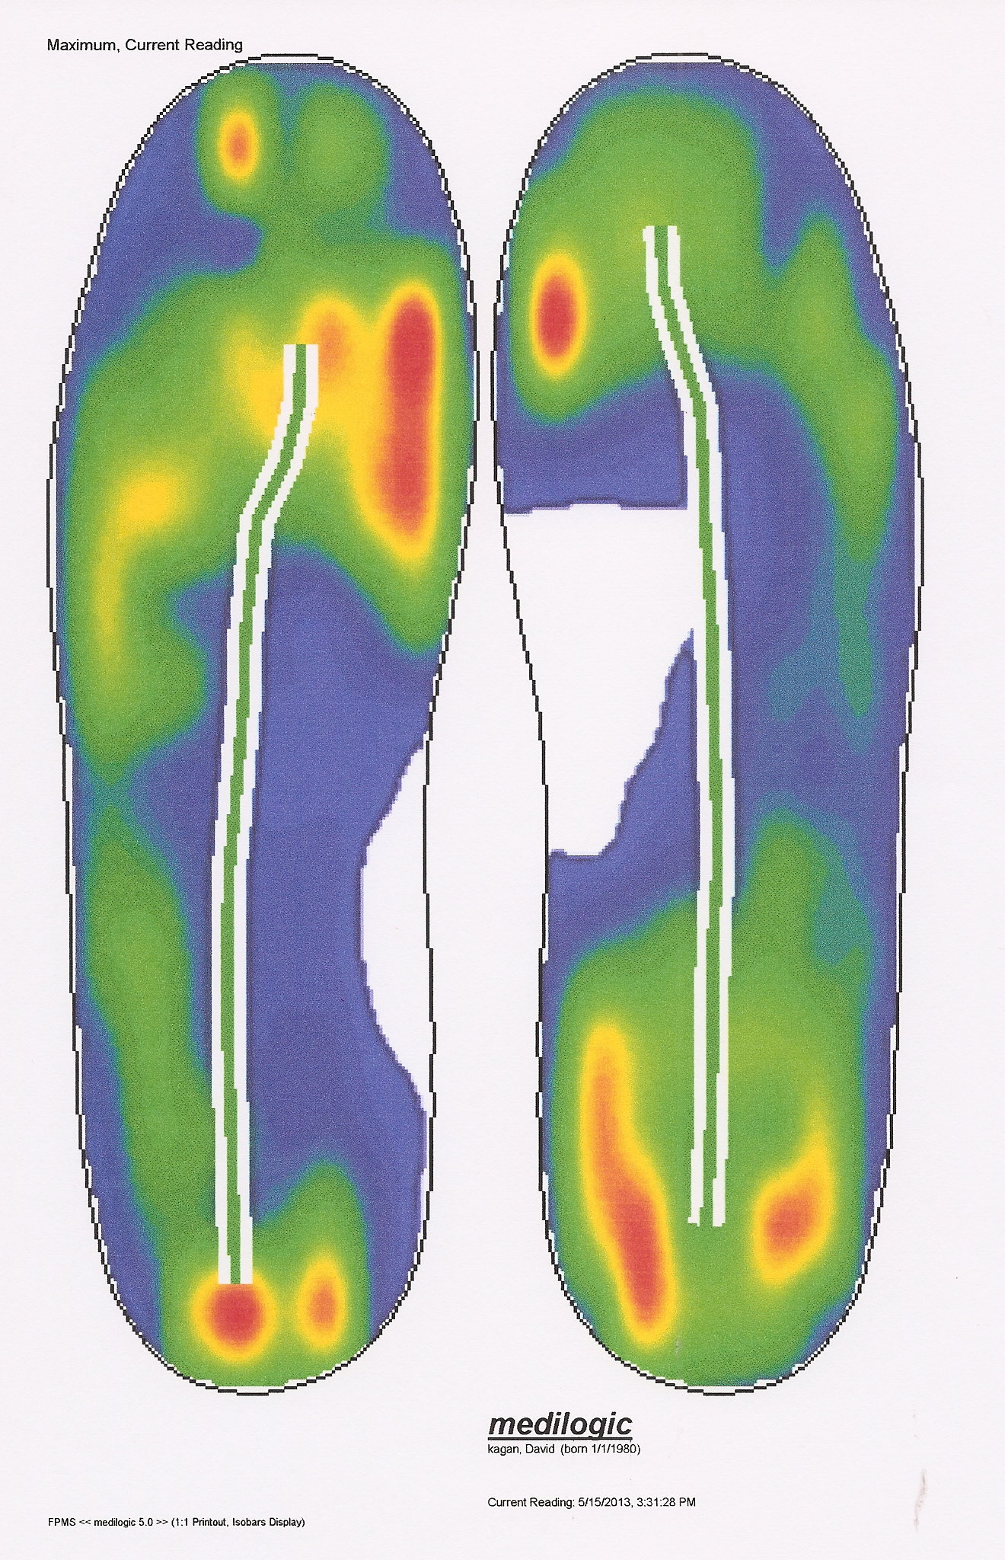
Size 8M------------------------Size 9M
However additional considerations like the effects of shape and size of the footwear on the foot creating the impression have to be taken into consideration.

Slide 21
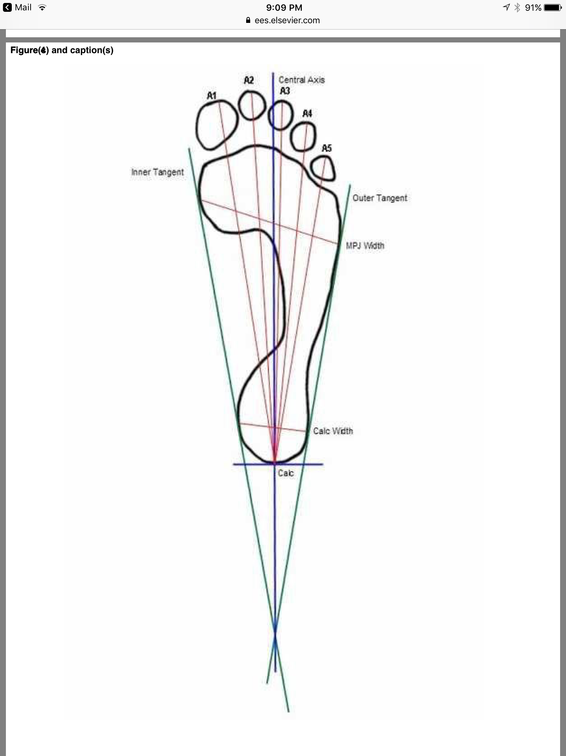
How do we examine the insole?
Length and Width measurements are taken using the Reel and Extended Gunn Methods
Both reliable and valid methods

Slide 22
Adobe© Photoshop© is used to enhance the insole foot impression and provide improved visualization of the foot prints by altering brightness and/or contrast

Slide 23
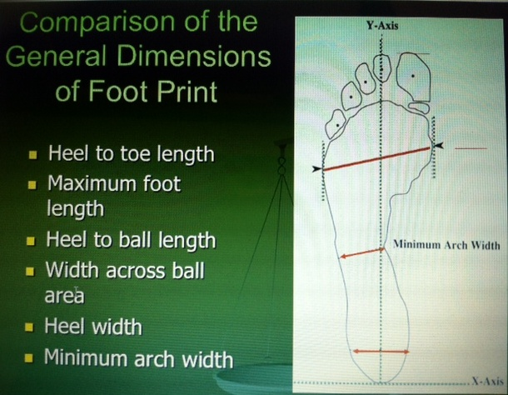
How do we examine the insole?

Slide 24
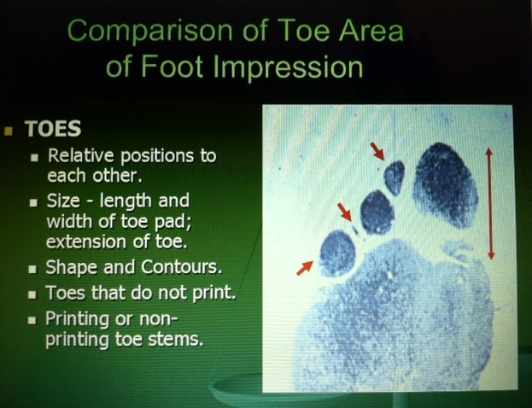

Slide 25
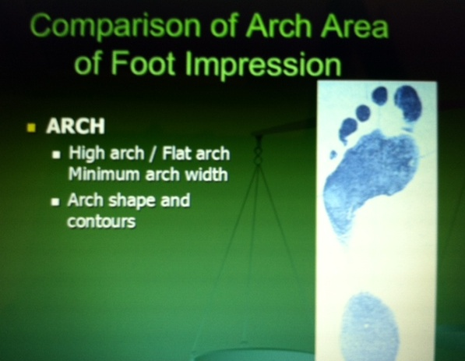

Slide 26
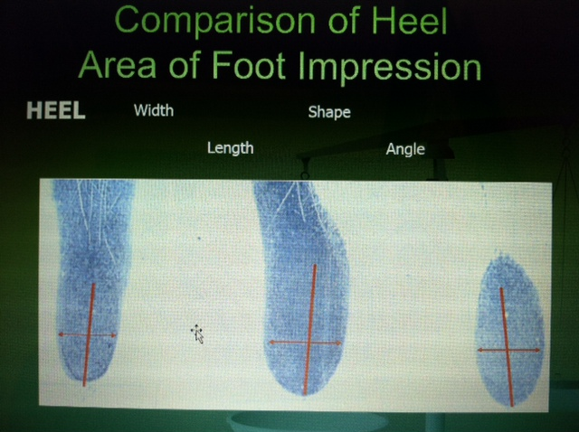

Slide 27
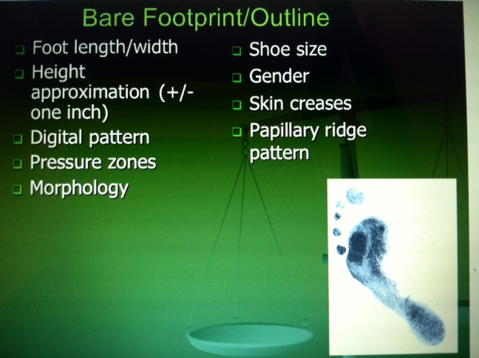

Slide 28
THESE EVALUATIONS ARE UTILIZING
2-DIMENSIONAL MEASUREMENTS [AND CHARACTERISTIC FEATURES ]

Slide 29
A BARE FOOTPRINT ON A SURFACE (FLOOR) SHOWS THE INTERACTION OF 1 DISTINCT MOMENT IN TIME

Slide 30
WOULD NOT INCLUDING 3-DIMENSIONAL MEASUREMENTS PROVIDE A MORE ROBUST EVALUATION?

Slide 31
WEIGHTBEARING BOTH STATIC AND DYNAMIC CREATE 3-DIMENSIONAL DEPTH DIFFERENCES ON THE SUBSTRATE

Slide 32
AND IS NOT THE INSOLE THE RECIPIENT OF STATIC WEIGHTBEARING PRESSURES
OF THAT STANDING INDIVIDUAL(S)?

Slide 33
AND IS NOT THE INSOLE THE RECIPIENT OF REPEATED DYNAMIC GAIT CYCLE PRESSURES OF THAT AMBULATING INDIVIDUAL(S)?

Slide 34
IT SHOWS THE INTERACTION OF THE FOOT WITH THE FOOTWEAR OVER TIME

Slide 35
SO WHY WOULDN’T AN INSOLE BE ABLE TO REVEAL FROM WEAR… CHARACTERISTIC 3-DIMENSIONAL FEATURES THAT CAN BE REPRESENTED AS A TOPOGRAPHICAL MAP

Slide 36
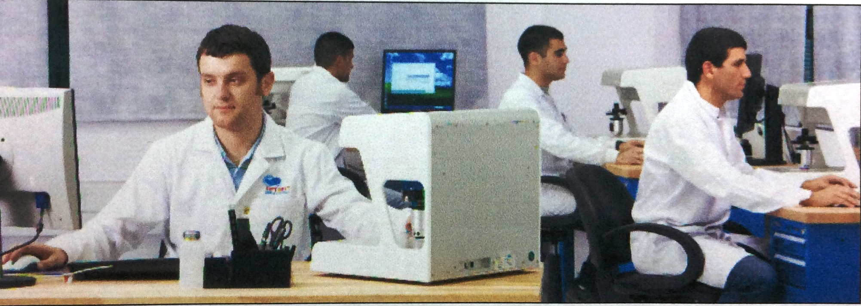
Optimet™ develops and manufactures non-contact distance measurement sensors based on the patented conoscopic holography technology

Slide 37
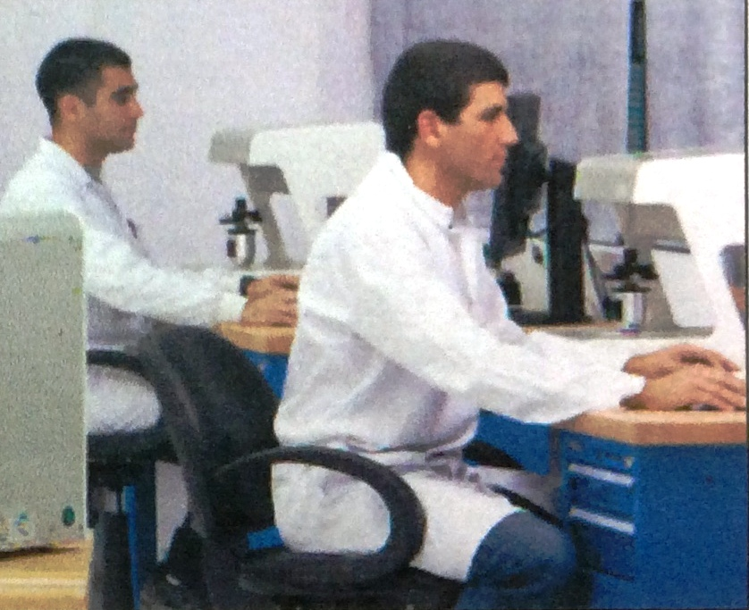
This technology relies on a unique optical phenomenon and is advantageous over the standard distance measurement methods for industrial and dental applications

Slide 38
Optimet™ integrates advanced optomechanical design and manufacturing capabilities together with advanced signal processing and data algorithms

Slide 39
Are not insoles the recipient of repeated weightbearing pressure from individuals during Ambulation?

Slide 40
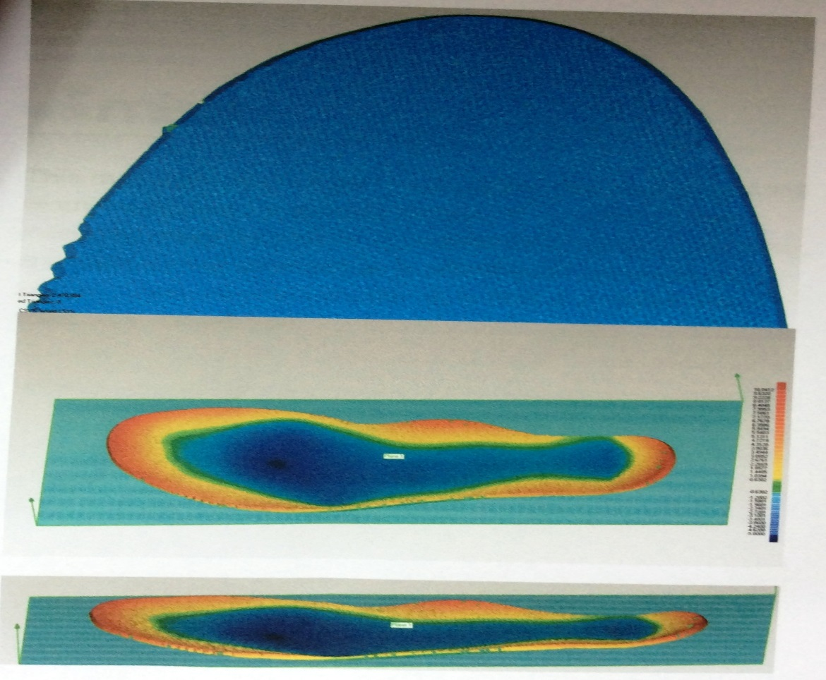
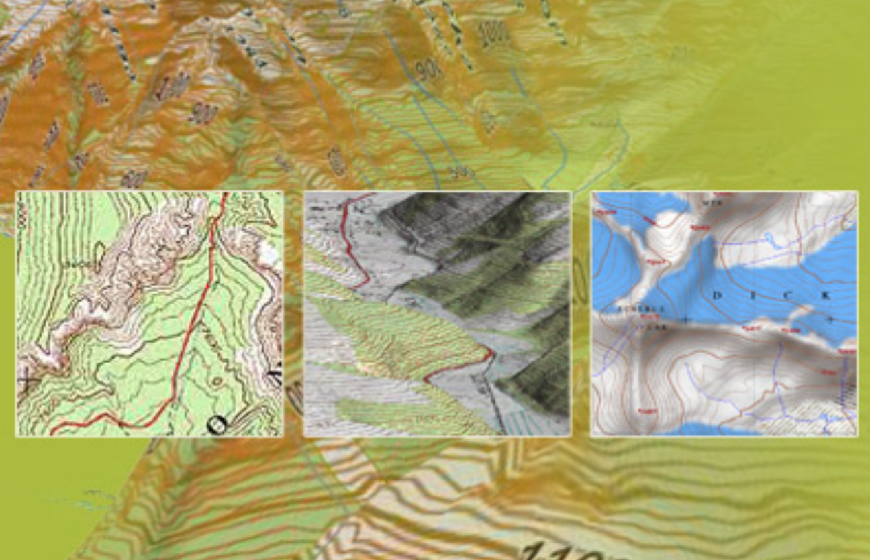
So why wouldn’t an insole be able to reveal from wear… characteristic mapping like a topographical map
A map characterized by large scale detail and quantitative representation of relief, using contour lines and a variety of methods
Initial Optimet scanning of insole

Slide 41
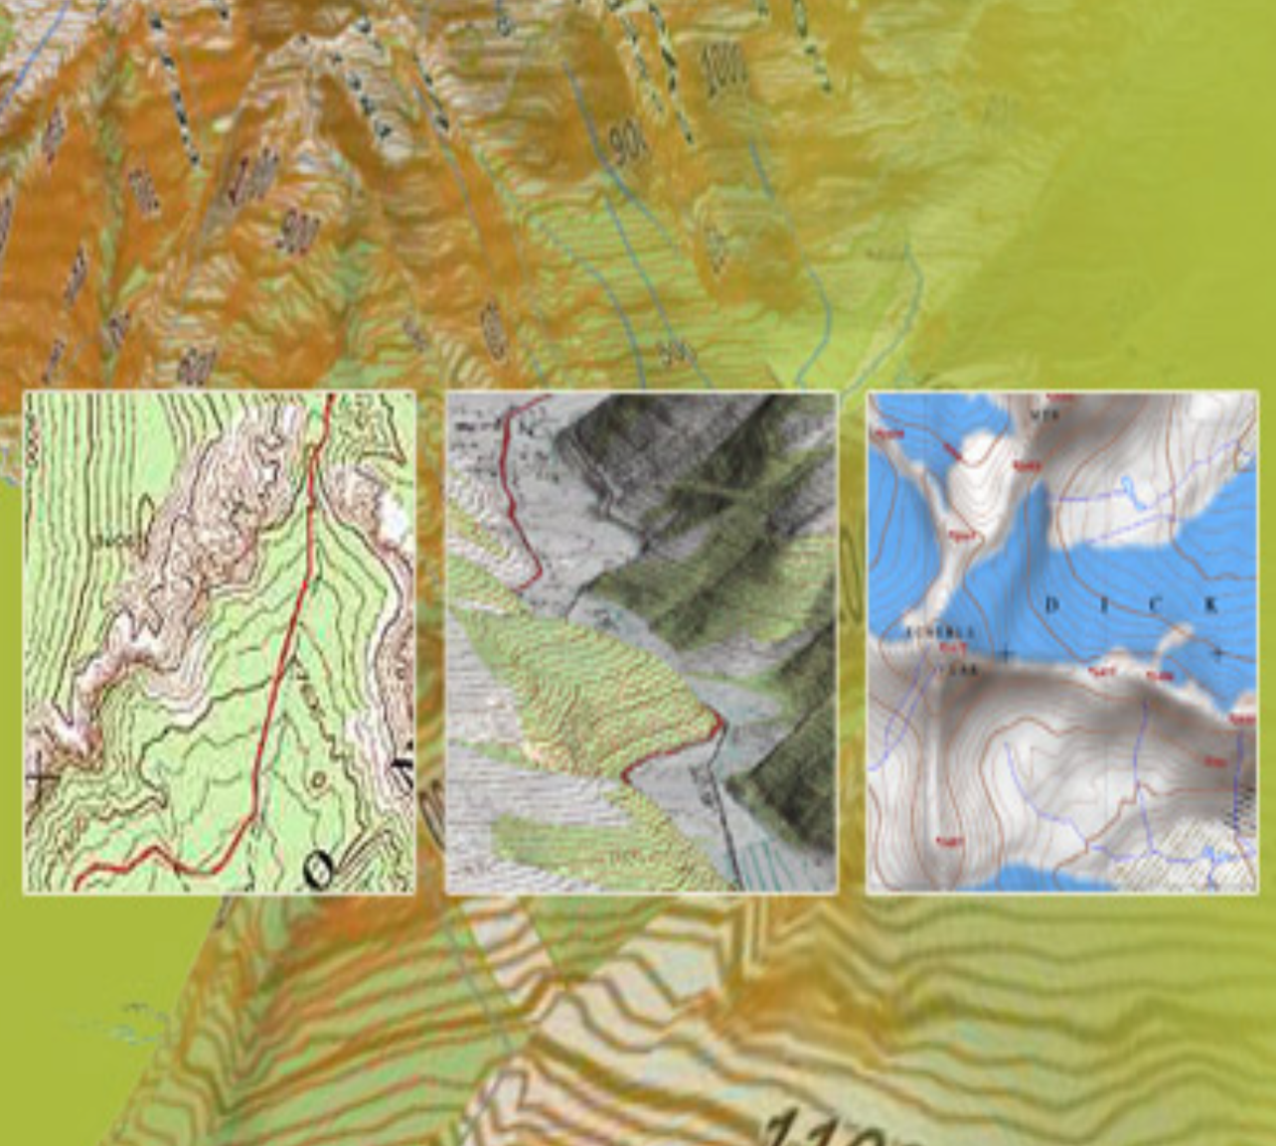
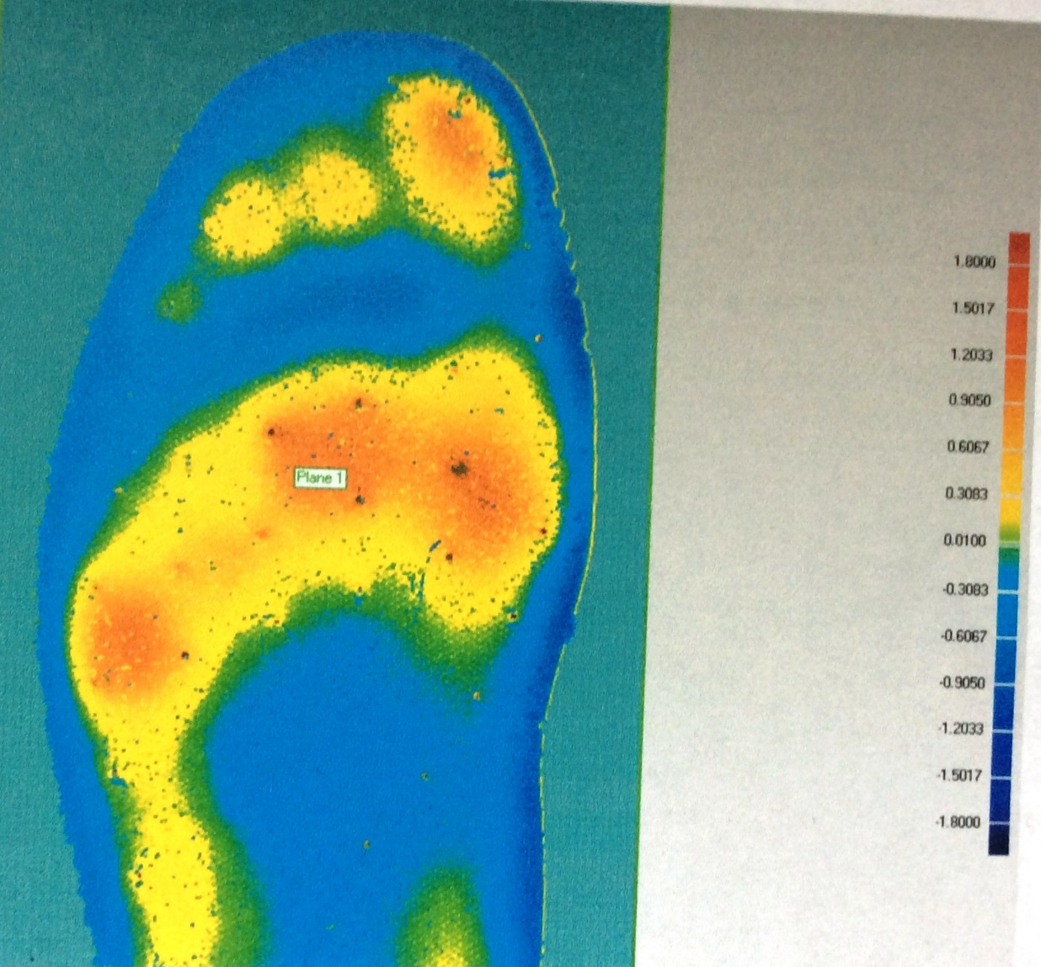
So why wouldn’t an insole be able to reveal from wear… characteristic mapping like a topographical map

Slide 42
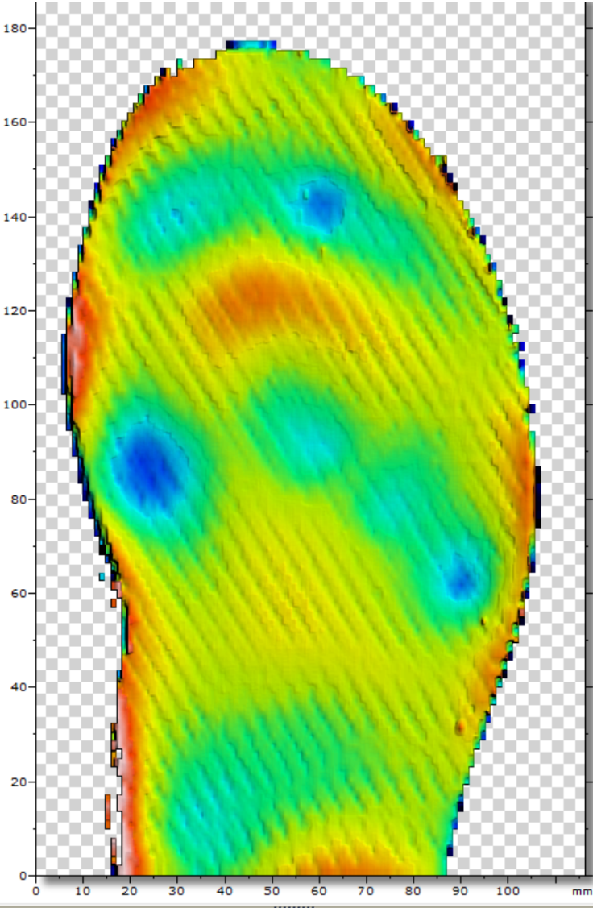
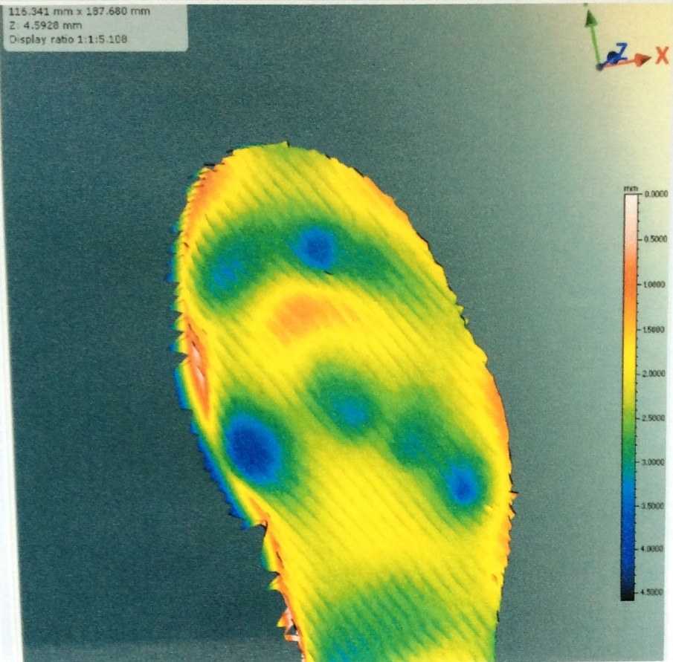
The insole was placed under glass and scanned.
There was no other pressure applied.

Slide 43
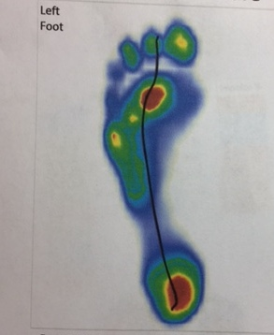
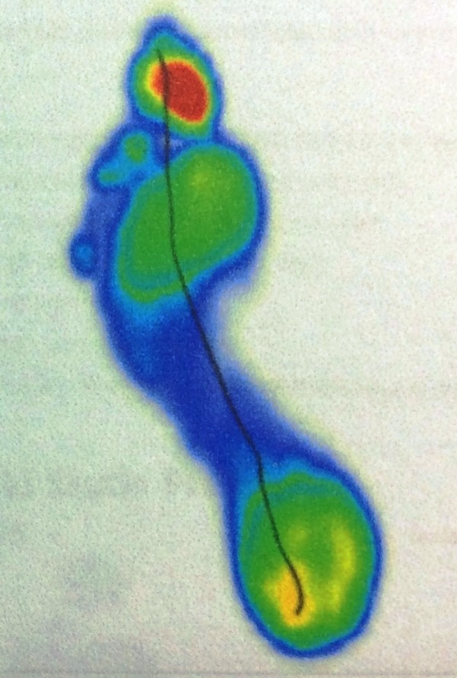
are these two gait patterns similar?

Slide 44
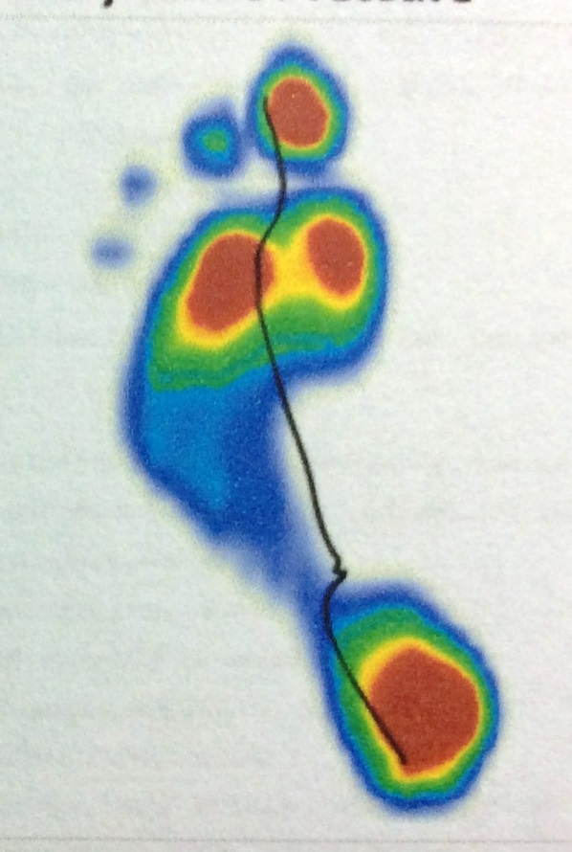
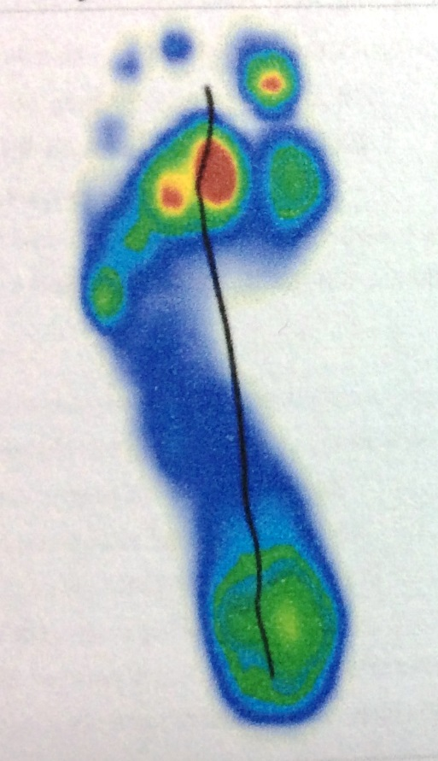
Are these 2 gait patterns similar?

Slide 45
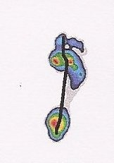
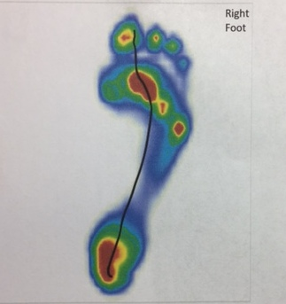
Question???????????
Are gait patterns of the same individual repeatable accurate and reliable?

Slide 46
Does Time affect it? [years]
Injuries? [TA Rupture]
Gait assessment technologies? [TOG,Tekscan,Zebra]

Slide 47
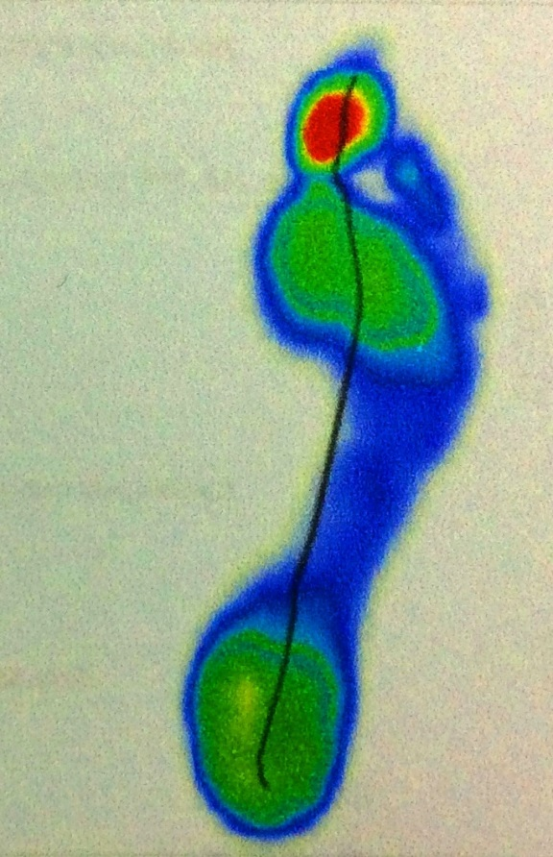
The gait patterns are different because individuals bear static and dynamic weight differently

Slide 48
What percentage of the population is the assessment of gait weightbearing different?

Slide 49
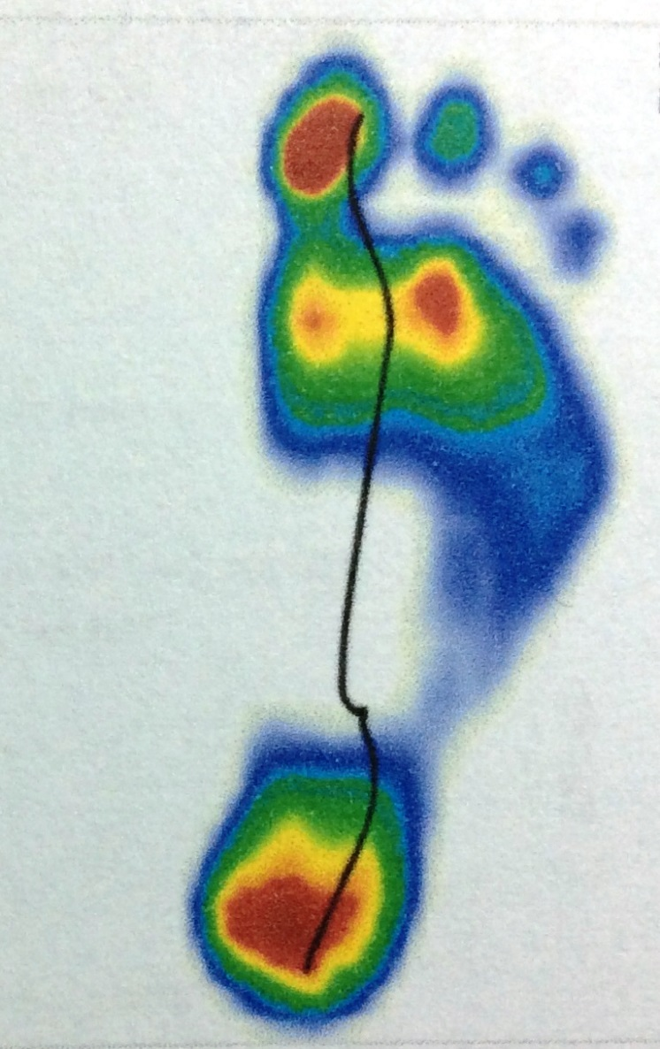
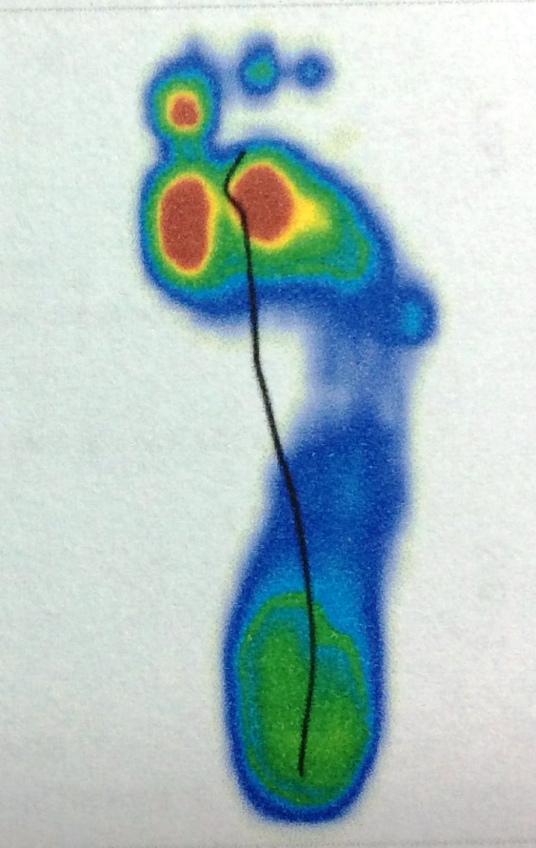
is gait weightbearing different
80-90%, 40-50%

Slide 50
How reliable is gait assessment software?

Slide 51
How many people have similar foot impressions?

Slide 52
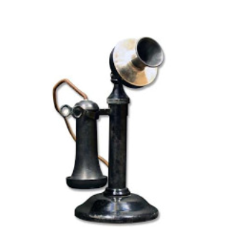
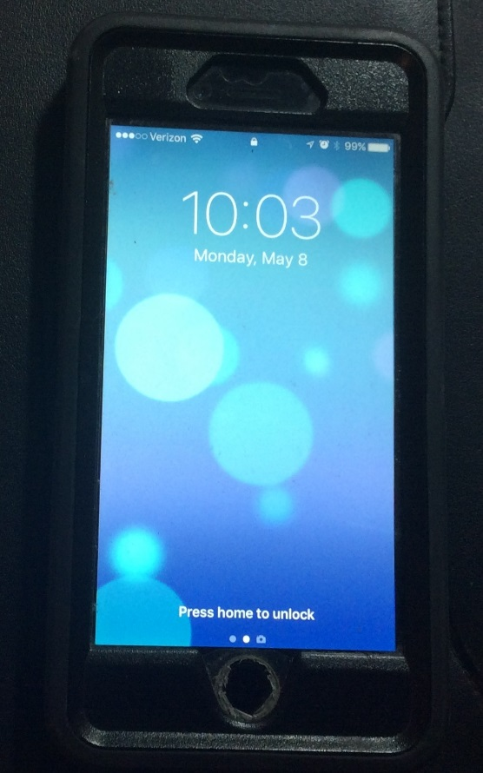
This is an initial study just like the telephone developed over time from alexander bell to the iphone

Slide 53
We are at the initial stage like the telephone of THE initial transmission and hopefully we will progress beyond towards the Iphone to be able to identify the wearer with an increasing degree of accuracy and reliability

Slide 54
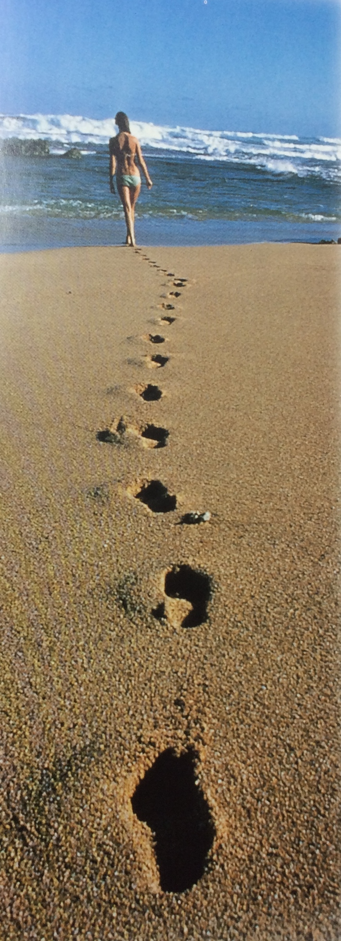
Can it become more accurate with a greater development of technology

Slide 55
Gratitude and thanks are extended to Michael Doherty,
Manager Applications Engineering
Optimet Products mks Instruments, inc
1616 Osgood street, north andover, Ma 01845 for assistance in the technical aspect of this study
**Ari Rubinstein, DPM for his help in utilizing his gait assessment software

