Slide 1
Essentials of Forensic Podiatry
Unit 3
Bryan B Kagan, DPM, MCSFS, DASFP
NYCPM

Slide 10
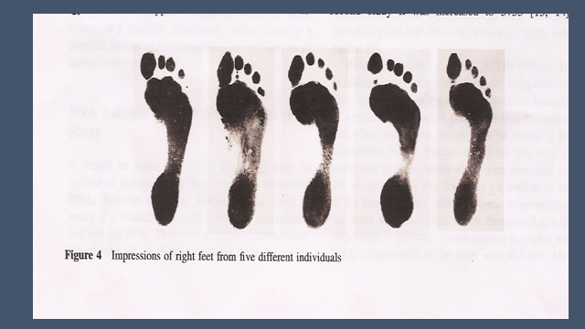

Slide 18
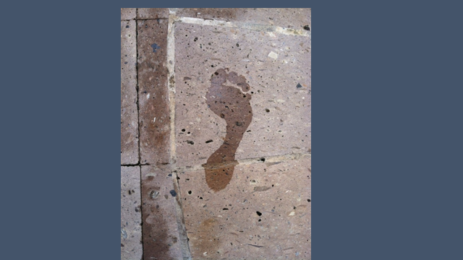

Slide 23
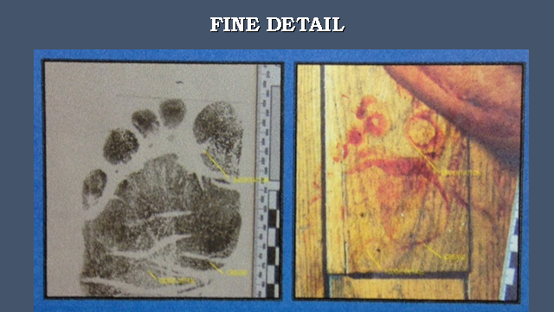

Slide 36
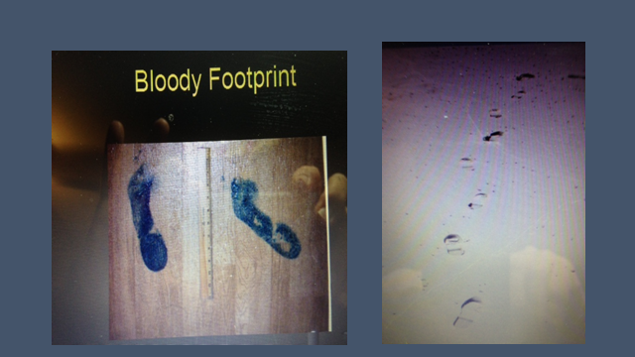

Slide 42
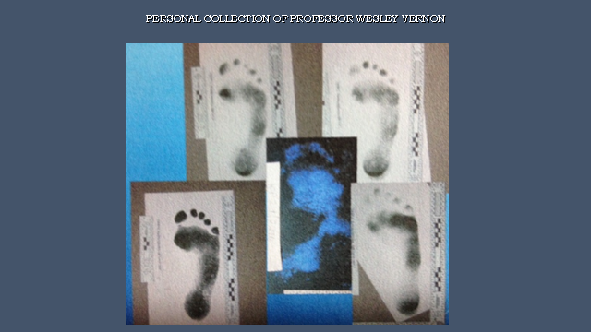

Slide 55
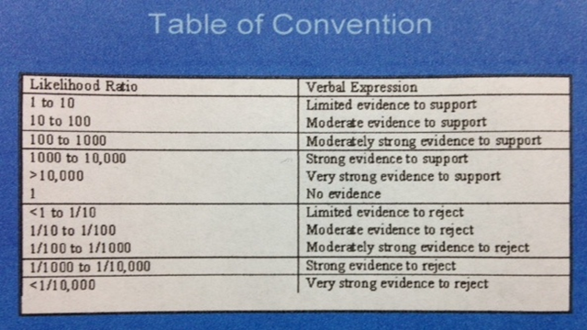

Slide 73
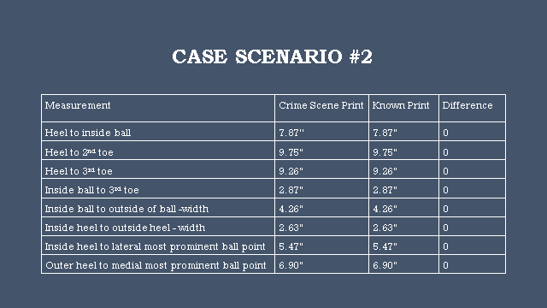

Slide 78
WHAT ARE THE POSSIBILITIES???????

