Slide 1
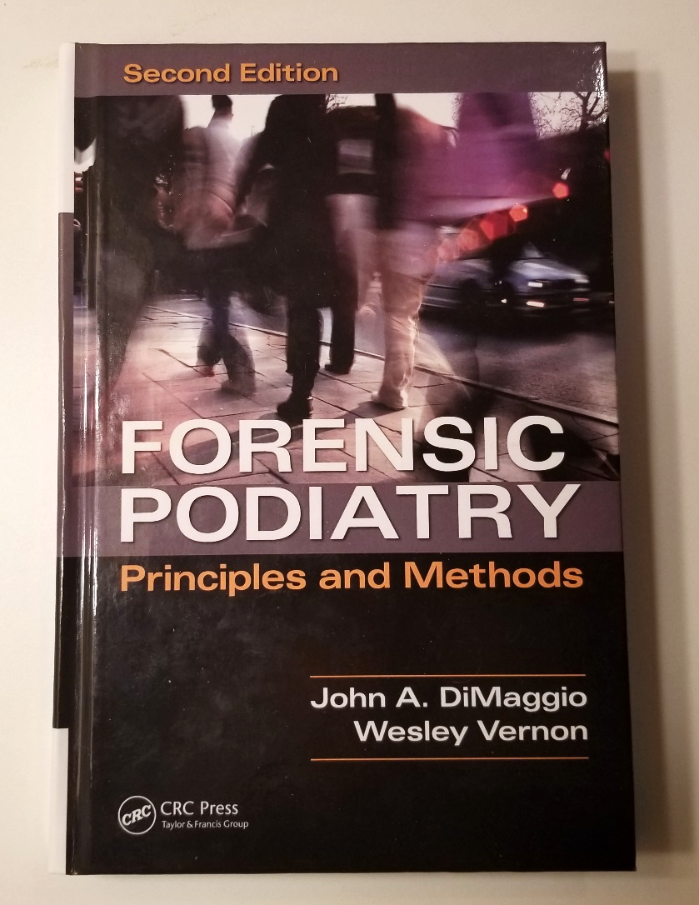

Principles of Pedal Evidence- Part 5

Slide 2
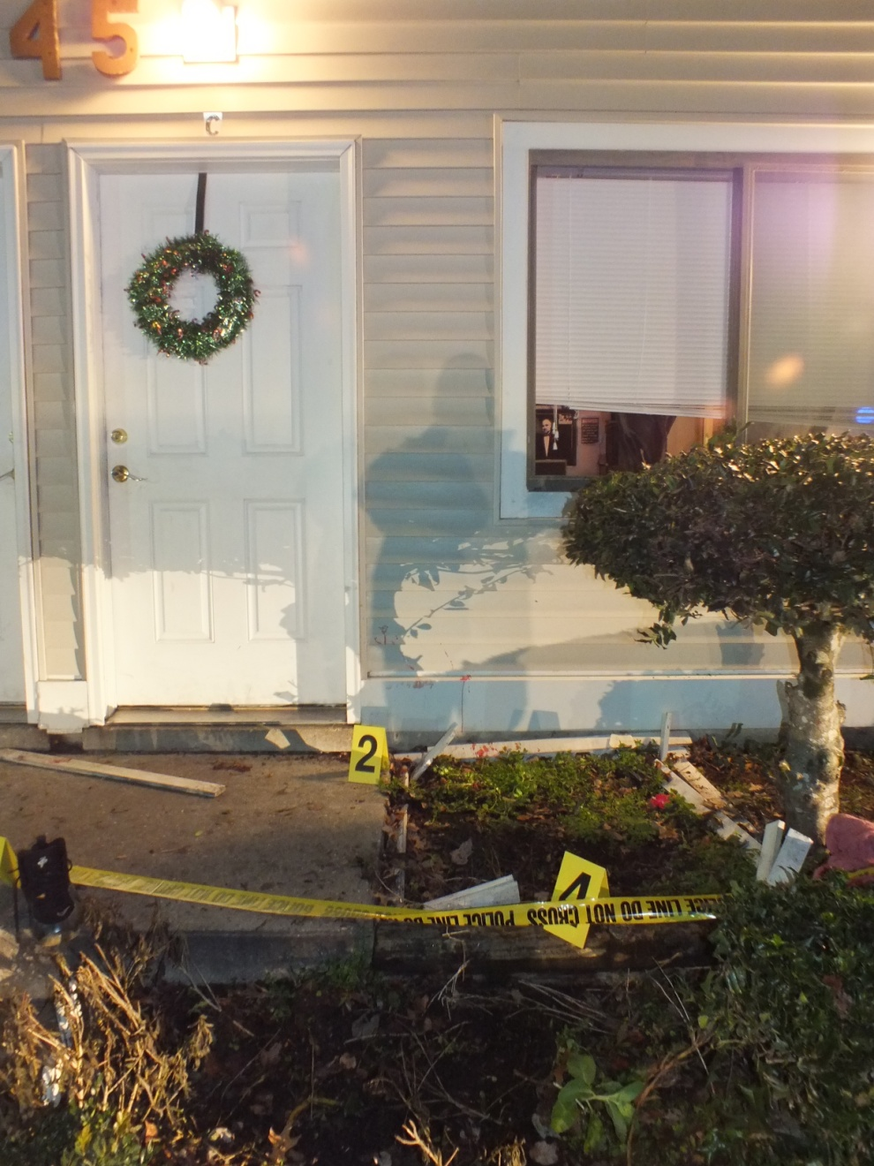
Commonwealth of Virginia vs.
Mr. Shymeek Stanfield
December 2012
Image adapted from image by Smithfield Virginia Police Dept.

Slide 3
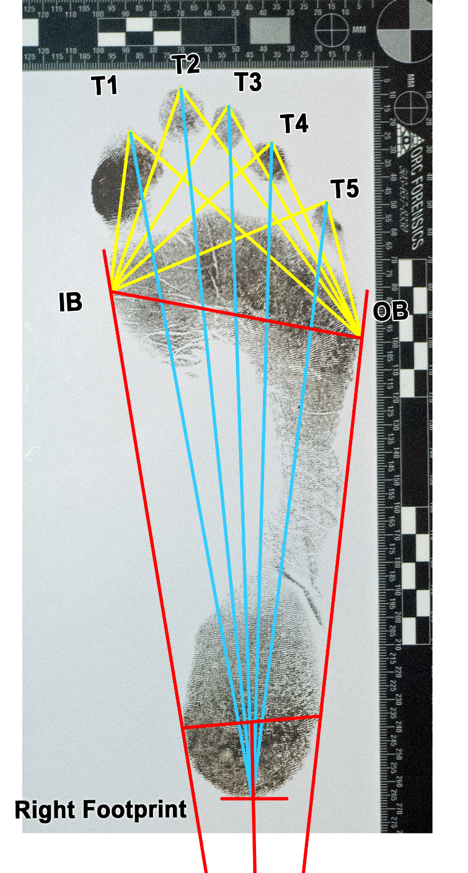
Line Measures

Slide 4
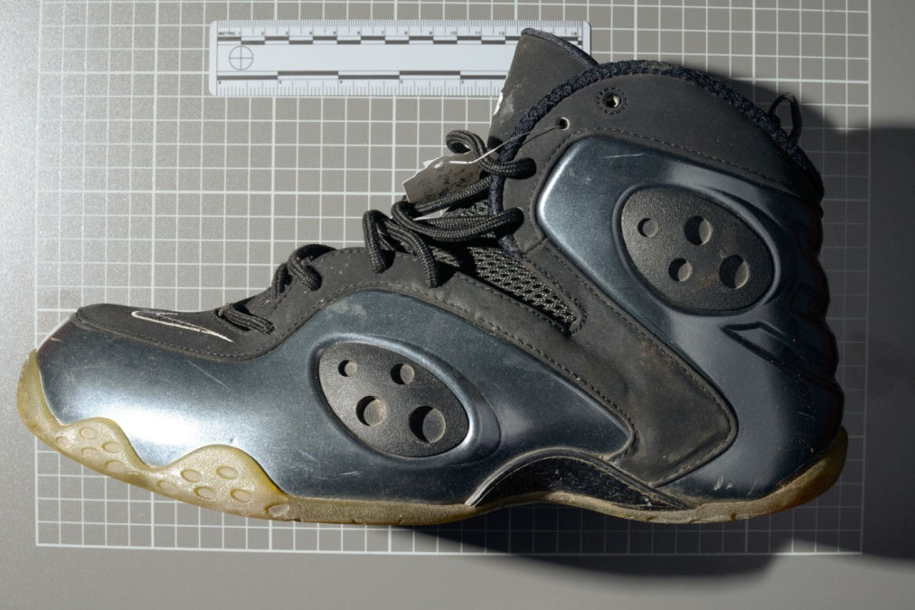
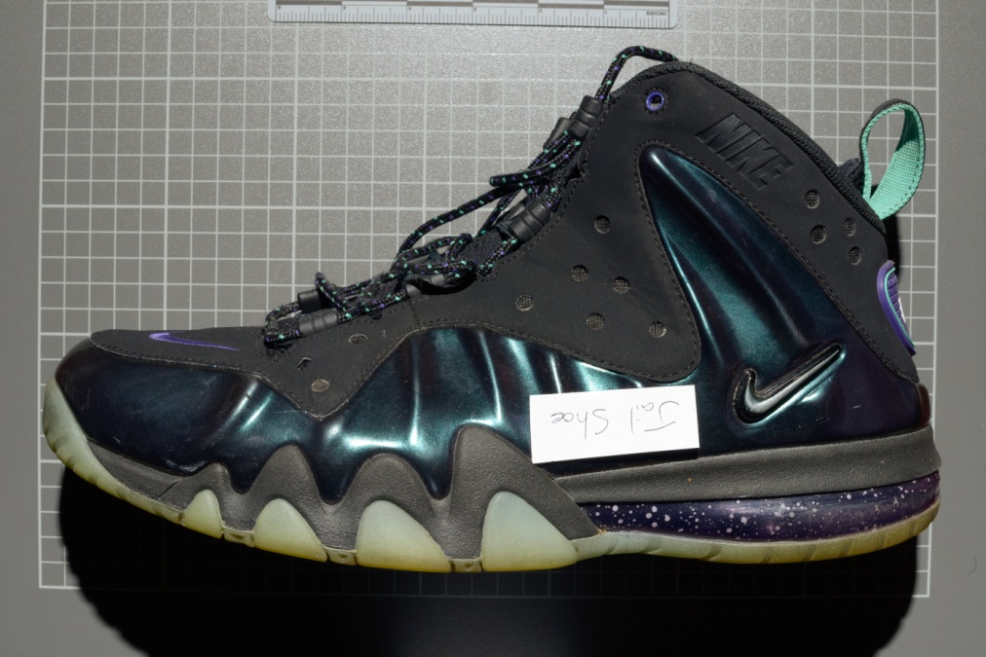
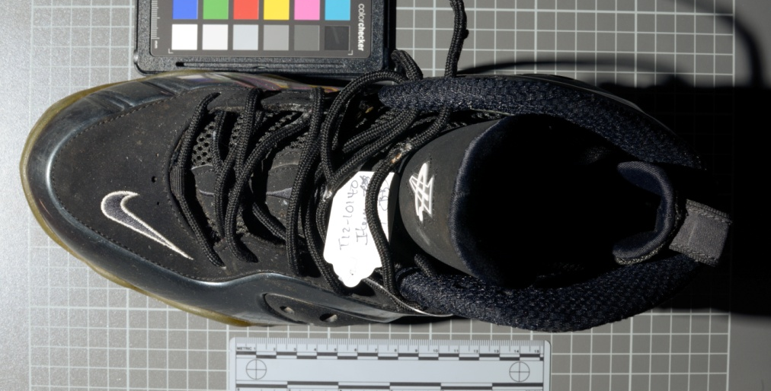
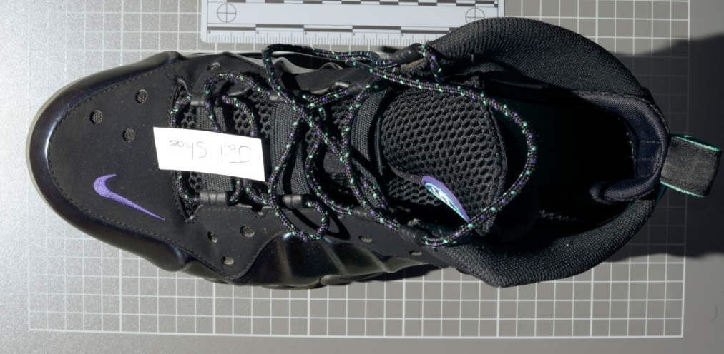
Crime Scene Shoe
Commonwealth Virginia v. Shymeek Stanfield
Suspect Shoe
Images adapted from images by Smithfield Virginia PD

Slide 5
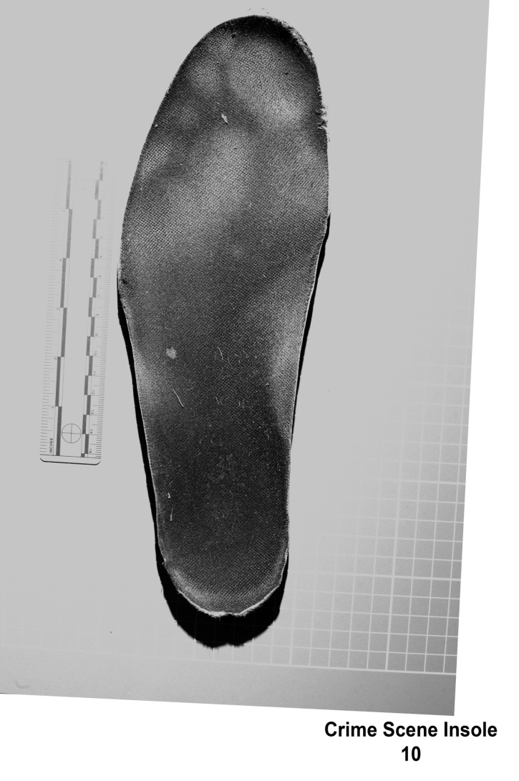
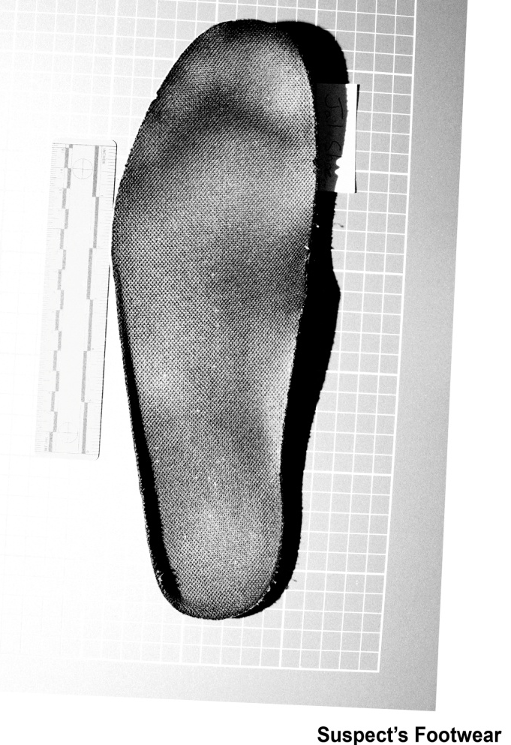
Interaction/Relationship of Foot to Shoe Over Time
Images adapted from images by Smithfield Virginia PD

Slide 6
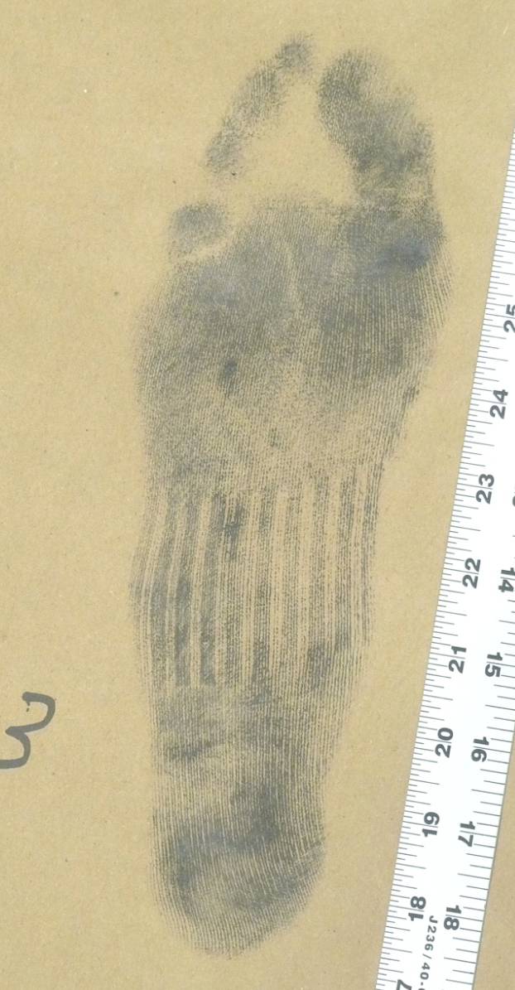
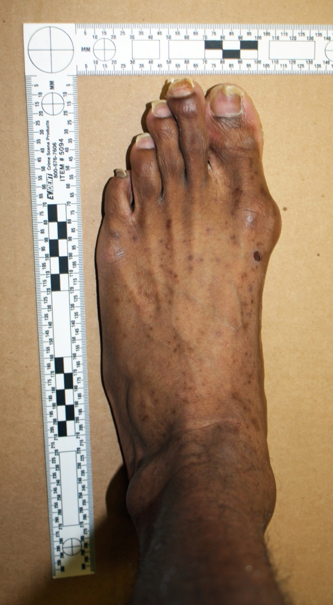
Suspect
Images adapted from images by Smithfield Virginia PD

Slide 7
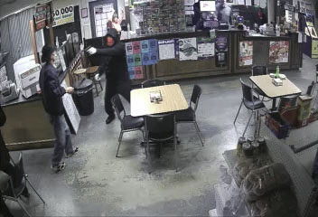
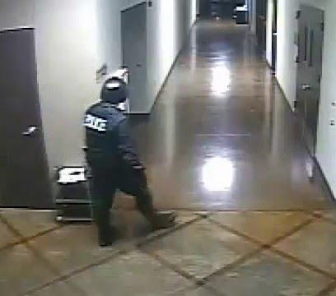
Forensic Gait Analysis

Slide 8

Thank You
Michael Nirenberg, DPM
DrNirenberg@friendlyfootcare.com

