Slide 1
FORENSIC PODIATRY II
Bare Footprint Analysis
©Bryan B Kagan, DPM 2015

Slide 2
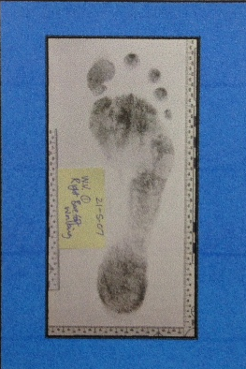
Bare footprint identification

Slide 3
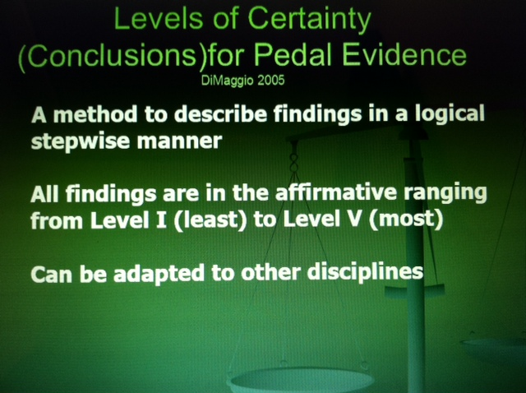

Slide 4
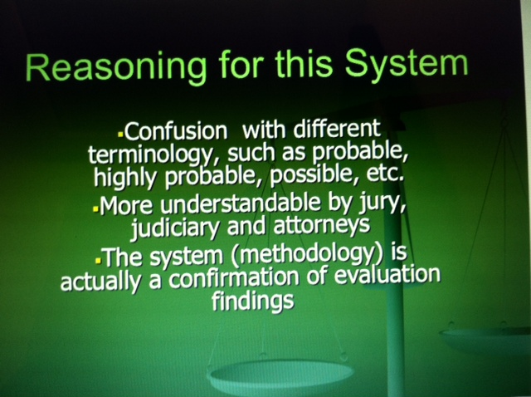

Slide 5
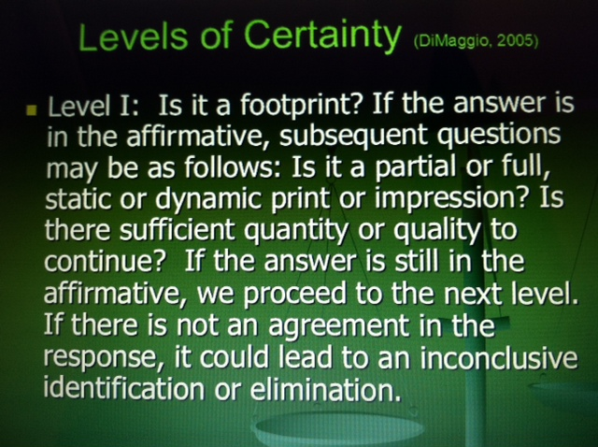

Slide 6
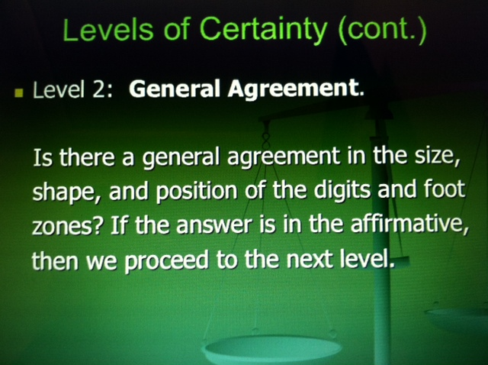

Slide 7
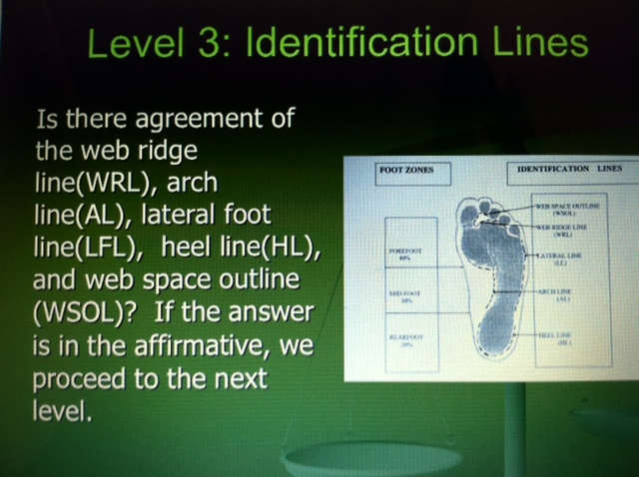

Slide 8
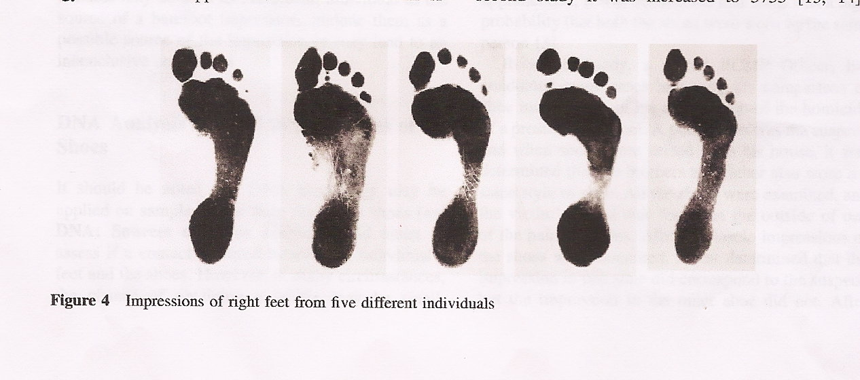

Slide 9
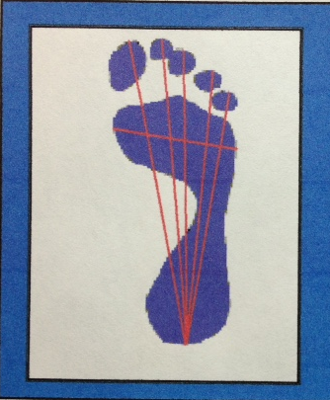
BAREFOOT PRINT ANALYSIS

Slide 10
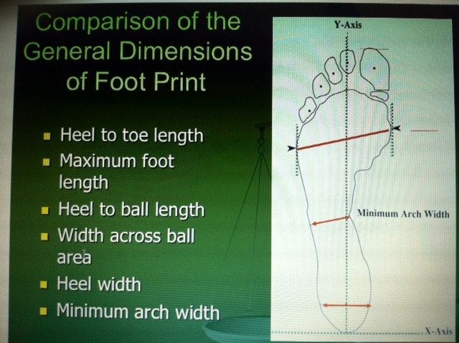

Slide 11
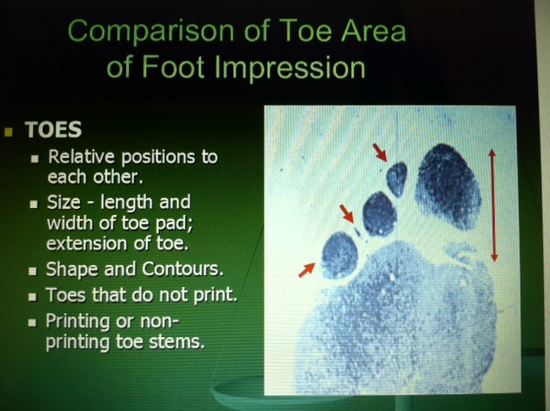

Slide 12
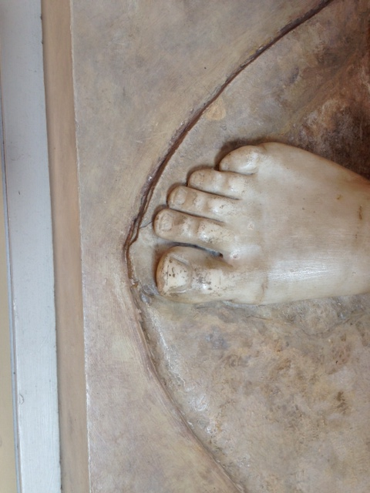
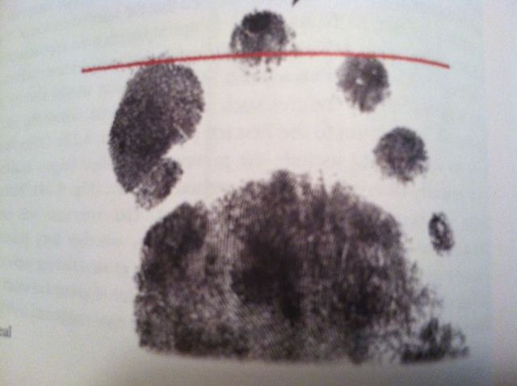
GREEK TOE
DiMaggio J, Vernon W, Forensic Podiatry, Humana Press, 2011, p 66

Slide 13
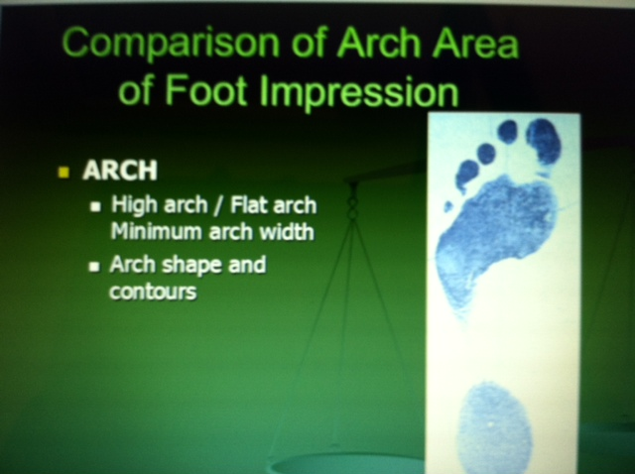

Slide 14
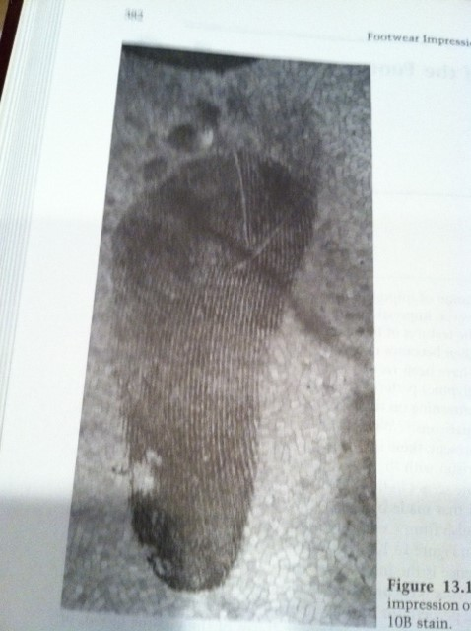
Sock impression

Slide 15
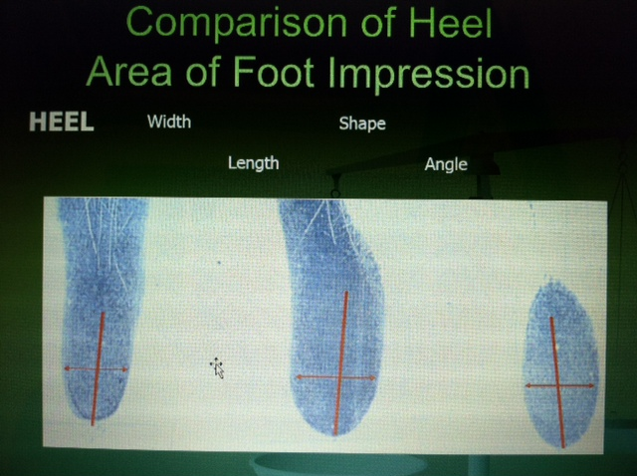

Slide 16
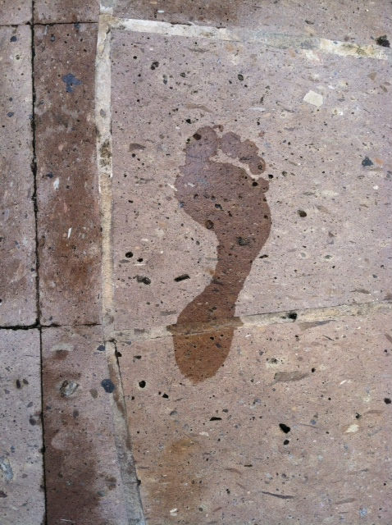

Slide 17
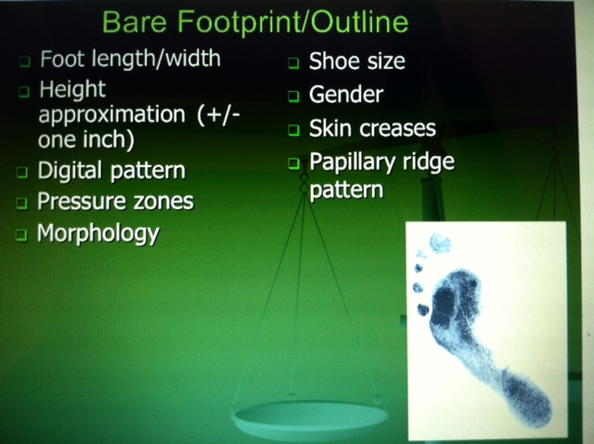

Slide 18
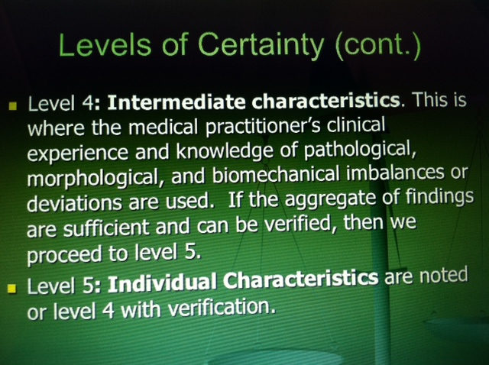

Slide 19
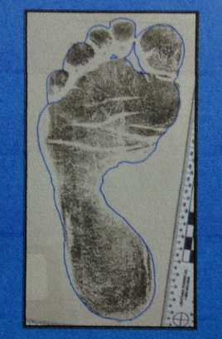
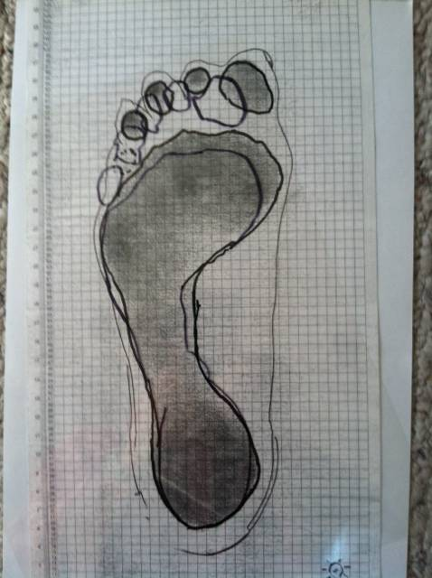
Barefoot print analysis
(Overlay Method)

Slide 20
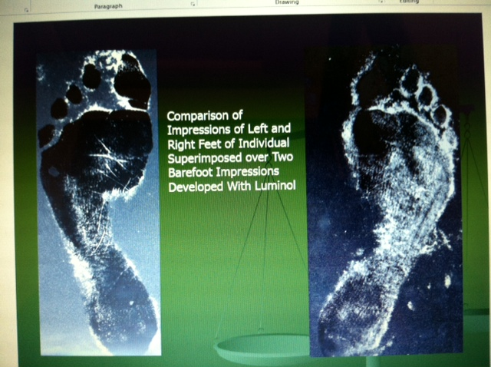
General fit, shape

Slide 21
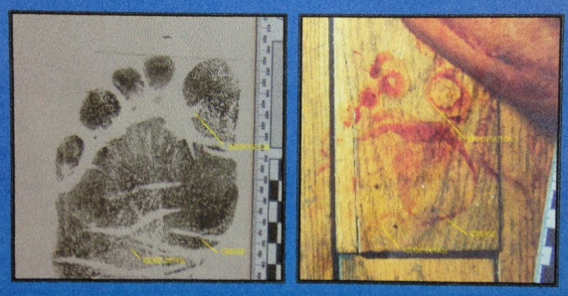
Fine detail

Slide 22
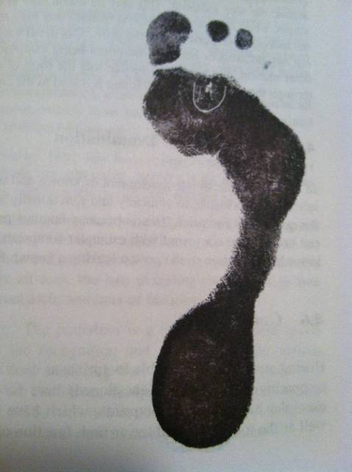
Note locations of creases and scars
Note areas of ridge detail ( that is not within our area of expertise- call in a ridge print examiner)

Slide 23
Measure the length of the heel to distal tip of hallux, to toe 2, .. 3,.. 4 and 5 in mm.
The length is the measurement from the heel to the longest toe in mm.
+/- 5mm

Slide 24
Measure the width from the widest part of foot from the medial most metatarsal protrusion to the lateral most metatarsal protrusion.
The cross ball distance is that width.

Slide 25
Note position of the toes and number them 1-5 in their length order. The longest toe is #1, then 2nd longest is #2, then #3,#4,#5.
1/2,3/4/5

Slide 26
Second Impression: 1/2/3/4/5

Slide 27
Third Impression: 2/1/3/4/5

Slide 28
Fourth Impression: 1/2/3/4/5

Slide 29
Fifth impression: 1/2/3/4/5

Slide 30
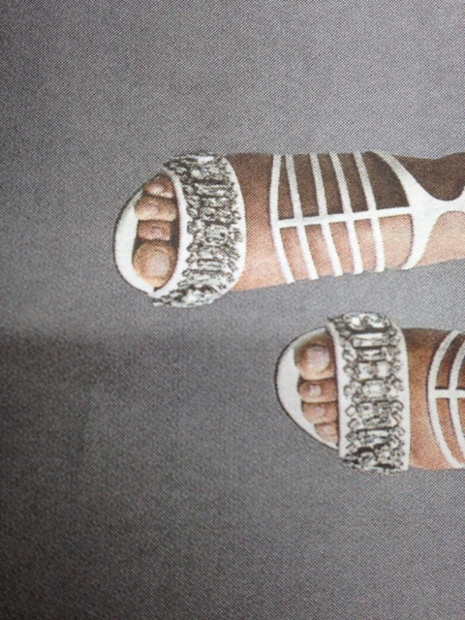
Right ?/?/?/?/? Left ?/?/?/?/?

Slide 31
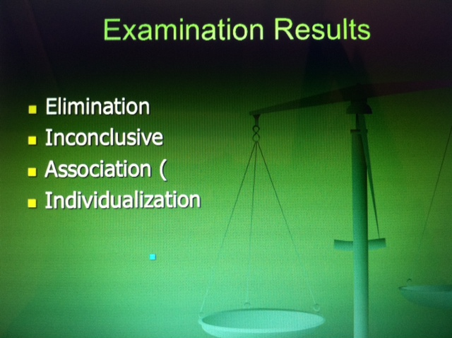

Slide 32
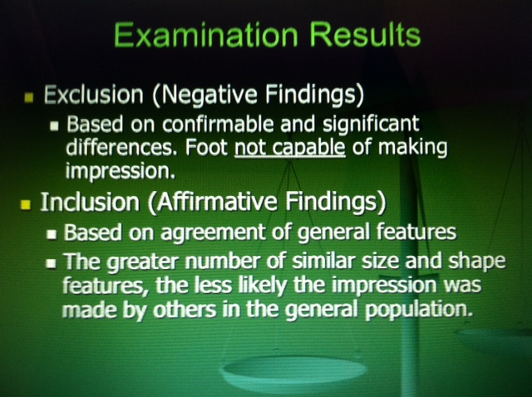

Slide 33
Written or Electronic Medical Records
Initially suggested by Dr. Ivor Doney 1984
Deceased persons could be identified from their podiatry records
1. Treatment undertaken
2. Foot type
3. Foot pathology
4. Site of existing skin lesions
5. Form of existing skin lesions

Slide 34
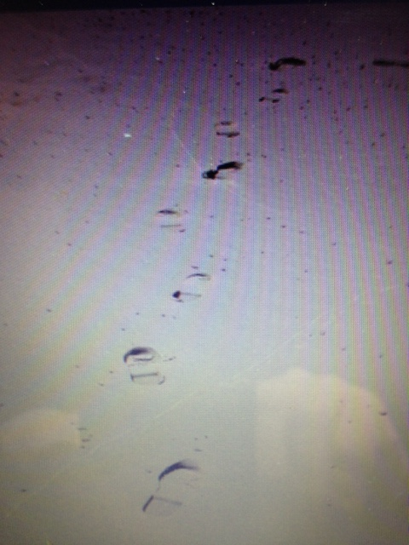
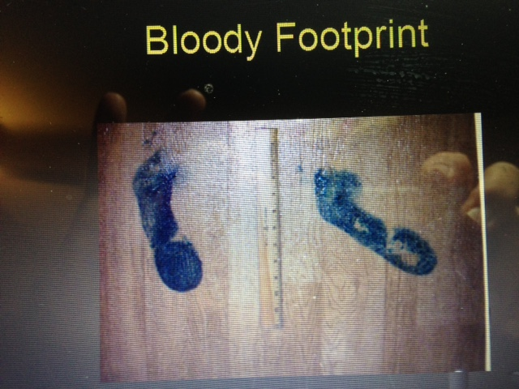

Slide 35
Forensic Podiatry
Case Study 1

Slide 36
Case Scenario
Suspect lived with his parents
Suspect had attended a rock concert that evening.
On his return home, parents were found stabbed to death.
Police became suspicious as suspect was martial arts “expert” skilled in Eskrima (Filipino Martial Arts that emphasize fighting with sticks, knives and other bladed weapons).
Luminol stained footprint was found at the crime scene.
Asked to compare this footprint with suspect’s footprints.

Slide 37
What process was followed??

Slide 38
What process was followed??
Foot prints obtained from suspect under various conditions barefoot/socked, walking/standing/running, hard surface/carpet.
…………….

Slide 39
What process was followed??
Foot prints obtained from suspect under various conditions barefoot/socked, walking/standing/running, hard surface/carpet.
Best quality footprints known foot prints compared with the best quality unknown footprints using the overlay and Gunn methods.

Slide 40
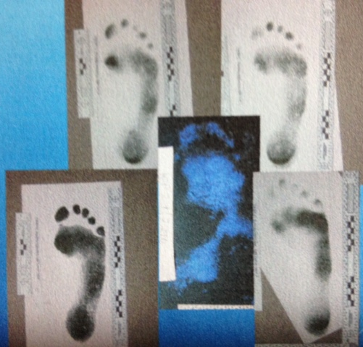
PERSONAL COLLECTION OF PROFESSOR WESLEY VERNON

Slide 41
How individual are human footprints?
Cassidy (1987) - Observed 1:90
Bodziak (2000) - Distinguished 1:1000
Freedman et al. (1945) Observed 1:6,700
Rossi et. al. (1983) – Observe 1:6,800
Kennedy (2005) - Distinguished 1:24,000
Kennedy et. al. (2003) - Statistically suggested 1:100million chance match

Slide 42
Comparison of Unknown Footprint with Known Footprint
Measurement | KNOWN FOOTPRINT | UNKNOWN FOOTPRINT | +/- mm
Heel to 1st Toe | 250mm | 250mm | 0mm
Heel to 2nd Toe | 255mm | 253mm | 2mm
Heel to 3rd Toe | 244mm | 240mm | 4mm
Heel to 4th Toe | 233mm | 232mm | 1mm
Heel to 5th Toe | 216mm | 206mm | 10mm
Cross Ball Measurement | 97mm | 95mm | 2mm

Slide 43
Comparison of Unknown Footprint with Known Footprint
Measurement
1st Toe Position | 2 | Toe position, cross ball measurement, anterior
2nd Toe Position | 1 | ball area contour and general morphological
3rd Toe Position | 3 | outline of foot very closely matched
4th Toe Position | 4
5th Toe Position | 5 | (+/- 5mm)
Cross Ball Measurement

Slide 44
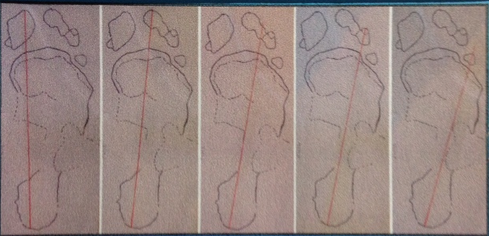
Length Measurements superimposed onto Questioned footprint from personal collection of Professor Wesley Vernon

Slide 45
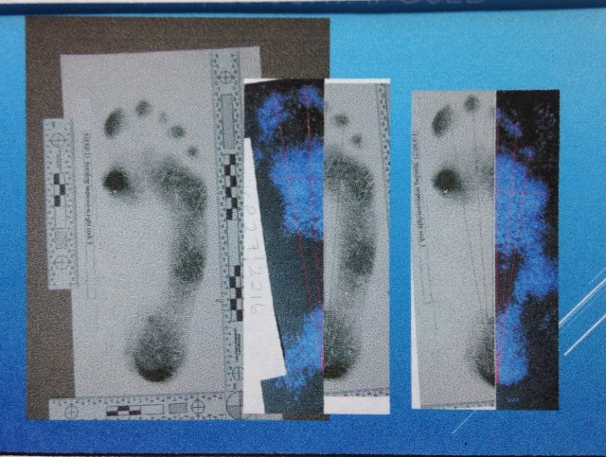
Juxtaposed unknown/known personal collection of Professor Wesley Vernon

Slide 46
conclusions
The close matching of the known footprints with the questioned footprint gave moderately strong support for the proposition that theses footprints were made by the same person.

Slide 47
Verdict???????

Slide 48
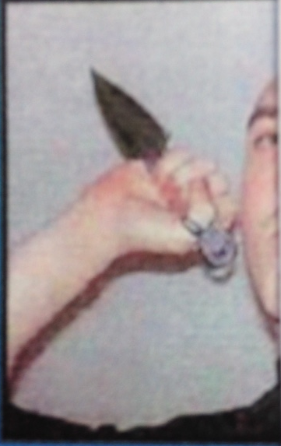
life sentence FOR parent killer

Slide 49


Slide 50
How do we show evidential value?
Evaluate class versus Unique characteristics.
Currently there is no forensic podiatry evidence demonstrated at the unique level.
There are various strength scales in use.
(possible, likely, most likely, identification)

Slide 51
Use of Likelihood Ratios and evaluative opinion
A likelihood ratio [LR] is a method to compare the probability of two things by simply dividing one by the other.
A horse is 10-1 and another is 50-1, then the LR is 5 (50/10) that the former will win over the latter and 0.2 (10/50) that the latter will win over the former.
A LR greater than 1(>1) favors the numerator, a LR less than 1 (<1) favors the denominator.

Slide 52
Use of Likelihood Ratios and evaluative opinion
It is a means of measuring how much more likely one thing is compared to another.
The use of LR in evaluation of forensic evidence has been promoted by some statisticians and scientists especially in the UK.
“It is fair and balanced, comparing the probability of the evidence given by the prosecution narrative with the probability of the evidence given the defense narrative.”

Slide 53
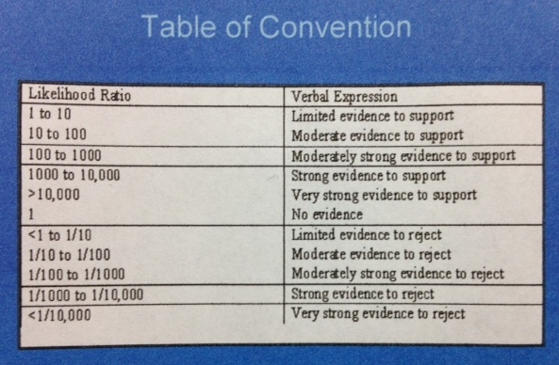

Slide 54
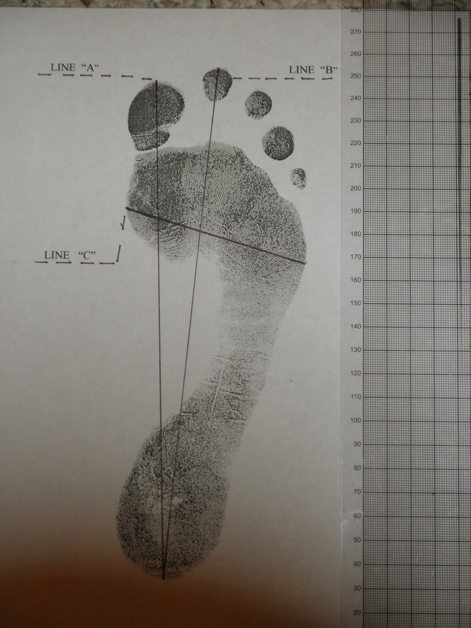
Likelihood Ratios
Suppose foot size 267mm.
That would require a size 9 UK shoe, or size 9.5 US shoe.
Data suggests approximately 14% (1/7) of the adult UK male population requires a true size 9 UK shoe.

Slide 55
Likelihood Ratios
The ball width/foot length ratio of the footprints of 34.4 places the individual in the category in which 3.7% (1/27) of the adult male population resides.

Slide 56
Likelihood Ratios
The toe position/formula of the person who made this footprint shows a definite Greek ideal which 11% (1/9) of the population are believed to exhibit.

Slide 57
Use of Likelihood Ratios
Multiply these factors together– 1/7 x 1/27 x 1/9 = 1/1701. This is the likelihood of finding these same features in another.
Then consider the features that would suggest a mismatch or alternative hypothesis– in this case none are apparent = 1/1.
Divide the likelihood of a match 1/1701 by the likelihood of a mismatch 1/1 to give a likelihood ratio [L/R] of 1701

Slide 58
Use of Likelihood Ratios
On the table, this example shows strong support for the proposition that the footprints were produced by the same individual.
L/R of 1701 falls in the line of 1000 to 10000.

Slide 59
Basis for judgment has to rely on a sufficiently large database.
Must disclose statistical analysis used in reaching expert opinion
……..and not
“just my gut feeling”,
“my years of experience”.

Slide 60
FORENSIC PODIATRY
Case Study 2

Slide 61
CASE SCENARIO #2
A motel room unit #4 in a twelve-room motel.
Unit #4 is a single room with a small bathroom
The room is divided into a kitchen area (vinyl floor) and a living area (carpeted floor)
Various stains and stain patterns in the crime scene assumed to be blood

Slide 62
CASE SCENARIO #2
Body of deceased was fully clothed (blue bib-overalls, a long sleeve red sweat shirt and hiking boots) lying on his back near the center of living room area.
There were apparent injuries to victim’s face and head with blood present on his face, head and right hand.
A pet bed was located near the victim’s head; the underside appeared to be covered in blood.

Slide 63
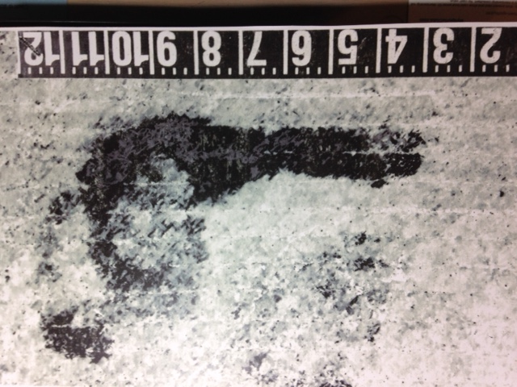
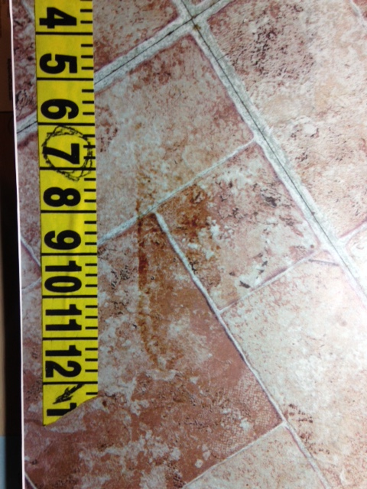
CASE SCENARIO #2
Small bloodstains were located on items surrounding the victim’s body
Fragments of apparent bloody footprints were visible on the kitchen and bathroom floors as well as the edges of the carpeting

Slide 64
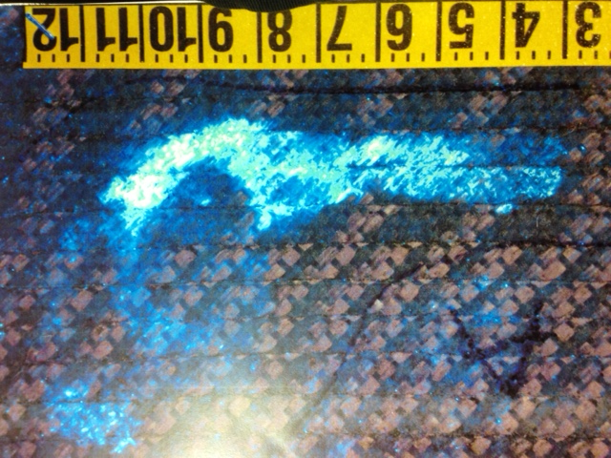
CASE SCENARIO #2
Chemical testing was used to search for latent blood resulting in revealing impressions consistent with bloody footprints.

Slide 65
CASE SCENARIO #2
Crime scene team left but later called back on a tip to process another unit at the motel.
A resident of another unit had heard loud arguing between deceased and another individual residing in unit #3.
Individual from unit #3 admitted that he and the deceased were drinking alcohol in Unit #4 but then he left after receiving a phone call.

Slide 66
CASE SCENARIO #2
Unit #3 floor plan was similar to unit #4
No items within unit #3 exhibited physical characteristics of blood.
Individual from Unit #3 had a contusion on his foot

Slide 67
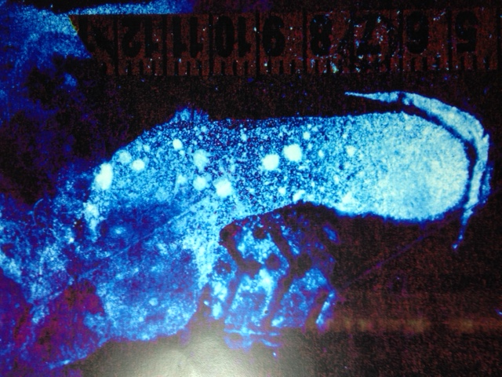
CASE SCENARIO #2
After chemical testing for latent prints, impressions were found consistent with apparent bloody footprints.

Slide 68
CASE SCENARIO #2
The shape and manner of the footprints in unit #4 lead CS Examiners to believe that an unknown person walked through the blood deposits without shoes.
They believed the person who walked through the blood without footwear was in close proximity to Unit #4 as there was snow on the ground and it was approximately 14 degrees outside.
It was felt that the person who left the prints most likely would leave similar footprints into the locale he retreated to.

Slide 69
CASE SCENARIO #2
The renter of unit #3 gave known footprint impressions barefoot and in socks similar to those found in his room
These were compared with the unknown footprint impressions using the measurement and overlay methods of comparison.

Slide 70
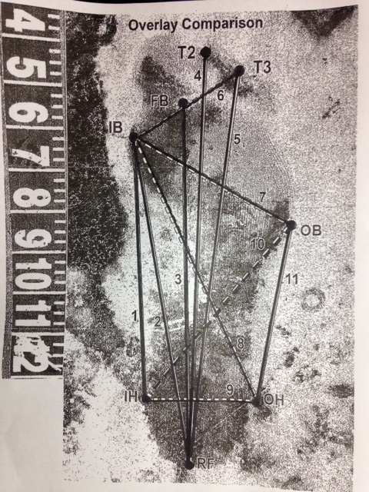
CASE SCENARIO #2
Measurement method

Slide 71
CASE SCENARIO #2
Measurement | Crime Scene Print | Known Print | Difference
Heel to inside ball | 7.87’’ | 7.87” | 0
Heel to 2nd toe | 9.75” | 9.75” | 0
Heel to 3rd toe | 9.26” | 9.26” | 0
Inside ball to 3rd toe | 2.87” | 2.87” | 0
Inside ball to outside of ball -width | 4.26” | 4.26” | 0
Inside heel to outside heel - width | 2.63” | 2.63” | 0
Inside heel to lateral most prominent ball point | 5.47” | 5.47” | 0
Outer heel to medial most prominent ball point | 6.90” | 6.90” | 0

Slide 72
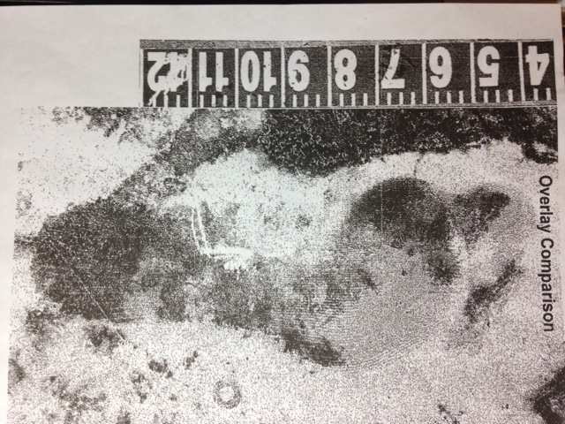
CASE SCENARIO #2
The position of the hallux, 2nd and third toes in relation to the ball of the foot is similarly positioned on both foot prints.
The web ridge demonstrates a similar morphology.
The heel is similar in terms of shape and size
The overall shape and size of the footprints are similar.

Slide 73
CASE SCENARIO #2
???VERDICT?????

Slide 74
WORKSHOP
Proper technique for barefoot impression and analysis
Requires a three person team
“T” Taping, spotter one, spotter two
Repetition of walking impression at least three times
Repetition of stepping impression at least three times

Slide 75
WORKSHOP
Overall features noted (foot zones, foot lines, positions of toes)
Measure lengths and width
Overlay comparison

