Slide 1
ESSENTIALS OF
FORENSIC PODIATRY
SHOEGEAR ANALYSIS
INSOLE ANALYSIS
UNIT 3
©Bryan Kagan 2015

Slide 2
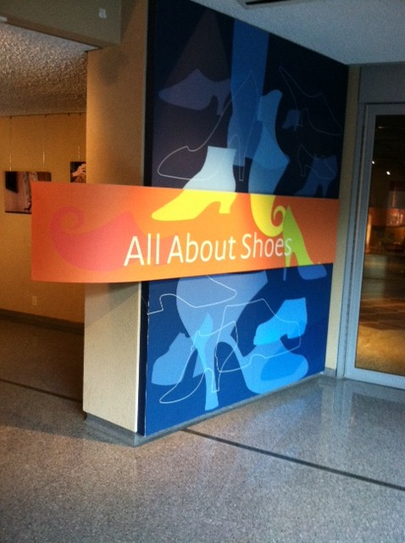
Shoe gear analysis
BATA Shoe Museum
Toronto, Canada

Slide 3
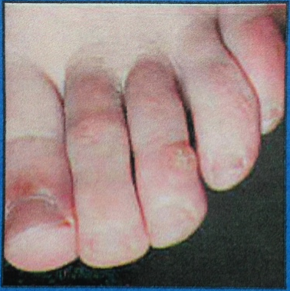
The effect of footwear on foot health

Slide 4
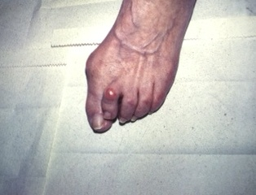
The effect of footwear on foot health

Slide 5
Potential Shoe Gear Examinations in a routine podiatry practice
20 patients per day
100 patients per week
4,500 patient visits per year
45,000 patient visits over 10 years
112,500 patient visits over 25 years
135,000 patient visits over 30 years
Total of 270,000 individual shoes for examination over 30 years
157,500 patient visits over 35 years
TOTAL of 315,000 shoes that you could have examined.

Slide 6
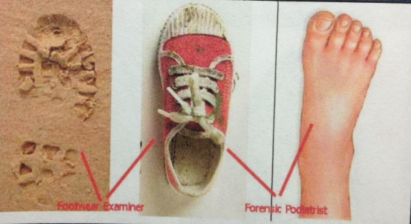
Shoe gear / footwear identification

Slide 7
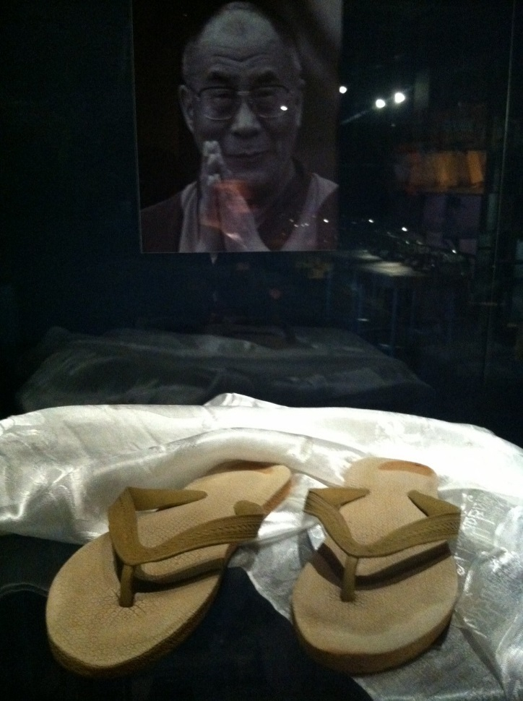
Common shoe-related questions asked of podiatrists
Is individual “x” the usual wearer of a certain specific shoe?
Do “A” and “B” shoes have the same individual wearing them?
Have there been multiple wearers of the shoes?

Slide 8
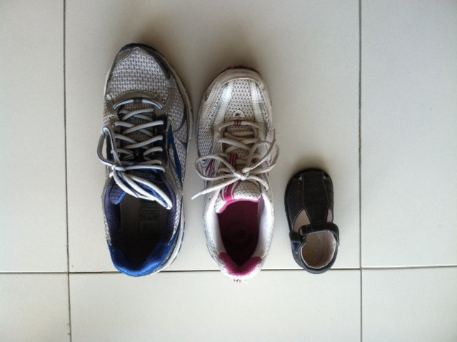
Common shoe-related questions asked of podiatrists
Could a foot fit into a particular shoe that is smaller than the foot?

Slide 9
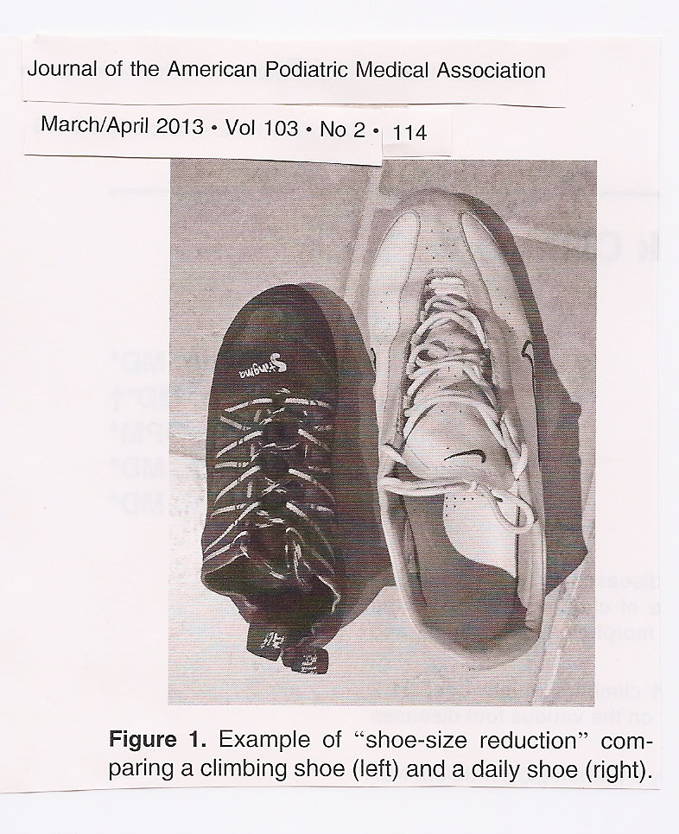
Common shoe-related questions asked of podiatrists
Can you explain [due to your podiatric knowledge and experience] differences between foot impressions, wear marks between shoes, and differences between feet and shoes?

Slide 10
Physical evidence
Physical evidence exists at class and individual characteristic levels
Class level shows consistency and compatibility.
Individual characteristics are understood to be unique.

Slide 11
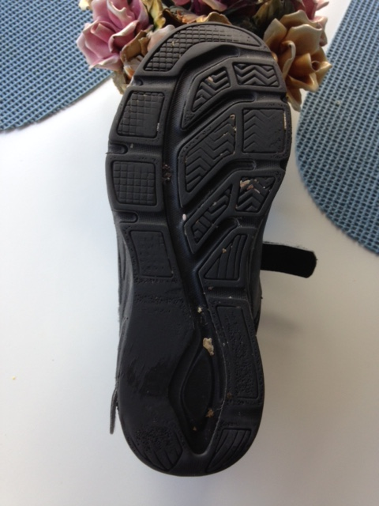
Individual characteristics
Cuts and nick marks, tears, trapped debris.
Consider size, position, shape and orientation of the damage.
Exercise care to distinguish from manufacturing repeatable defects.

Slide 12
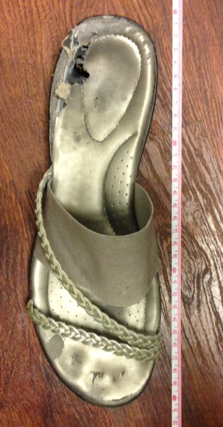
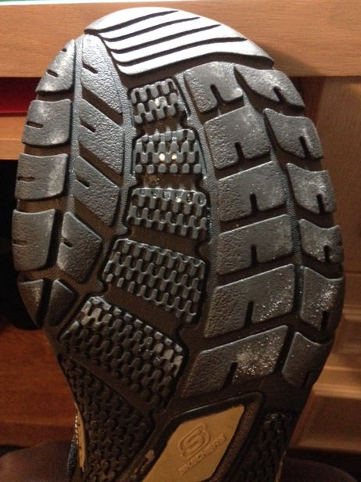
Identifying characteristics

Slide 13
Class characteristics
Shoe style
Fastening/ closure mechanism
Shoe color
Last style

Slide 14
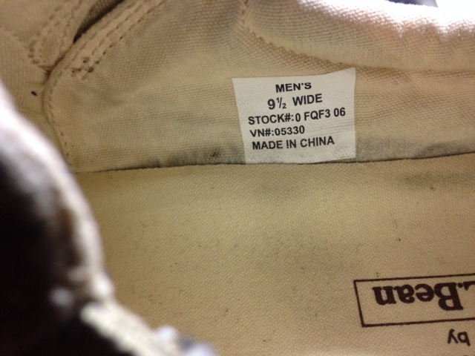
Marked shoe size
What is the marked size shoe length?
Are the questioned and known footwear compatible.

Slide 15
It is important to remember…..
AT THIS TIME THERE IS NO FORENSIC PODIATRY CHARACTERISTIC THAT HAS BEEN PROVEN TO BE UNIQUE.
We deal with class characteristics alone.

Slide 16
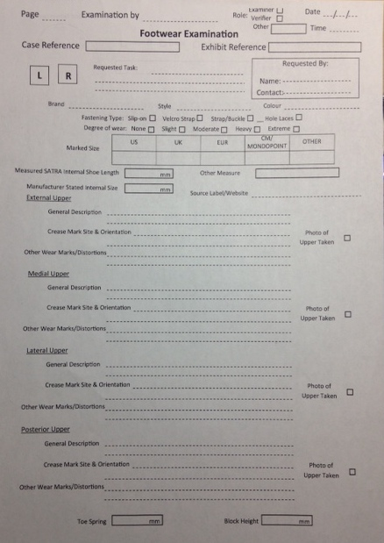

Slide 17
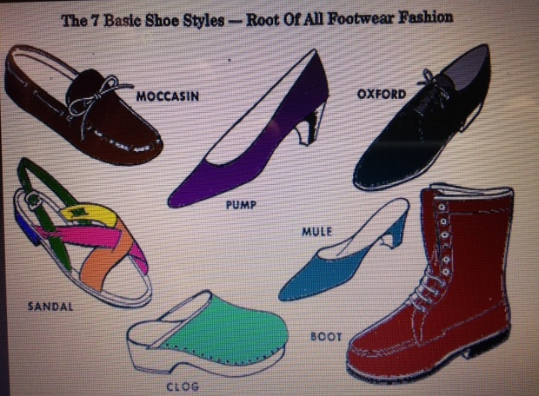

Slide 18
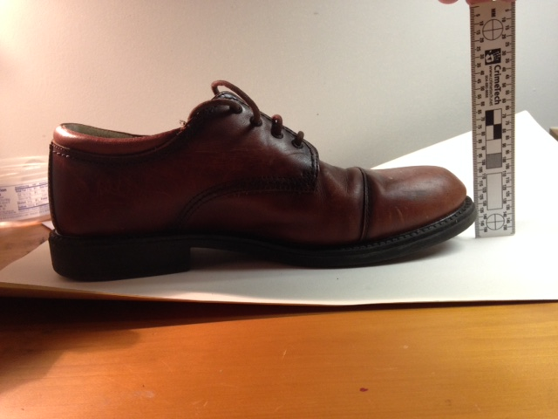
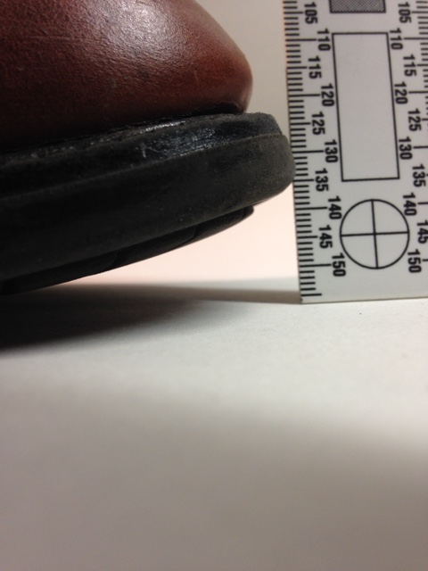
Toe spring is the elevation of the toe end of the last from the horizontal surface when the seat is raised to its correct height

Slide 19
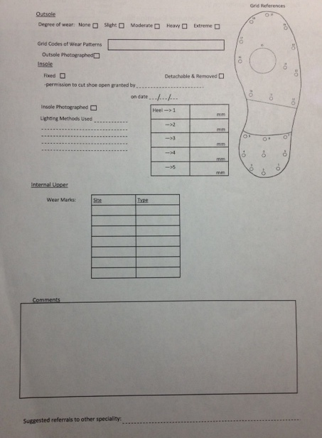

Slide 20
Combined, class characteristics create much stronger individuality
e.g. OJ Simpson case
Shoeprint found at scene of crime.
Bruno Magli shoe.
Outsole covered two Bruno Magli shoe styles.
Shoe was a size 12.
Only 29 pairs sold in the USA in that make outsole and size.
Source of purchase traced
source Bodziak W 2000

Slide 21
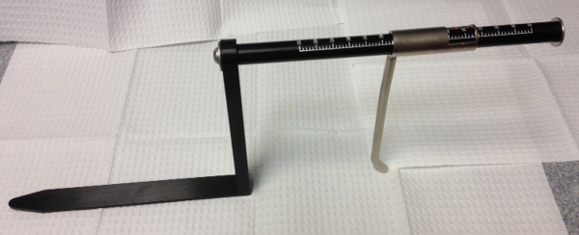
Shoe gear sizing
The SATRA Internal Shoe Size Gauge
Is designed to estimate the internal stick length of a shoe.
It consists of two probes, one rigidly connected to, and one which moves in relation to a graduated scale.
The gauge is placed in the footwear so that one probe is at the toe and one at the heel.
The stick length is given by the position of the moveable probe in relation to the graduated scale.

Slide 22
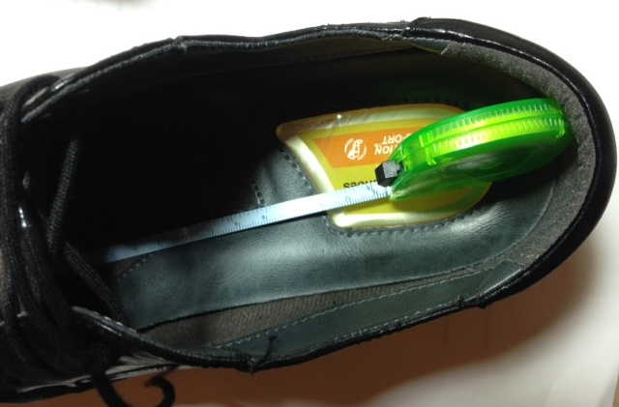
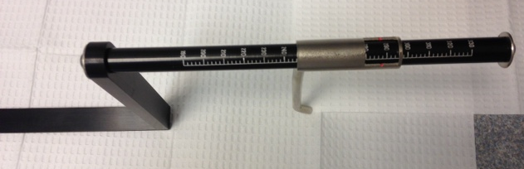
Shoe gear sizing

Slide 23
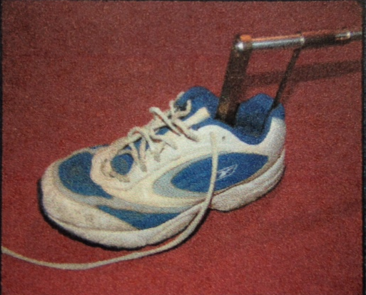
OPERATING PROCEDURES
1. Remove the laces or undo any fasteners.
2. Insert the long flat probe into the forepart of the test footwear so that it is in contact with the insole at the toe.
3. Slide the moveable probe back until it is in contact with the insole at the heel. (Take care not to apply too much force and distort the footwear.
4. Read the internal stick length from the graduated scale.
Satra Technology Owner’s Manual, p 5
Photo: DiMaggio J,Vernon W, Forensic Podiatry, Humana Press, 2011, p83

Slide 24
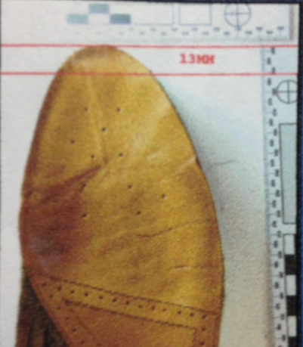
Shoe gear sizing

Slide 25
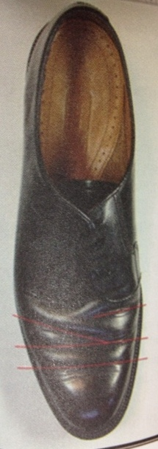
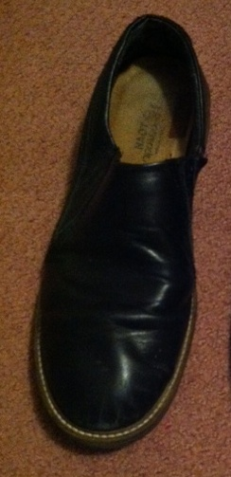
Analyze Wear
External- look for crease mark and positions
Consider all distortions
DiMaggio J, Vernon W, Forensic Podiatry, Humana Press, 2011, p90

Slide 26
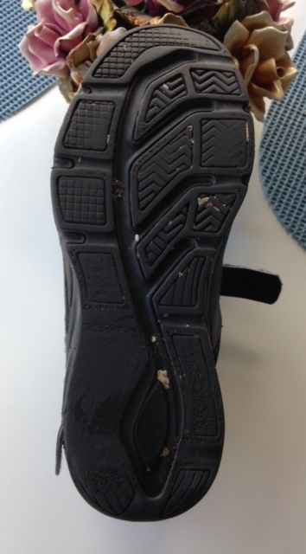
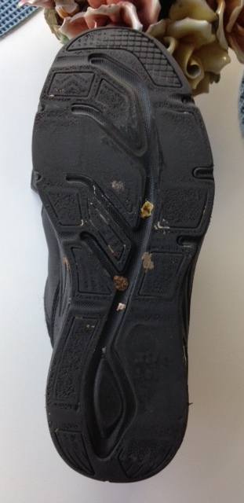
Analyze Wear
Outsole –

Slide 27
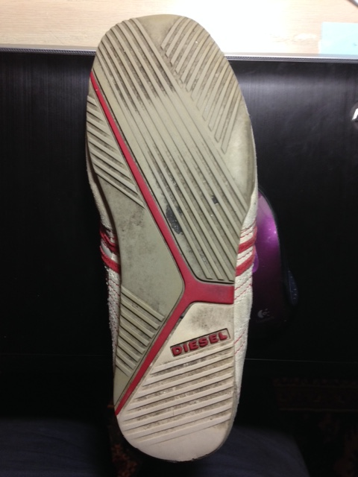
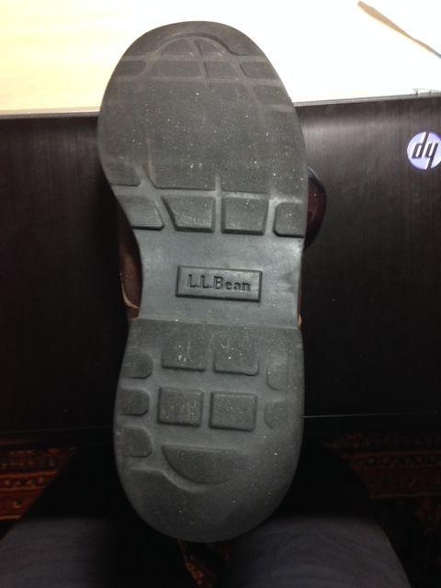
Analyze Wear
Outsole

Slide 28
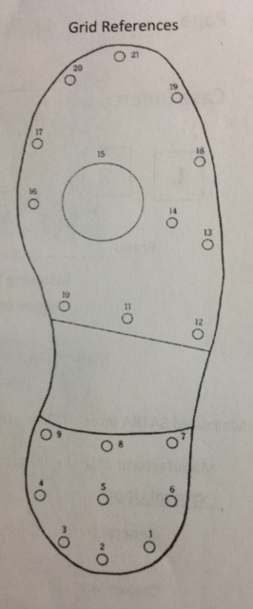
Outsole examination
Describe and compare using the focal point principle.
Consider any unusual patterns.
REMEMBER that you cannot link causal pathology in isolation…..
You need background information and context for a more accurate interpretation.
DiMaggio J, Vernon W, Forensic Podiatry, Humana Press, 2011, p 81

Slide 29
Model of shoe wear influence
Variables Influencing Form of Wear
SHOE WEAR
Primary Intention of Walking- INTRINSIC VARIABLE
Variables Influencing Amount of Wear
Foot Pathology- INTRINSIC VARIABLE
External Influence and Non-Walking Function- EXTRINSIC VARIABLE

Slide 30
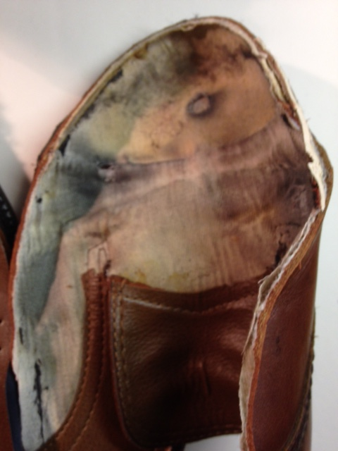
Analyze Wear
Internal Upper – look for dorsal anatomical landmarks of toes that align with the marks and impressions on the upper lining.
Further size implications.

Slide 31
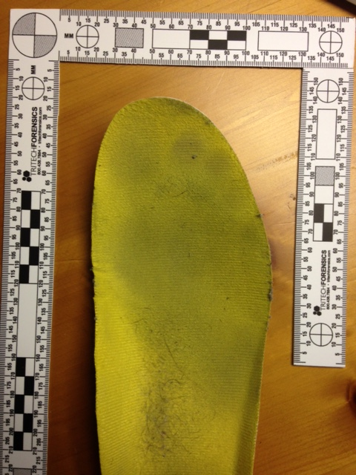
Analyze Wear
Insole –foot impressions left are the strongest source of podiatric evidence in footwear.

Slide 32
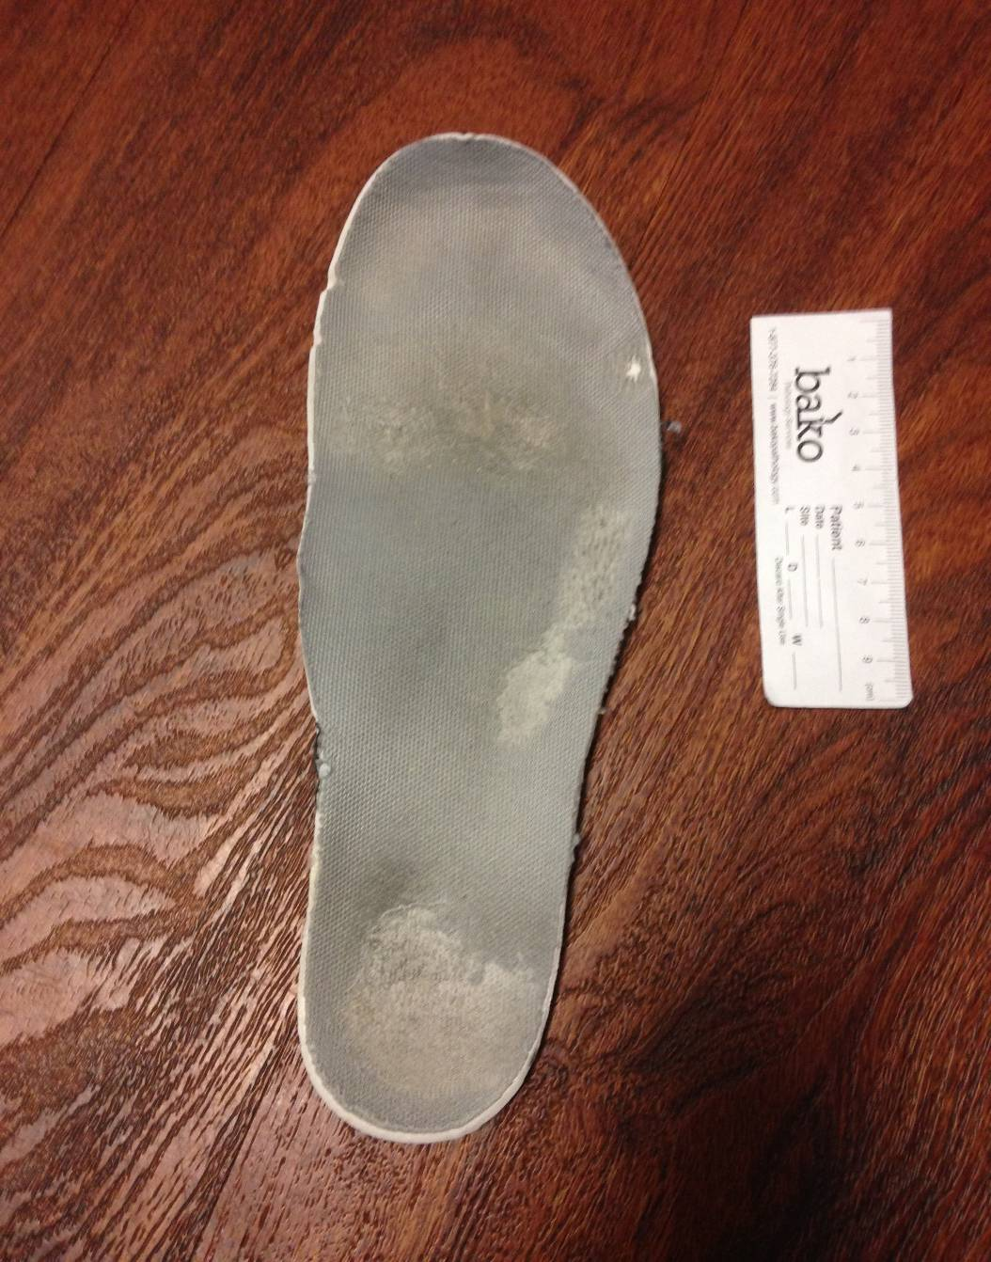
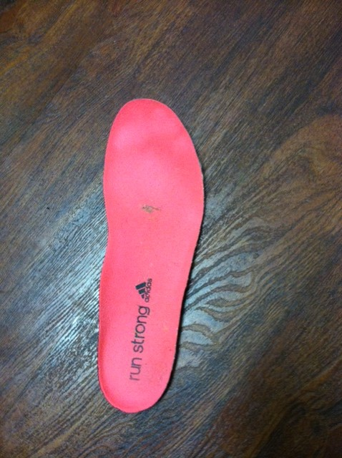
Analyze Wear

Slide 33
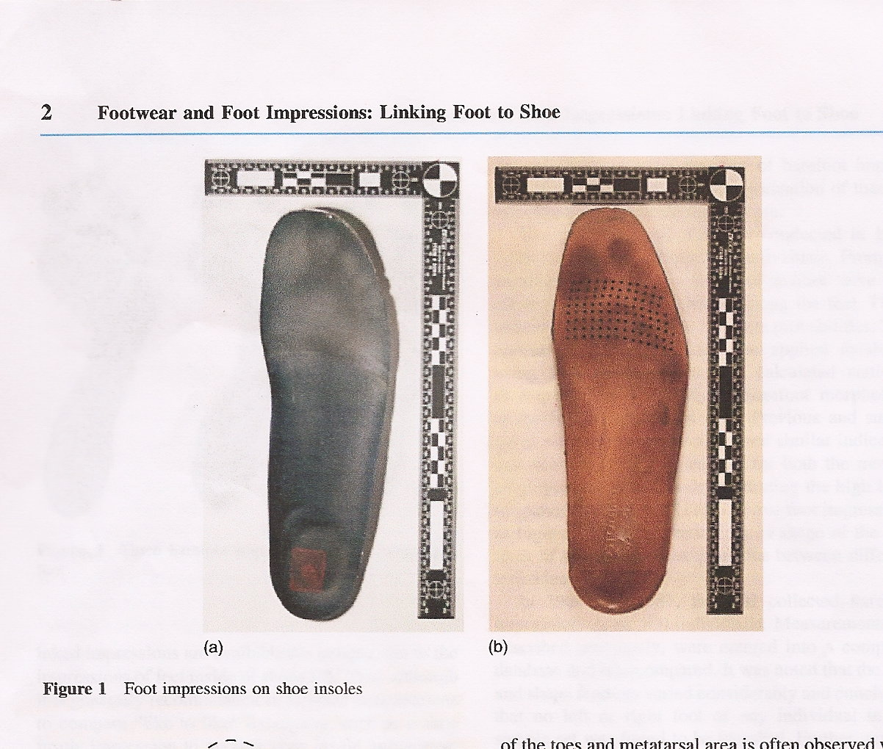
The foot impression is the strongest source of podiatry evidence in footwear.

Slide 34
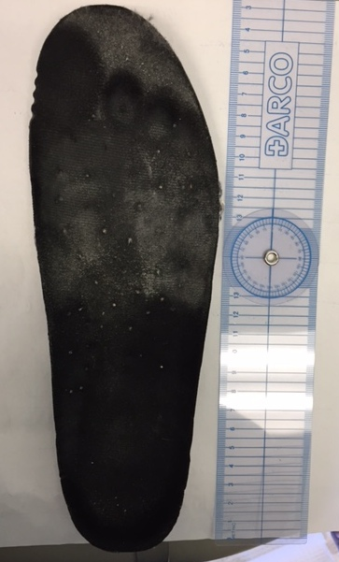
Measure with device

Slide 35

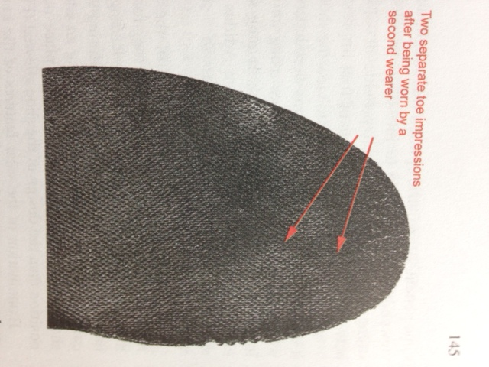
Single/multiple wearer

Slide 36
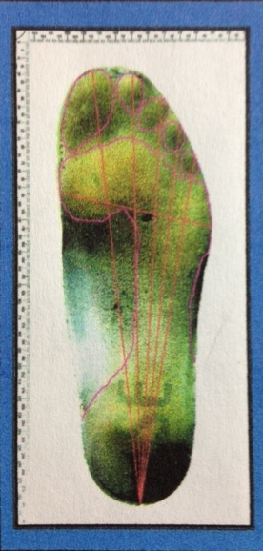
Insole examination
The techniques are as in barefoot print analysis.
BUT in-shoe and barefoot impressions are different
With your podiatric knowledge and clinical experience
A. consider the interaction of footwear.
B. consider the effects of function.
C. consider the implication of the impression of the foot versus the shoe size.
Sheffield NHS Teaching Hospital, Forensic Podiatry Workshop, Professor Wesley Vernon OBE©2010

Slide 37
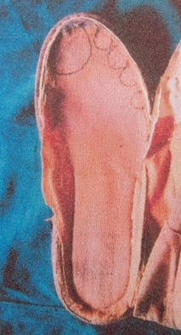
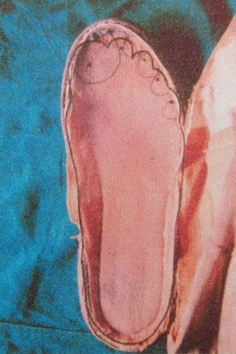
Insole Case example

Slide 38
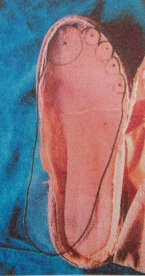
Insole case example

Slide 39
Case study “A”
Forensic Podiatry Workshop © Professor Wesley Vernon OBE
Involved a homicide.
At the side of the highway were Reebok® trainers.
Blood on the trainers were tested for DNA and matched the victim.
Based on a tip, a suspect was apprehended and Adidas® trainers were seized from the suspect for comparison.

Slide 40
Case study “a”
Forensic Podiatry Workshop © Professor Wesley Vernon OBE
R/1 and R/2 – The questioned Reebok® trainers associated with the crime.
A/1 and A/2 - Adidas® trainers owned by the suspect that were used for comparison

Slide 41
Case study “a”
Forensic Podiatry Workshop © Professor Wesley Vernon OBE
R/1 and R/2 – The questioned Reebok® trainers associated with the crime.
Marked UK size 8
Internally sized as 8
Additional anterior crease mark.
Position of the 1st toe impression in the upper noted.
Anterior toe impression position noted.
Anterior dorsal displacement of the shoe insoles noted.
Tip wear
A/1 and A/2 - Adidas® trainers owned by the suspect that were used for comparison.
Marked UK size 8
Internally sized as 7
No toe positions noted
No upper crease mark noted
No tip wear noted

Slide 42
Case study “a”
Forensic podiatry Workshop© professor Wesley Vernon obe
R/1 and R/2 – The questioned Reebok® trainers associated with the crime.
Marked UK size 8
Internally sized as 8
Additional anterior crease mark.
Position of the 1st toe impression in the upper noted.
Anterior toe impression position noted.
Anterior dorsal displacement of the shoe insoles noted.
Tip wear
A/1 and A/2 - Adidas® trainers owned by the suspect that were used for comparison.
Marked UK size 8
Internally sized as 7
No toe positions noted
No upper crease mark noted
No tip wear noted

Slide 43
Case study “a”
Forensic Podiatry workshop© professor Wesley Vernon obe
R/1 and R/2 – The questioned Reebok® trainers associated with the crime.
Marked UK size 8
Internally sized as 8
Additional anterior crease mark.
Position of the 1st toe impression in the upper noted.
Anterior toe impression position noted.
Anterior dorsal displacement of the shoe insoles noted.
Tip wear
Trainer is too long for the wearer.
A/1 and A/2 - Adidas® trainers owned by the suspect that were used for comparison.
Marked UK size 8
Internally sized as 7
No toe positions noted
No upper crease mark noted
No tip wear noted
Trainer is correctly sized for the wearer

Slide 44
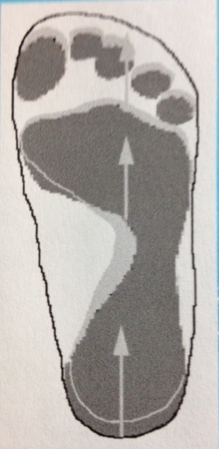
Case study “a” comparison
Shapes of the anterior ball of the feet were similar.
Toe position differences – the impressions in trainer “R” were 1/3 inch (8.466mm) longer than those in trainer “A”
The difference of 1/3 inch is the exact measured difference between UK shoe sizes.

Slide 45
Case study “a” comparison
In the Reebok® trainers which were too long for the wearer, the foot would be able to slide forward to the position it would have adopted in a trainer of the correct fit, making that impression longer than the foot length would suggest.

Slide 46
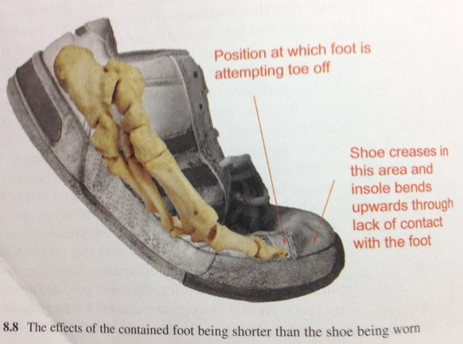
Case study “A”
DiMaggio J, Vernon W, Forensic Podiatry, Humana Press, 2011, p146.
Conclusions
Shoe size difference would justify toe position differences observed in terms of ownership.
In terms of “likelihood ratios”, the explanation for shoe size differences within this context increased the strength of support for the shoe impression evidence.

Slide 47
Be careful….be cautious
When shifting from the clinical mindset to the forensic identification mindset.
Don’t overstate the certainty of this evidence.

Slide 48
Case Study “B” forensic podiatry workshop, Sheffield nhs, ©professor Wesley Vernon obe 2010
A fight had taken place, leading to a homicide of a man.
Various witnesses stated that an involved woman was seen without her shoes.
One witness stated that he saw the woman striking the man in the head with her shoe.
The woman said she had not removed her shoes to be used as a weapon but that they were off her feet because they were too large and she regularly walked out of them.

Slide 49
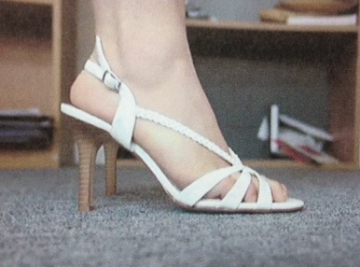
Case Study “B” forensic podiatry workshop, Sheffield nhs, ©professor Wesley Vernon obe 2010
What is your task??

Slide 50
Case Study “B” forensic podiatry workshop, Sheffield nhs, ©professor Wesley Vernon obe 2010
Task Required
To examine the woman and her footwear.
To determine whether her story (that the shoes were too large for her and they regularly fell off) could be substantiated.

Slide 51
Case Study “B” forensic podiatry workshop, Sheffield nhs, ©professor Wesley Vernon obe 2010
Areas of Interest
The basic fitting dimensions of the woman’s feet.
The fit of footwear similar to the questioned shoes, when worn by the woman.
The basic fitting dimensions and design variables of the questioned shoes.
Any diagnostic indications of the way the questioned shoes had fitted their usual wearer.

Slide 52
Case Study “B” forensic podiatry workshop, Sheffield nhs, ©professor Wesley Vernon obe 2010
Assessment: Individual’s Feet
Bilateral Greek ideal
Short, slightly clawed 5th toes bilaterally
Healed abrasions at back of heels
Both 1st medial sulci slightly inflamed
R/F (Right foot) size 4 ½, 5 , width E/F
L/F (Left foot) size 5, width D/E
Indicative shoe size 5E

Slide 53
Case Study “B” forensic podiatry workshop, Sheffield nhs, ©professor Wesley Vernon obe 2010
Assessment: Footwear
Questioned footwear: elasticized sling back high heeled sandal
Matched footwear was of a slightly different pattern, but of same style and dimensions
Size of questioned and matched footwear (5) confirmed with SATRA® internal size gauge
Position of foot impression in questioned shoes suggested correct length for usual wearer, but inadequate width
Sling back on questioned shoes positioned on its tightest setting

Slide 54
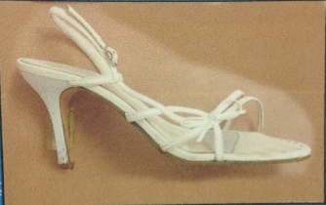
Case Study “B” forensic podiatry workshop, Sheffield nhs, ©professor Wesley Vernon obe 2010

Slide 55
Case Study “B” forensic podiatry workshop, Sheffield nhs, ©professor Wesley Vernon obe 2010
Assessment: Wearing of Similar Footwear
Reliance on sandal gripping the foot across ball area and attachment at back of heel area
Appropriate length fitting, though left foot fitted slightly further forward than right
Heel to ball fitting appropriate
Inadequate ball width
Toe pressure from styling of shoe
Sling back fitted snugly on 3rd tightest setting out of 4 setting options

Slide 56
Case Study “B” forensic podiatry workshop, Sheffield nhs, ©professor Wesley Vernon obe 2010

Slide 57
Case Study “B” forensic podiatry workshop, Sheffield nhs, ©professor Wesley Vernon obe 2010
EVALUATION:
Movement required in order to lift heel out of shoe was an extreme forced dorsiflexion and not to be expected in normal walking
High heel shoe design concentrates the body weight on the ball of the foot, affecting the heel to ball action as the need for heel lift is reduced
In a shoe with a heel height greater than 2 inches, there will be no further heel rise as the shoe has already fully accounted for this rise

Slide 58
Case Study “B” forensic podiatry workshop, Sheffield nhs, ©professor Wesley Vernon obe 2010
CONCLUSION:
No evidence to support the claim that the woman walked out of the shoes because they were too large for her

Slide 59
Case Study “B” forensic podiatry workshop, Sheffield nhs, ©professor Wesley Vernon obe 2010
VERDICT:
Found GUILTY of murder

Slide 60
Keep in Mind
We need to understand “scientific knowledge” has its limitations.
We need to recognize that the essential element of forensic practice is interpretation.
We need to recognize that in order to correctly interpret, we must appreciate the context.
Context is everything!

Slide 61
Day to day activity affects wear of shoes

Slide 62
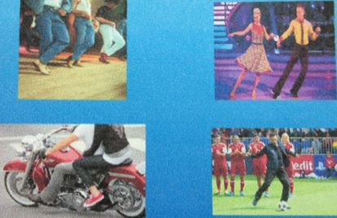
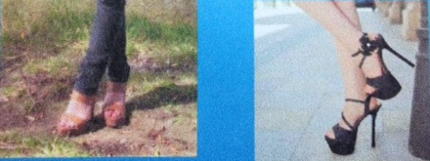
Context is everything
©Forensic Podiatry Workshop, Professor Wesley Vernon OBE 2010
Hobbies
Habits

Slide 63
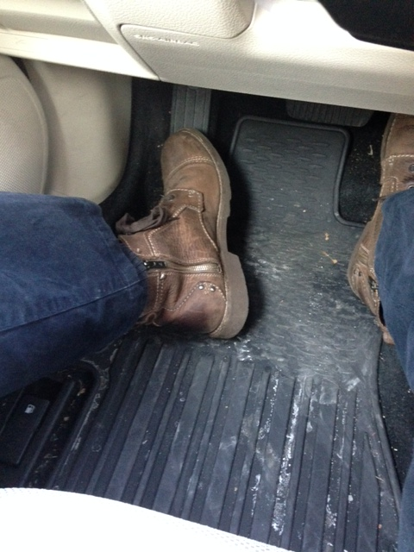
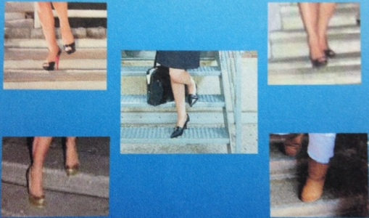
Context is everything
Driving- Abrasion
Walking Down Stairs
©Forensic Podiatry Workshop, Professor Wesley Vernon OBE

Slide 64
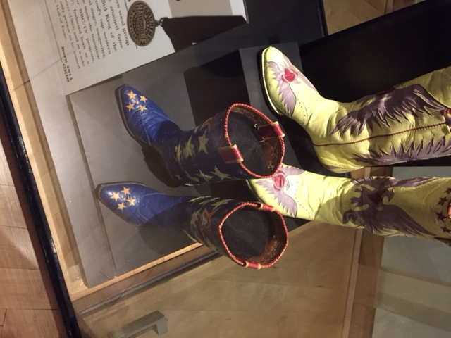
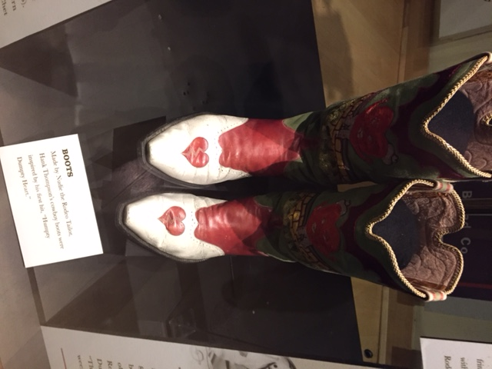
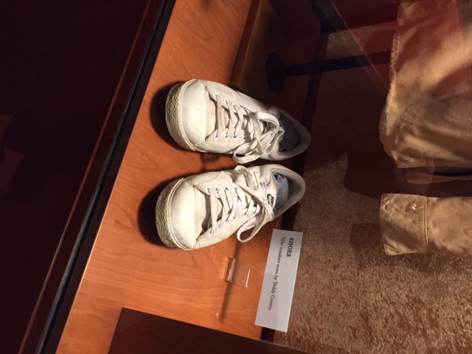
Context is Everything!!!

Slide 65


Context is everything
Abrasion
General Trauma

Slide 66


Context is everything
Brick
Concrete

Slide 67


Context is everything
Environment
Decking

Slide 68


Slide 69


Slide 70
R v T
In R v T [2010] a judgment was delivered in the Court of Appeals, Criminal Division, that in footwear evidence, no attempt could be realistically made in the generality of cases to use a formula to calculate probabilities.
The practice had no sound basis.
Outside of DNA, Bayes theorem and Likelihood ratios should not be used.

Slide 71
R v T
Homicide case.
The issue was identification.
An expert with extensive experience of footwear marks, compared footwear marks from the crime scene with trainers found in the defendant’s house after his arrest.
The expert opinioned that there was a “moderate degree of scientific evidence” to support his view that the trainers recovered at the defendant’s house had made those marks that were left at the crime scene.

Slide 72
R v T http://www.criminallawandjustice.co.uk/clj-reporter/R-v-T-2010-All-ER-D-240-Oct-2010
There was no statistical information or reference to Likelihood ratios in his report.
The practice of using likelihood ratios to formulate opinions placed before a jury, without disclosing is contrary to the principles of open justice.
For future cases, strict compliance with the obligation of transparency should ensure that in each case where an expert provider of forensic opinion seeks to develop a new way of arriving at an opinion, that new way can be examined in open court applying the ordinary principles for the admissibility of expert evidence.

Slide 73

Recommended reading
    Vernon w., The Development and Practice of Forensic Podiatry”, JCFM, Oct. 2006, p 2284-7
    Vernon et al. The Role and Scope of Practice of Forensic Podiatry, www.theiai.org/disciplines/podiatry/podiatry_role_and_scope.pdf

