Slide 1
BRYAN B. KAGAN, DPM, MCSFS, DASFP DEPARTMENT OF COMMUNITY MEDICINE NYCPM 2017 BBK©2017
ESSENTIALS OF
FORENSIC PODIATRY
Unit 1 Part 2

Slide 20
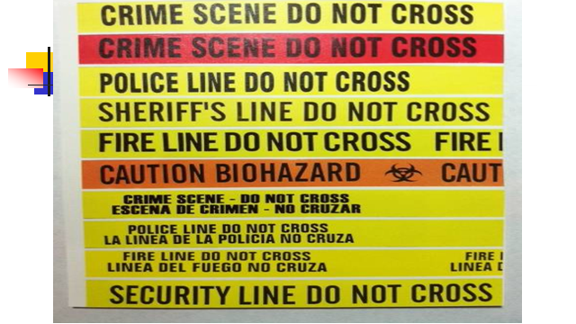

Slide 28
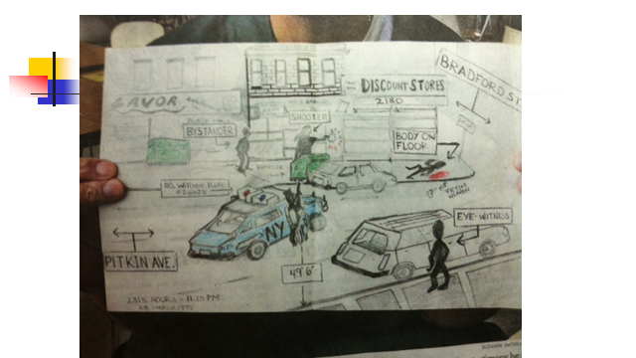

Slide 33
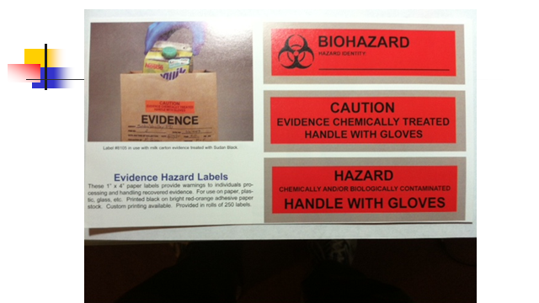

Slide 36
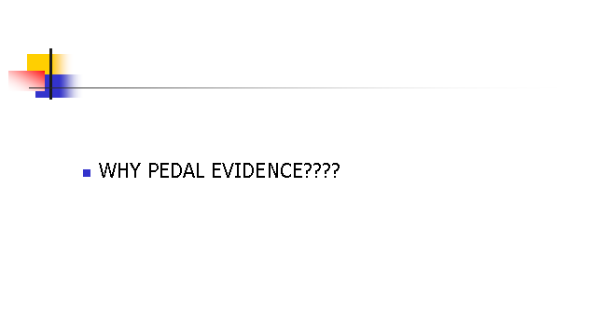

Slide 37
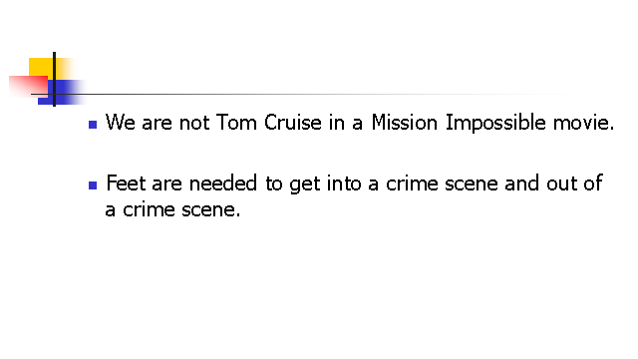

Slide 50
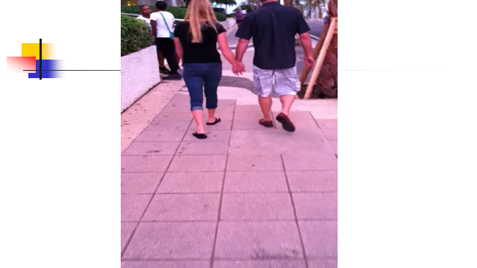

Slide 51
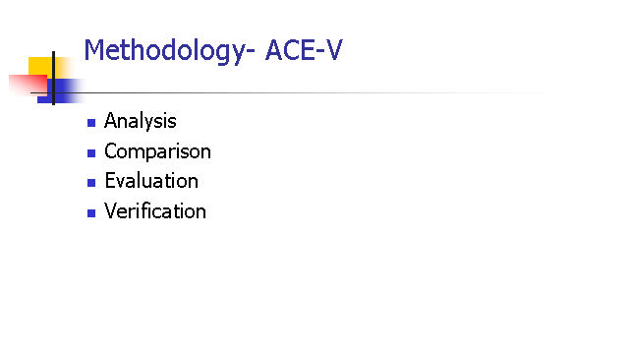

Slide 58
