Slide 1
Forensic Podiatry
Forensic Gait Analysis
©Bryan Kagan 2015

Slide 2
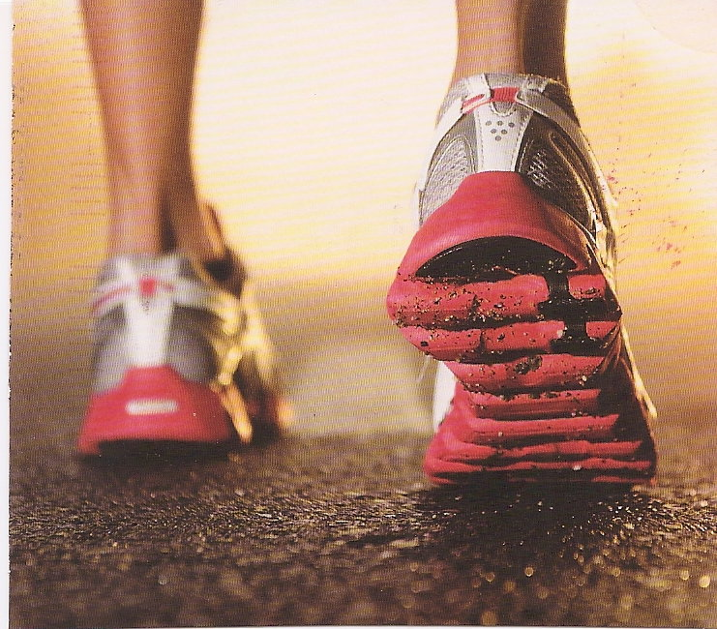
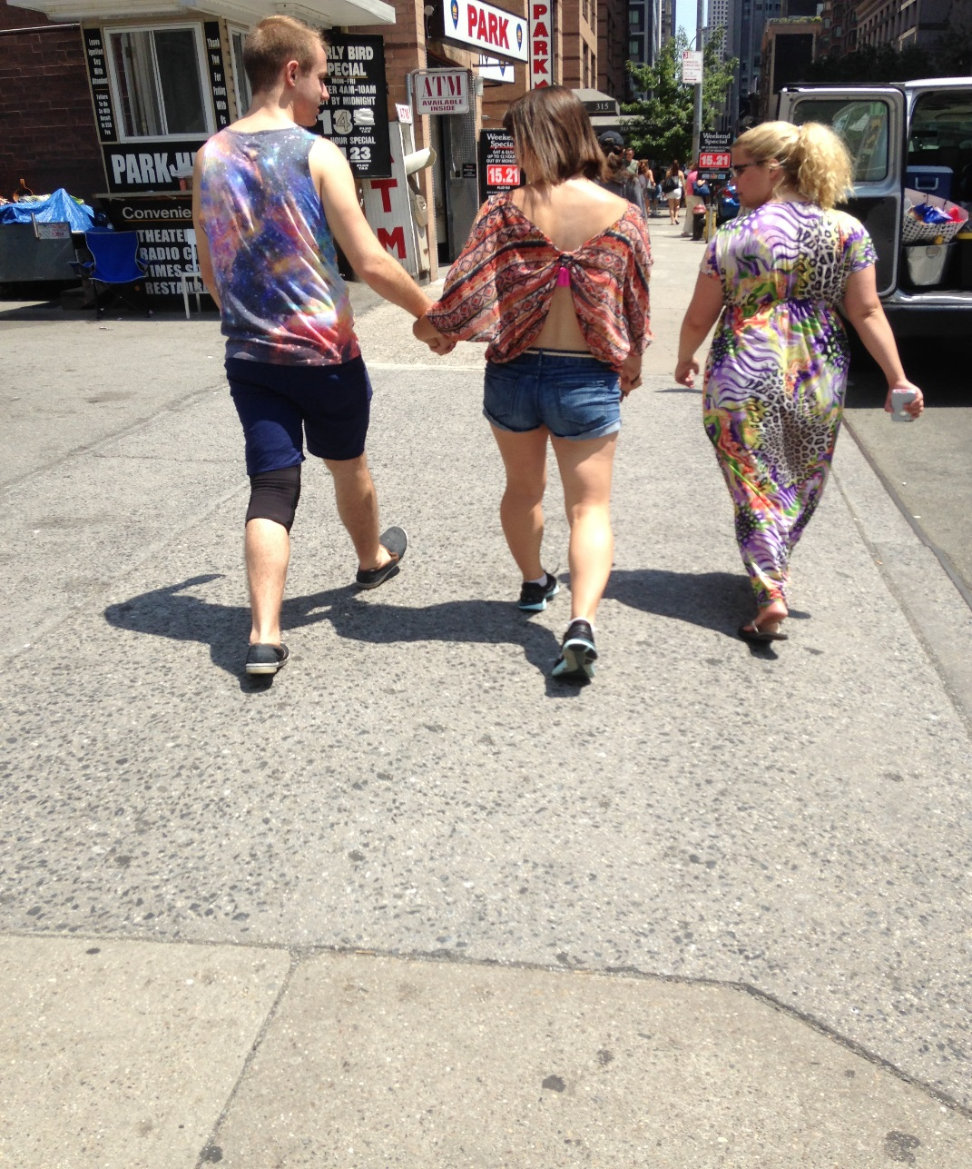
Gait is the manner of walking, stepping

Slide 3
John Wayne had his swagger.
Naomi Campbell sashays along the catwalk in a certain way.
John Cleese has his elongated strides for the Ministry of Silly Walks.
But it is not just stars that have recognizable walking features and patterns.
We all have a signature walking style that can be identified much like a fingerprint.
http://www.Southampton.ac.uk/research/southamptonstories/medhealthlike/walk_this_way.

Slide 4
The identification of individuals by observational gait analysis using closed circuit television footage.
Birch I,Raymond L,Christou A,Fernando MA, Harrison N, Paul F. Sci Justice. 2013 Dep;53(3):339-42
The results of this study suggest that individuals with experience in gait analysis perform well in the comparative identification of suspects from CCTV footage and therefore DO have a role to play as expert witnesses in the field.

Slide 5
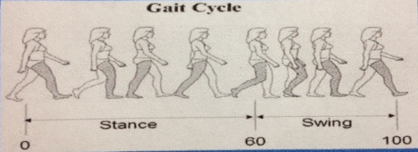
Gait cycle is one of repetitive movements
Stance and swing phase
Single and double support phases
Forensic Podiatry Workshop ©Professor Wesley Vernon OBE 2010

Slide 6
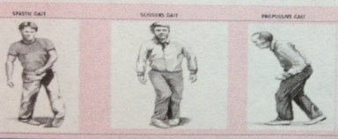
First Phase recognizing deviations and problems relating to lower limb and movement
Forensic Podiatry Workshop ©Professor Wesley Vernon OBE 2010

Slide 7
There are two methods to quantify and interpret human locomotion
1. Subjective or qualitative- a non-numerical evaluation of movement, usually visual. Experience- based skill learned and improved with practice.
2. Objective or quantitative- a numerical evaluation of movement from data collected and analyzed by technology.

Slide 8
Forensic Gait Analysis- (FGA)
“Forensic Gait Analysis involves the recognition and comparison of gait and features of gait to assist in the process of identification.” (DiMaggio& Vernon 2011)

Slide 9
Forensic Gait Analysis- (FGA)
“Forensic Gait Recognition identifies individuals by the unique characteristics of their manner of walking” where “features are extracted from a person’s gait in order to recognize them.” (Grant, 2006)

Slide 10
Engineers from the Southampton’s School of Electronics and Computer Science (ECS) have been working on a computer sytem that can analyze the gait of criminals caught on CCTV and then compare them with those of a suspect.
Research started by Professor Mark Nixon in the early 1990s after the murder of Jamie Bulger.
http://www.Southampton.ac.uk/research/southamptonstories/medhealthlike/walk_this_way.

Slide 11
The police only had grainy CCTV pictures of two main suspects walking away from the crime scene. Their faces were obscured so the only characteristic they could rely on for identification purposes was their gait.
http://www.Southampton.ac.uk/research/southamptonstories/medhealthlike/walk_this_way.

Slide 12
Forensic Gait Analysis- (FGA)
Forensic Gait Analysis is usually an analysis of CCTV (Closed Circuit Television)

Slide 13
Professor Nixon explains that subtle differences in physical attributes such as muscle strength, bone density and visual acuity all contribute to a personal walking style.
What do you think? Yes/No?????
Discuss why……
http://www.Southampton.ac.uk/research/southamptonstories/medhealthlike/walk_this_way.

Slide 14
Gait recognition can have significant implication for the police and crime investigators.
Its difficult for someone to disguise the way they walk.
Police used it in Sweden to identify a robber involved in a bank raid in which a customer was killed.
http://www.Southampton.ac.uk/research/southamptonstories/medhealthlike/walk_this_way.

Slide 15
Clinical versus Forensic Gait Analysis
Clinical Practice
Biomechanical/Gait Assessment
FGA
Gait Analysis

Slide 16
Clinical versus Forensic Gait Analysis
Clinical Practice
Biomechanical/Gait Assessment
Non Weight-bearing
FGA
Gait Analysis
Assist in identification

Slide 17
Clinical versus Forensic Gait Analysis
Clinical Practice
Biomechanical/Gait Assessment
Non Weight-bearing
Weight-bearing/Stance
FGA
Gait Analysis
Assist in identification
To understand the differences

Slide 18
Clinical versus Forensic Gait Analysis
Clinical Practice
Biomechanical/Gait Assessment
Non Weight-bearing
Weight-bearing/Stance
Gait Analysis
FGA
Gait Analysis
Assist in identification
To understand the differences
Potential for error (Vernon 2000) However if aware of this, it can be a valuable tool

Slide 19
Clinical versus Forensic Gait Analysis
Clinical Practice
Biomechanical/Gait Assessment
Non Weight-bearing
Weight-bearing/Stance
Gait Analysis
To understand the how and why
FGA
Gait Analysis
Assist in identification
To understand the differences
Potential for error (Vernon 2000) However if aware of this, it can be a valuable tool

Slide 20
FGA
Until recently the domain of forensic podiatrists, now human movement scientists are becoming involved.
Biometric systems are being developed by electronic and computing engineers. It is not yet in practical use.
Other medical and biomedical disciplines with gait and movement background knowledge are entering the field.

Slide 21
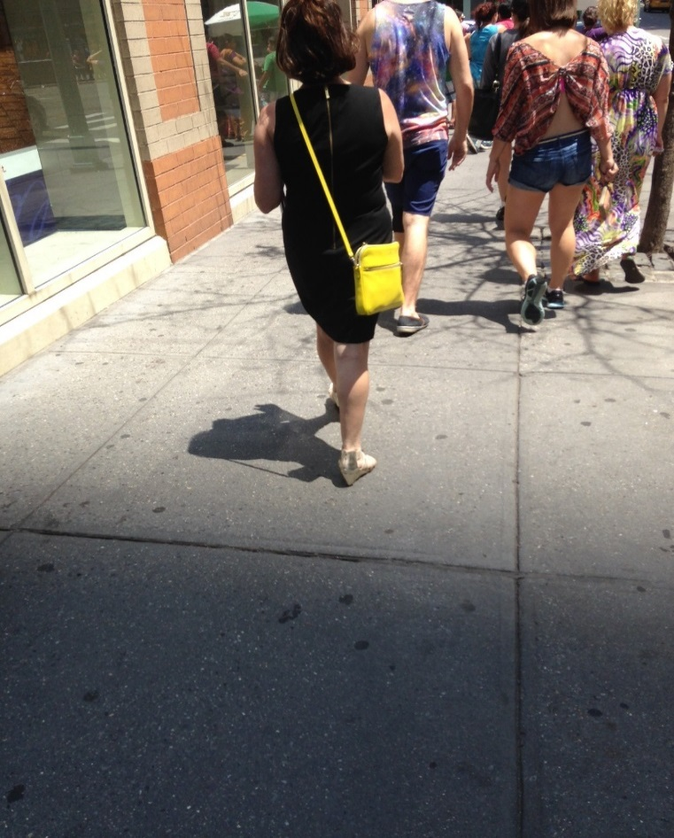
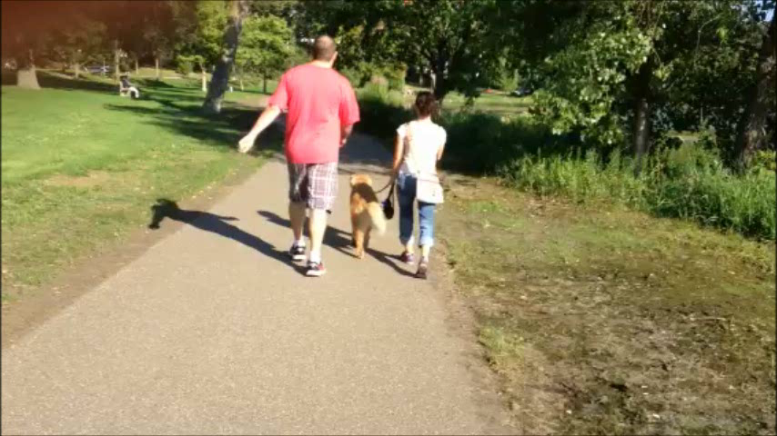
The Process

Slide 22
Gait Anomalies
When observed can be supported by the use of wear features of the footwear.
When observed can be supported by the individual’s medical records.

Slide 23
Recognizable gait features in FGA DiMaggio J, Vernon W, Forensic Podiatry, Principles and Methods, Humana Press, p112, 2011
ABduction
Adduction
Ankle equinus
Ataxic gait
Calcaneal gait
Chorea
Drop foot
Excessive ankle dorsiflexion

Slide 24
Recognizable gait features in FGA
Genu Valgum
Genu varum (bow legged)
Hemiplegic gait
High stepping gait
Limping
Paraplegic gait
Pronated gait
Scissor gait

Slide 25
Recognizable gait features in FGA
Shuffling gait
Tibial varum
Toe walking
Waddling gait
??Bopping gait??

Slide 26
How can you identify a criminal by the way they walk? http://news.bbc.co.uk/2/hi/uk_news/magazine/7348164.stm
With the ubiquity of CCTV cameras, many of which produce only very low quality pictures, the use of forensic podiatry is booming. [UK]
First used in 2000, in the UK by Haydn Kelly.
Criminal Rigg was exhibiting some form of genuvarum or bow-leggedness.

Slide 27
How can you identify a criminal by the way they walk? http://news.bbc.co.uk/2/hi/uk_news/magazine/7348164.stm
There are many distinctive conditions to look for.
The suspect might display circumduction when walking or..
Abduction of the arm, moving out to the side.
Look how they use their head, their shoulders, their arms and their elbows.

Slide 28
How can you identify a criminal by the way they walk? http://news.bbc.co.uk/2/hi/uk_news/magazine/7348164.stm
Your analysis may explain how holding an object like a knife alters the gait or…
How wearing bulky or baggy clothes does not stop the analysis.
Gait analysis is not like fingerprinting where a 100% match can be found but there is a sliding scale of likelihood.

Slide 29
Perpetrators of crime have been captured on CCTV
Use the same METHODOLOGY- ACE
Analysis
Comparison
Evaluation

Slide 30
Perpetrators of crime have been captured on CCTV
Analysis – Visual recognition of gait features by a competent forensic podiatrist.
Comparison – Compare the features recognized to those features seen in the recordings of the known individual.
An individual’s medical records and footwear wear features can also be used in the comparison.

Slide 31
Perpetrators of crime have been captured on CCTV
Evaluation – The significance of matched and unmatched features are evaluated referencing to published research, clinical data, and clinical experience.
Conclusion – The strength of the conclusion is stated.

Slide 32
Forensic Gait vs. Clinical Gait Analysis
Quality of recordings available
Other variables with which examiner has to be aware of.

Slide 33
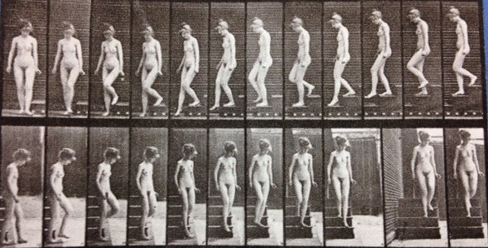

Is this Forensic Gait Analysis or not??

Slide 34
So how reliable is FGA?
RELIABILITY – Are the measures of looking at this consistent?
VALIDITY – Are we looking at what we think we are looking at?

Slide 35
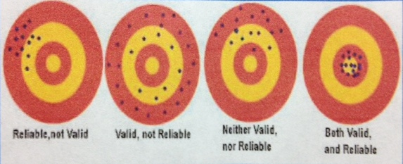
Reliability vs. Validity

Slide 36
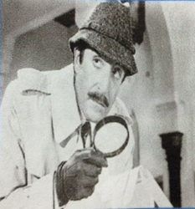
Forensic Gait Analysis is based on “expert” observation which potentially is prone to error

Slide 37
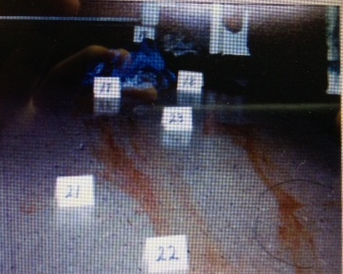
Forensic Gait Analysis is based on “expert” observation which potentially is prone to error

Slide 38
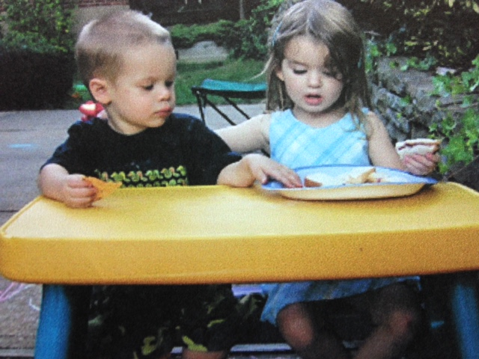
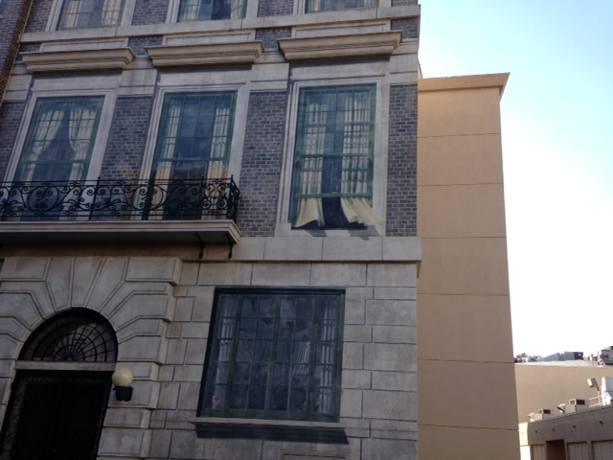
Forensic Gait Analysis is based on “expert” observation which potentially is prone to error

Slide 39
Forensic Gait Analysis requires:
Expertise in gait recognition
The ability to consider and account for the variables in assessing gait in a real world situation recognizing the limitations of technology.

Slide 40

Factors to Consider #1
Is the individual close enough for you to distinguish visibly the details of their gait.

Slide 41
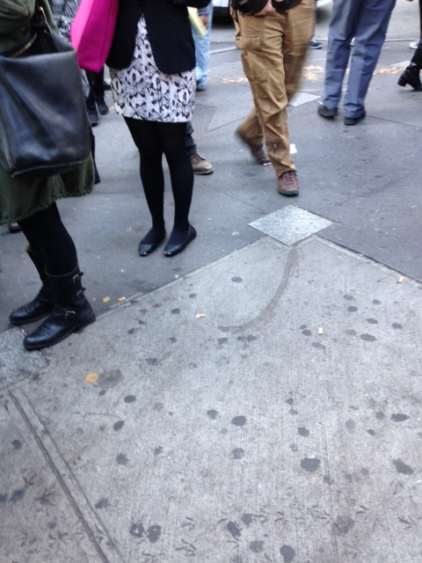
Factors to Consider #2
Is what you are looking at gait?

Slide 42
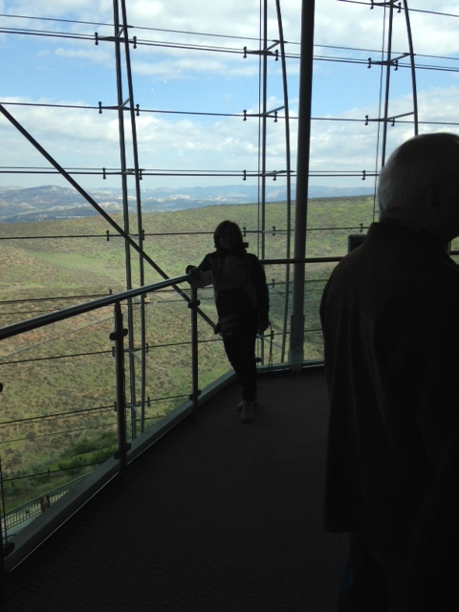
Factors to Consider #3
Are the images of suitable quality for you to proceed?

Slide 43
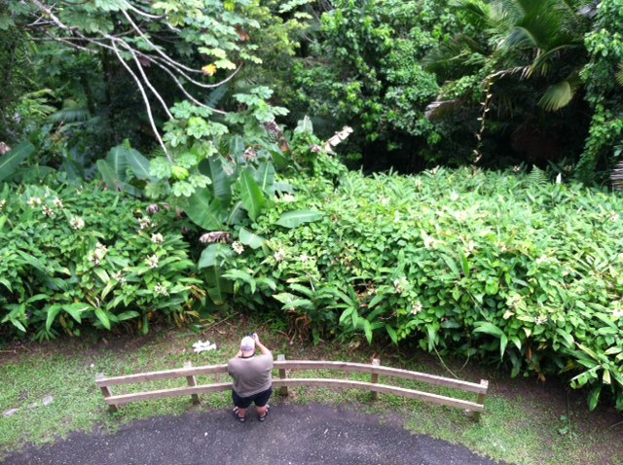

Factors to Consider #4
you to do a comparison??
Does the angle of view allow

Slide 44
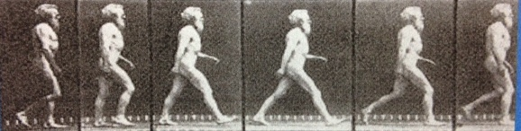
Factors to Consider #5
Is the frame rate too fast or too slow?

Slide 45
The effect of frame rate on the ability of experienced gait analysts to identify characteristics of gait from closed circuit television footage. Birch I, Vernon W, Burrow G, Walker J. Sci Justice. 2014 Mar;54(2): 159-633
Frame rate affects the ability of experienced practitioners to identify characteristics of gait captured on CCTV footage.
Study was of analyzing walking at 25 frames/sec to 1 frame/sec.
Every effort should be made to ensure that CCTV footage used in criminal proceedings be captured at as high a frame rate as possible

Slide 46
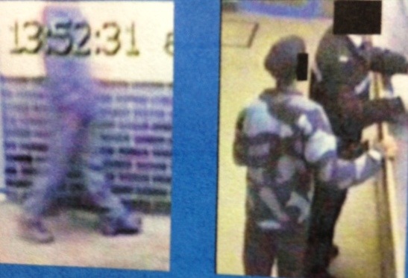
Factors to Consider #6
Are the subjects body viewed adequately? Y/N??

Slide 47
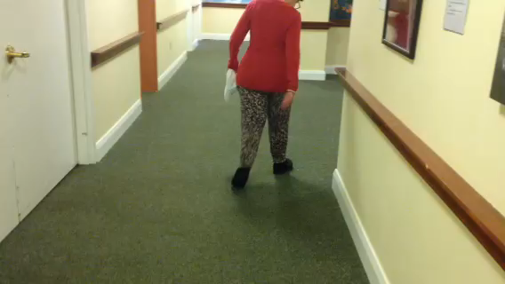
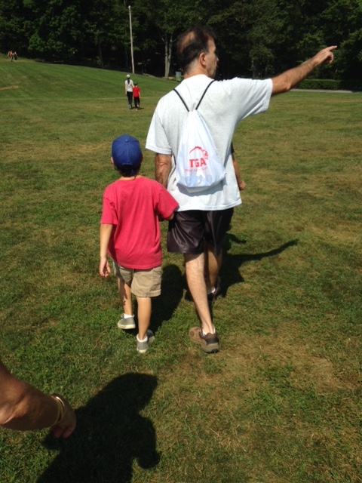
Factors to Consider #7
How many steps are in view??

Slide 48
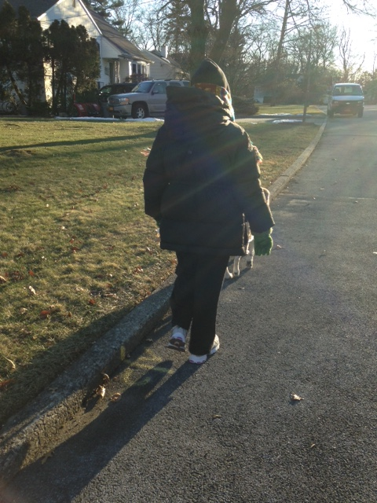
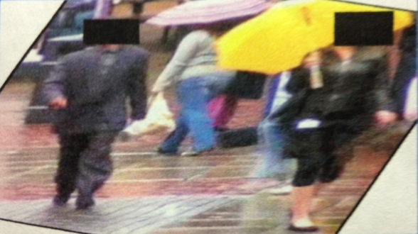
Factors to Consider #8
Interference from clothing??

Slide 49
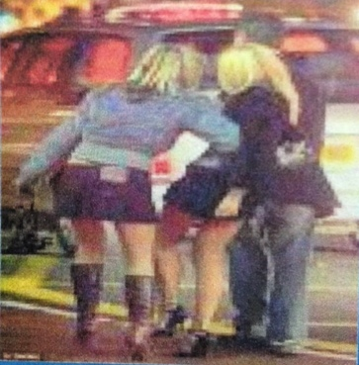
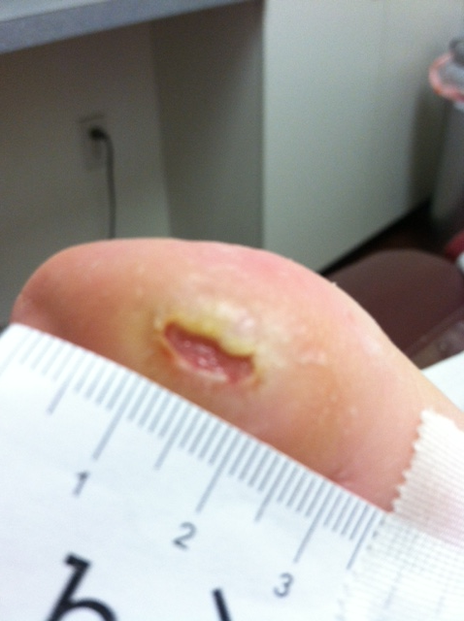
Factors to Consider #9
Variables affecting gait??

Slide 50
If all the variables have been accounted for and the comparative footage is adequate/acceptable
then the forensic expert can proceed with confidence.

Slide 51
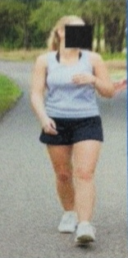
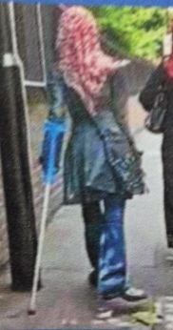
How characteristic are the features of gait.

Slide 52
Comparison
Same quality considerations of exemplar footage as those involved in assessment of the questioned footage.
Compare “like to like” in terms of gait speed approximation and angle of view.
Remember those collecting the footage know in advance..

Slide 53
Gait recognition is non invasive and people can be tracked at a distance without their knowledge.
As part of the larger picture, it has a major part in the crackdown against crime and also global terrorism.
http://www.Southampton.ac.uk/research/southamptonstories/medhealthlike/walk_this_way.

Slide 54
