Slide 1
ESSENTIALS OF FORENSIC PODIATRY
UNIT 5
Bryan Kagan©2017

Slide 2
Dynamic Gait Pattern Analysis
Forensic Gait Analysis
Evaluation of ACE-V
Practical Exercises and Discussion

Slide 78
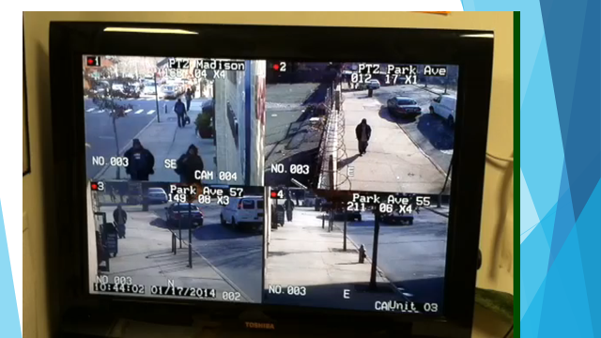

Slide 80
